Slide 1
4.05 Time Management

Slide 2
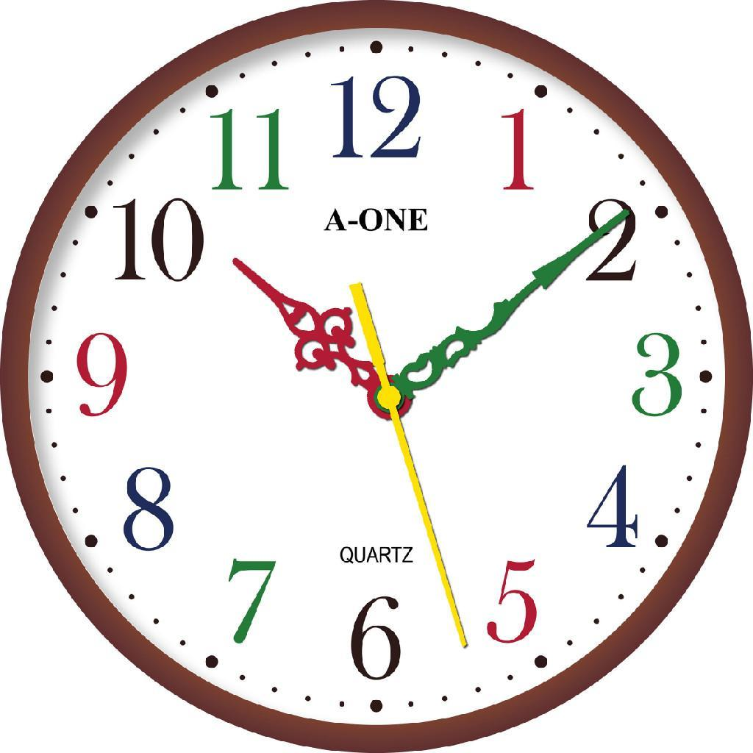
Time Management Skills
Time management is a STRATEGY to focus on making the most of the time you haveto help prevent or reduce stress.

Slide 3
Time Management Skills 6 Benefits
Puts the individual in charge

Slide 4
Time Management Skills 6 Benefits
Keeps things in perspective if events are overwhelming.

Slide 5
Time Management Skills 6 Benefits
Increases productivity

Slide 6
Time Management Skills 6 Benefits
Uses time more effectively

Slide 7
Time Management Skills 6 Benefits
Enjoy activities

Slide 8
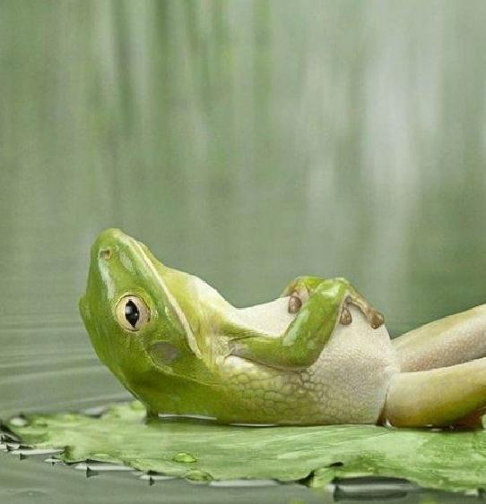
Time Management Skills 6 Benefits
Provides time to relax and enjoy life

Slide 9
Time Management Skills 6 Benefits
Why do you think most athletes make better grades in school when their sport is in season?

Slide 10
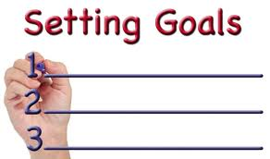
Setting Goals
Setting goals help you to know where you are going and will help you to get the results you want.

Slide 11
Setting Goals
**Write down goals to make them seem real and attainable.

Slide 12
Setting Goals
Short term goals: take days, weeks, or months to attain.
***(Ex.: a high school senior may have a goal to apply for different scholarships.)

Slide 13
Setting Goals
Long term goals: may take years or a lifetime to accomplish.
***(Ex.: to graduate from medical school.)

Slide 14
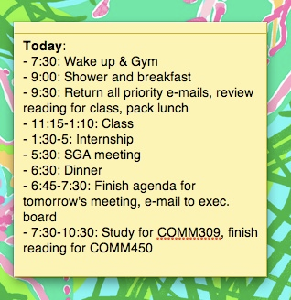
Time Management
**A time management summary lets you know how you’re using your time.
**It ensures success in meeting goals. It will enable you to complete more tasks in the same amount of time.

Slide 15
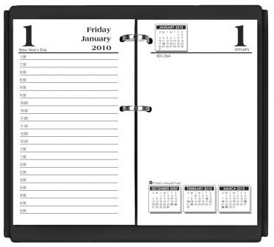
Time Management
A calendar and ***a daily planner are important time management tools.

Slide 16
Effective Time Management Plans
1. Analyze and prioritize: List goals and the tasks needed to achieve goals.

Slide 17
Effective Time Management Plans
2. Identify habits: Know when you have the most energy and when rest, exercise, or social activities are needed.

Slide 18
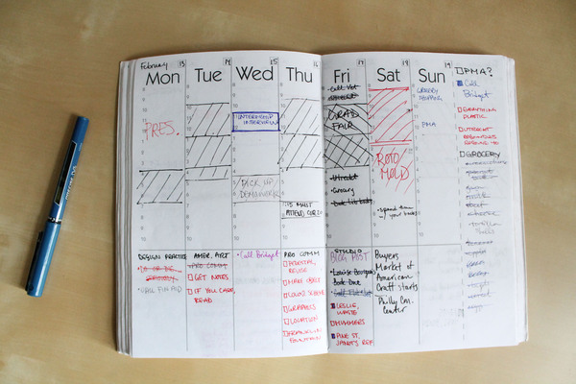
Effective Time Management Plans
3. Schedule tasks: ***Use the daily planner and calendar to write down all events including rest time, exercise, meals, hobbies. If two things are scheduled at the same time, prioritize and reschedule.

Slide 19
Effective Time Management Plans
4. ***Make a daily “to-do” list: list all tasks everyday and cross them out when they are accomplished.

Slide 20
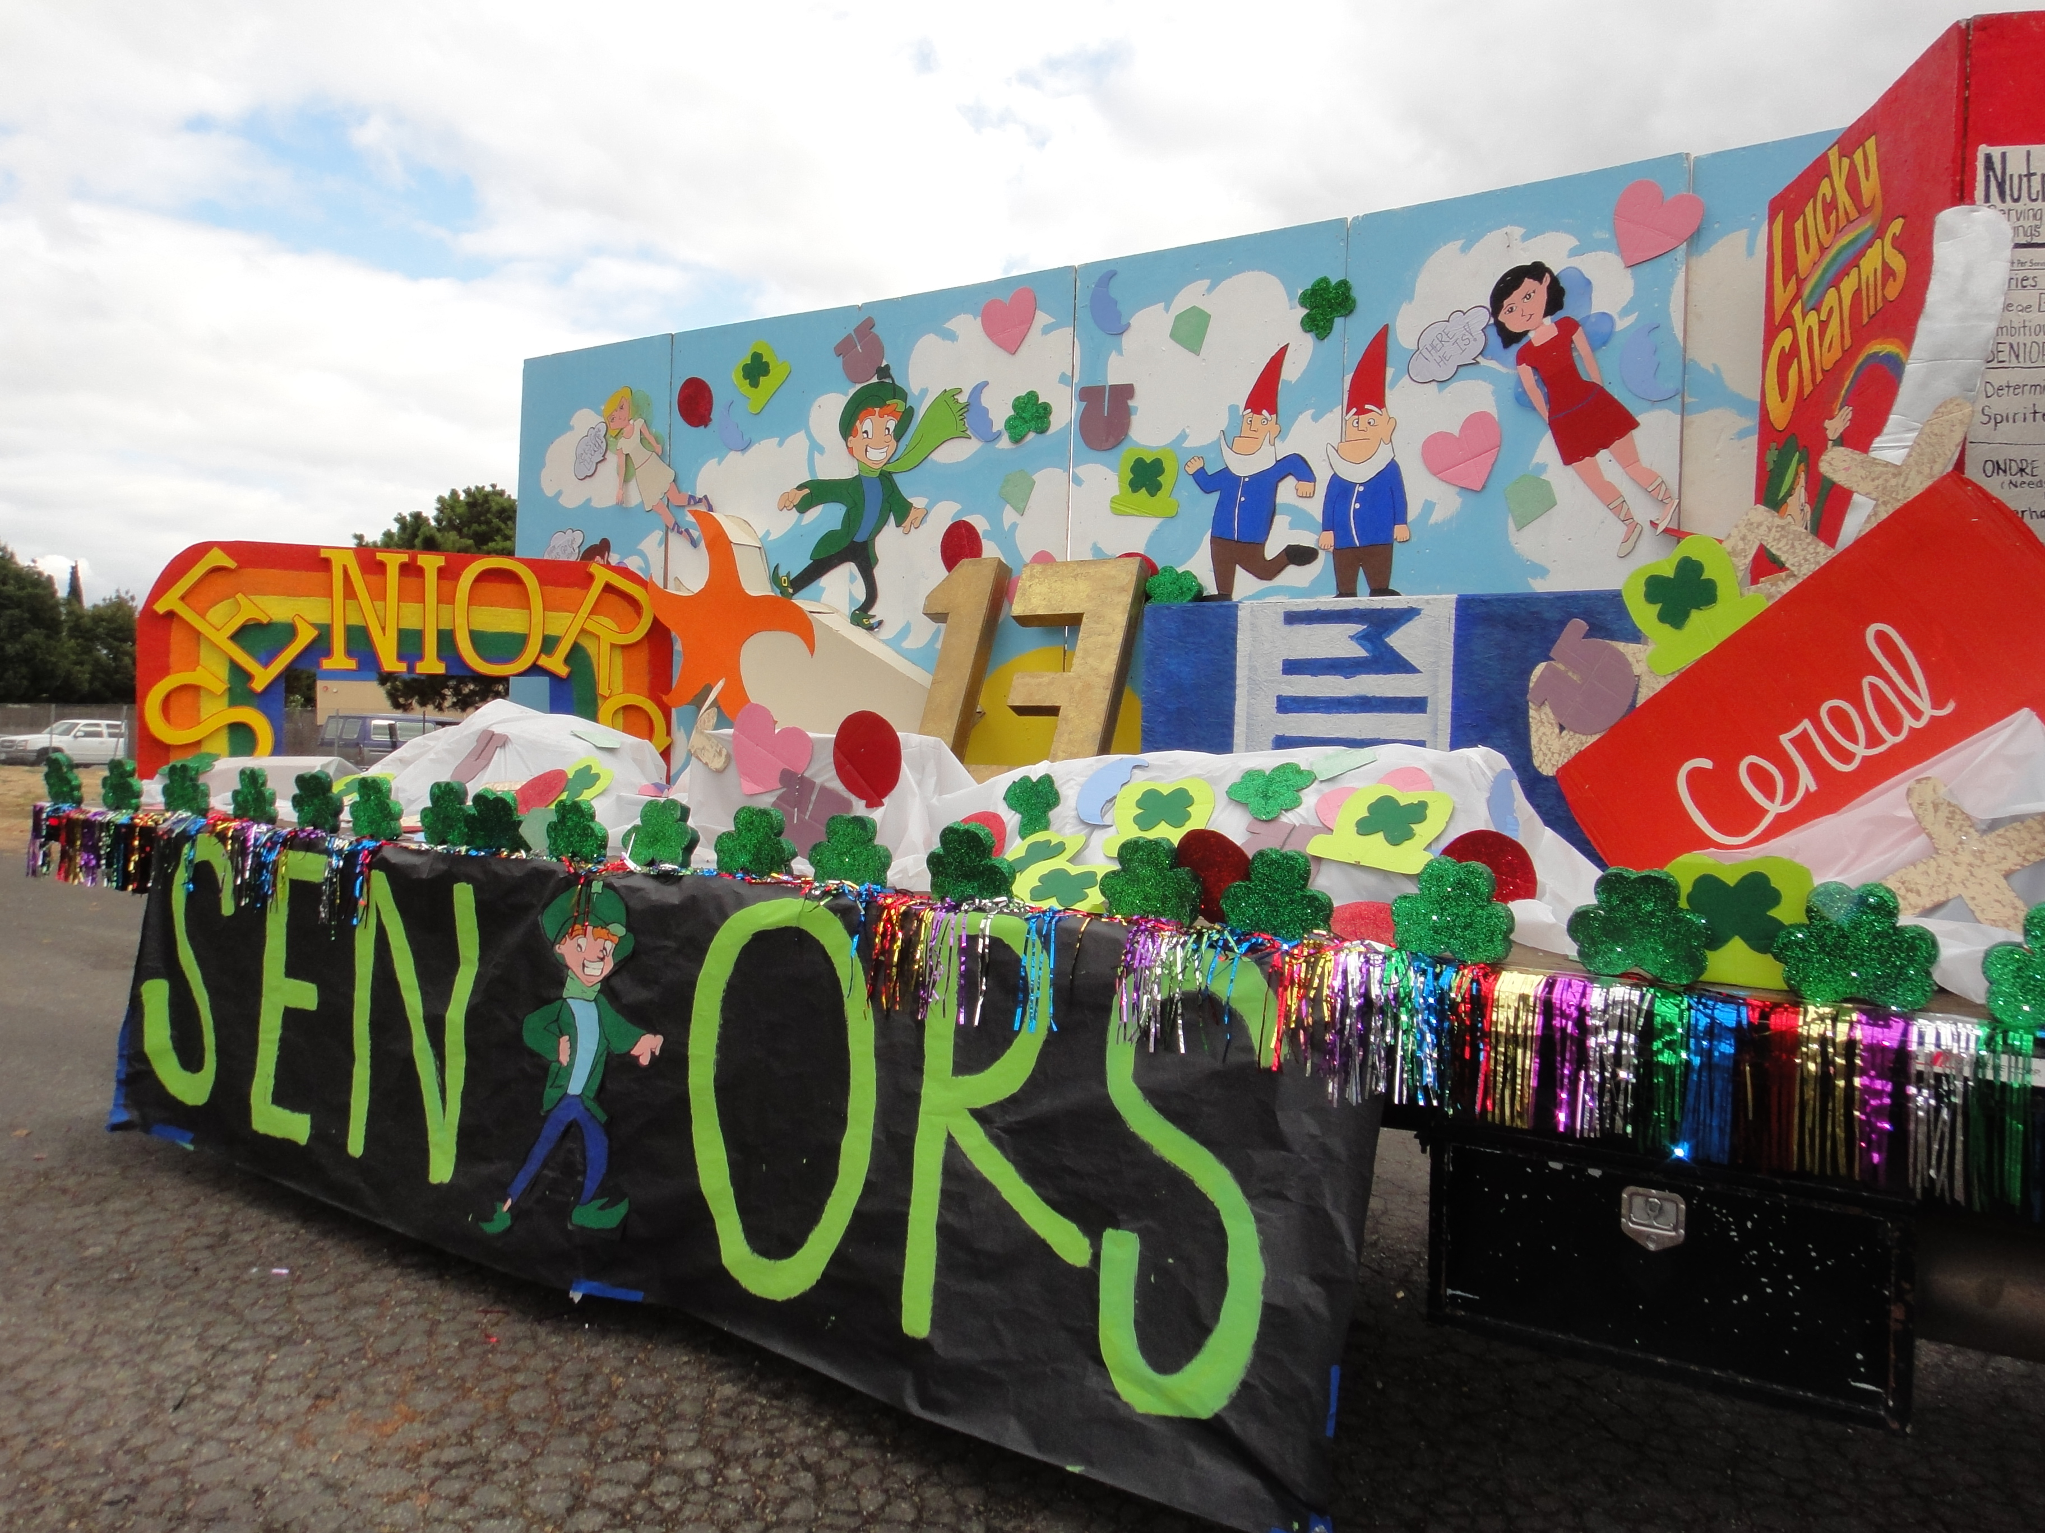
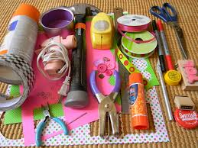
Effective Time Management Plans
5. ***Plan your work from start to finish: (Ex.: Making a HOSA float for the parade.) Have what you need to complete the task, do one thing at a time, ask for help if needed.

Slide 21
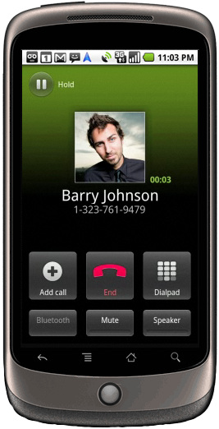
Effective Time Management Plans
6. Avoid distractions: screen phone calls, learn to say “no”, don’t procrastinate.

Slide 22
Effective Time Management Plans
7. **Take credit for a job well done: recognize achievements; if the job is a difficult one, reward yourself by taking a short break or another positive action.

Slide 23
THE
END!

