Slide 1
6.01 Legal and ethical responsibilities of the healthcare worker

Slide 2
Legal and ethical responsibilities
Certain laws and responsibilities protect us in every aspect of our life. (ex.: school rules, dress codes, traffic laws, etc.)

Slide 3
Legal and ethical responsibilities
Why?
Following legal responsibilities will protect you, your employer and the patient.
Legal responsibilities are based on law and they must be followed.
Federal, state and local governments enforce the laws.
Healthcare workers must follow any laws that affect healthcare and they must also know and follow state laws that regulate their license or registration.
(These are a set of standards for their profession to prevent a lawsuit.)

Slide 4
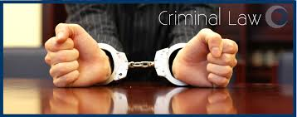
Legal and ethical responsibilities
Criminal Law (Crime): wrongs against a person, property or society. (Ex.: practicing a healthcare profession without a license, misuse of narcotics, theft, murder, etc.)

Slide 5
Legal and ethical responsibilities
Civil Law: relationships between people; protection of rights.

Slide 6
*Legal and ethical responsibilities
Tort: a wrongful act; a civil crime that does not involve a contract.

Slide 7
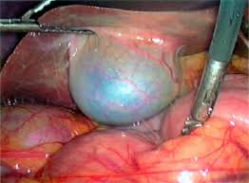
*Common Torts
Malpractice
:“bad practice”; “professional negligence”; the failure of a professional to use learned knowledge or skills and an injury occurs, or, there is loss or damage to the person receiving care.
(Ex.: a nurse performs surgery; the doctor accidentally cuts the patients bladder while removing the appendix.)

Slide 8
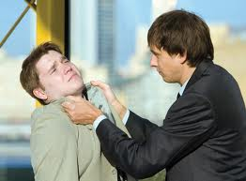
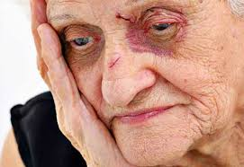
*Common Torts
Abuse: care that results in physical harm, pain or mental anguish.

Slide 9
*Common Torts
Healthcare providers must look for signs and symptoms of abuse: bruises, fractures, burns, poor personal hygiene, change in personality, irrational fears, aggressive, withdrawn, statements indicating abuse or neglect.
ANY abuse must be reported by the health care worker to the immediate supervisor.

Slide 10
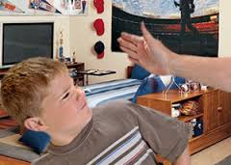
*Common Torts
: hitting, forcing against will, restraining movement, withholding food and/or water, not providing physical care.
Physical abuse
(Ex.: slapping a child because she keeps pulling on her I.V. dressing.)

Slide 11
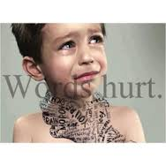
*Common Torts
Verbal abuse: speaking harshly, swearing, shouting, use of inappropriate words to describe race, writing threats or abusive statements.

Slide 12
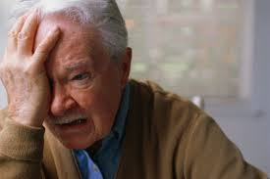
*Common Torts
Psychological abuse: threatening harm, denying rights, belittling, intimidating, ridiculing, threatening to reveal information about the patient.

Slide 13
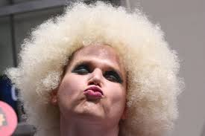
*Common Torts
Sexual abuse: any unwanted sexual touching or act; use of sexual gestures or suggesting sexual behavior.

Slide 14
*Common Torts
Defamation:
False statements or incorrect information that causes the person to be ridiculed or damages their reputation.
(Ex.: Assuming that someone in a car accident was drunk and they report that to the news media, but actually the accident was caused by a medical condition.)

Slide 15
*Common Torts
2 Types of Defamation:
“Slander”=
Spoken lies
“Libel”
=
Written lies
versus

Slide 16
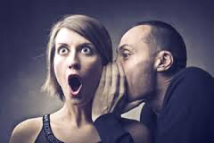
*Common Torts
Defamation:
Slander: Spoken, incorrect information; lies.
(Ex.: Telling your friends that your neighbor is having a wild party and actually her church youth group is at her house cooking for a homeless shelter.)

Slide 17
*Common Torts
Defamation:
Libel: Written, incorrect information; lies.
(Ex: A dentist writes a letter to a newspaper editor claiming that a patient is a big baby and never pays his bills.)

Slide 18
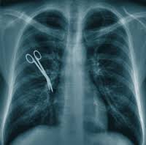
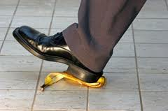
*Common Torts
Negligence:
Failure to give normally expected care which results in injury to a person. (Ex.: Patient falls out of the bed because the side rails were not put up)
Ex.: Improper use of a heat pack or hot water and the patient gets burned, leaving side rails down on bed, or leaving arm rests up on dental chair)

Slide 19
*Common Torts
Assault and Battery:
is the threat or attempt to injure.
Assault:
(Example of assault: threatening to hit a patient if the patient doesn’t cooperate.)

Slide 20
*Common Torts
Assault and Battery:
Battery: is the unlawful touching of a person without consent.
(Example of battery: A EMT forces an accident victim into the ambulance when the victim told the EMT that he didn’t need help and he didn’t want the EMT to touch him.)

Slide 21
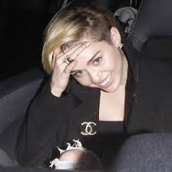
*Common Torts
Invasion of Privacy:
Unnecessarily exposing an individual; revealing personal information without consent.
(Ex.: Improperly uncovering a patient during a procedure and leaving the door open; taking a famous person’s picture (Miley Cyrus) and selling it to the newspaper without her consent.

Slide 22
*Common Torts Invasion of Privacy:
Ex.: Leaving a patient’s record open and a visitor sees that the patient has an STD.
STD

Slide 23
*Common Torts
False Imprisonment:
restraining an individual or restricting an individual’s freedom.
(Ex.: Keeping patients hospitalized against their will, or applying physical restraints without proper authorization.)
*Must have physician’s order for restraints

