Slide 1
6.02 Contracts and professional standards for healthcare worker

Slide 2
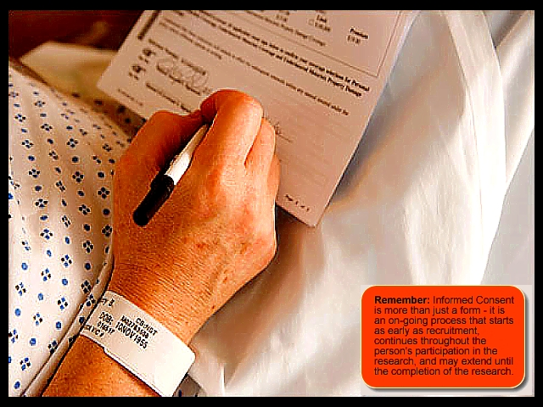
*Informed Consent
Informed consent: permission given voluntarily by a person of sound mind after all the risks involved have been explained. (The patient cannot give consent if semi-conscious, under the influence of medication, anesthesia, etc.); the patient has the right to withdraw consent.

Slide 3
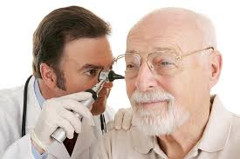
*Contract: an agreement between two or more parties.
Most contracts have 3 parts:
1.) Offer: A competent individual agrees to be a patient.
2.) Acceptance: The health care provider gives an appointment or examines/treats the patient.
3.) Consideration: The payment for services.

Slide 4
*Contract
2 Types of Contracts:
1.) Implied contract: obligations that are understood without verbally expressed terms. (Ex.: The healthcare worker prepares a medication and the patient takes it.)
2.) Expressed contract: stated in distinct,
clear language—orally or in writing. (Ex.: a surgical permit which explains all risks to the patient.)

Slide 5
*Contract:
Legal Disability: a person who does not have the legal capacity to enter into a legal agreement. mentally incompetent, under the influence of drugs/alcohol, semi-conscious/unconscious; ALL parties entering into a contract must be free of legal disability.)
(Ex.: minors,
(Ex.: A 12 year old cannot make an offer as part of a contract.)

Slide 6
*Contract:
Contract Law: Requires that certain standards of care are performed, and, if not performed according to the agreement,
a breach of the contract occurs.
(Ex.: Breach of contract—failure to pay a doctor’s bill.)

Slide 7
*Contract:
Parts of Contract Law:
The Agent: The employee.
(Ex.: The nurse in the medical office.)

Slide 8
*Contract:
Parts of Contract Law:
The Principal: The employer.
(Ex.: The doctor, the dentist.)
Healthcare workers protect the interests of employers by abiding to contract law.

Slide 9
*Health care records (privileged Communications)
Health care records: Contains confidential information about patient care.
The patient also has a right to the health care record.
Healthcare agencies and workers that provide care to the patient are entitled to review the records.
( Ex: Doctor, dentist, nurse, hospital agency)

Slide 10
*principles to follow with health care records
DO NOT ERASE MISTAKES on the medical record!
write the correct information, initial it and date it.
To correct an error- cross out errors with a single line,
Patient ate half of her apple for breakfast.
Ex.: orange K.H. 4/15/14
Patient ate half of her apple for breakfast.
DO NOT ERASE!

Slide 11
*principles to follow with health care records
STORE RECORDS in a locked/secured area for the amount of time that state law requires; limit access to computerized records.

Slide 12
*principles to follow with health care records
DESTROY RECORDS by shredding or burning them.
Shred
OR
BURN

Slide 13
*principles to follow with health care records
HIPAA (Health Insurance Portability and Accountability Act): Passed by the federal government in 1996 and established standards to protect health information and maintain confidentiality.

Slide 14
*principles to follow with health care records
HIPAA Standards:
Patients may see and obtain copies of their health records.
Patients may know how the health care provider uses their medical information.
Limits are set on how patient information is used.
Communication is kept confidential.
Patient is provided information on how to file a complaint if privacy act is violated.
Principles vary from state to state. Healthcare workers must learn the standards and know what is legally permitted so they are familiar with their responsibilities. The healthcare worker is liable for their actions.
Patients have the right to say who has access to their medical information, including family members.

Slide 15
Professional standards
1. Perform only those procedures for which you have been trained and are legally permitted to do.

Slide 16
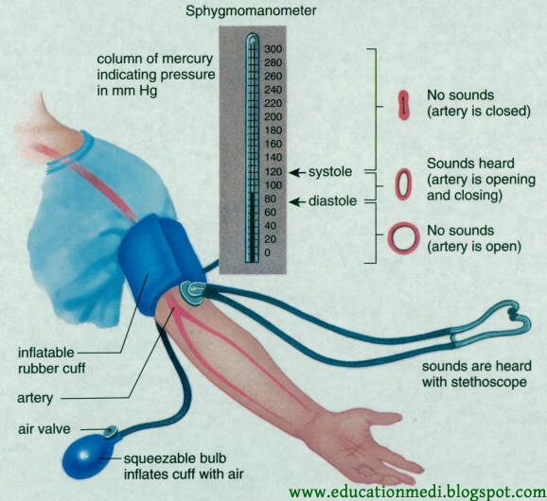
Professional standards
2. Use approved, correct methods while performing any procedure.

Slide 17
Professional standards
3. Obtain proper authorization before performing any procedure.

Slide 18
Professional standards
4. *Identify the patient and obtain the patient’s consent before performing any procedure.
(If the patient refuses for you to perform a procedure, you should notify your immediate supervisor.)
The correct way to identify the patient is to check the identification band and state the patient’s name correctly.

Slide 19
Professional standards
5. *Observe all safety precautions.

Slide 20
Professional standards
6. *Keep ALL information confidential. (Don’t place records in an areal where they can be see, don’t reveal information without the patient’s consent., make sure that conversations can’t be heard by others when reporting, don’t talk about patient’s at home or in any place outside of the agency, DON’T gossip about patients.

Slide 21
Professional standards
7. Think before you speak and carefully consider every thing you say.

Slide 22
Professional standards
8. Treat all patient’s equally regardless of race, religion, social or economic status, sex, or nationality.

Slide 23
Professional standards
9. Accept no tips or bribes for the care you provide.

Slide 24
Professional standards
10. Behave professionally in dress, language, manners and actions.

Slide 25
Professional standards
11. *If any error occurs or you make a mistake, report it immediately to your supervisor.

