Slide 1
6.03 Ethics, Patient Rights, and Advance Directives for Healthcare

Slide 2
Ethics:
Set of principles relating to what is morally right and wrong; provides a standard of conduct, a code of behavior.
Ethics enable the health care worker to make decisions based on what people believe is right and good conduct.

Slide 3
Ethical code guidelines
Principles of Right or Wrong
In order to deal with ethical dilemmas, employees of medical facilities must follow organizational and professional codes, policies and protocols.

Slide 4
Ethical code guidelines
1. Ethical code should be learned for the chosen occupation---this will earn respect and confidence of patients, co-workers and employers.

Slide 5
Ethical code guidelines
2. Make every effort to keep the patient as comfortable as possible and to preserve life whenever possible.

Slide 6
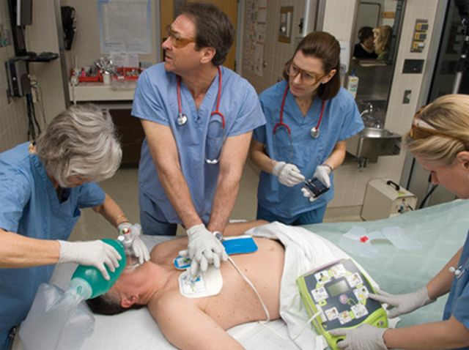
Ethical code guidelines
3. Put the saving of life and the promotion of health above all else.

Slide 7
Ethical code guidelines
4. Respect the patient’s choice to die peacefully and with dignity when all options have been discussed with the patient and family or when options have been pre-determined by advanced directives.

Slide 8
Ethical code guidelines
5. Treat all patient’s equally, regardless of race, religion, social or economic status, sex or nationality. Prejudice or discrimination does not have a place in health care.
6. Provide care for all individuals
to the best of your ability.

Slide 9
Ethical code guidelines
7. Maintain a competent level of skill consistent with your particular occupation.
8. Stay informed and up to date and pursue continuing education as necessary.

Slide 10
Ethical code guidelines
9. Maintain CONFIDENTIALITY! Confidentiality means that information about the patient must remain private and can be shared only with other members of the patient’s health care team.
Gossiping about a patient is ethically wrong!

Slide 11
Ethical code guidelines
10. Refrain from immoral, unethical and illegal practices. If you observe others taking part in illegal actions, they should be reported to proper authorities.

Slide 12
Ethical code guidelines
11. Show loyalty to patient’s, co-workers and employers. Avoid negative statements and always express a positive attitude.
12. Be sincere, honest and caring. Treat others as you would want to be treated.

Slide 13
ethical DILEMMAS
Principles of Right or Wrong
Is euthanasia justified?

Slide 14
ethical DILEMMAS
Principles of Right or Wrong
Should the patient be told that the health care provider
has AIDS?

Slide 15
ethical DILEMMAS
Principles of Right or Wrong
Should aborted fetuses be used for research?

Slide 16
ethical DILEMMAS
Principles of Right or Wrong
When should life support be discontinued?

Slide 17
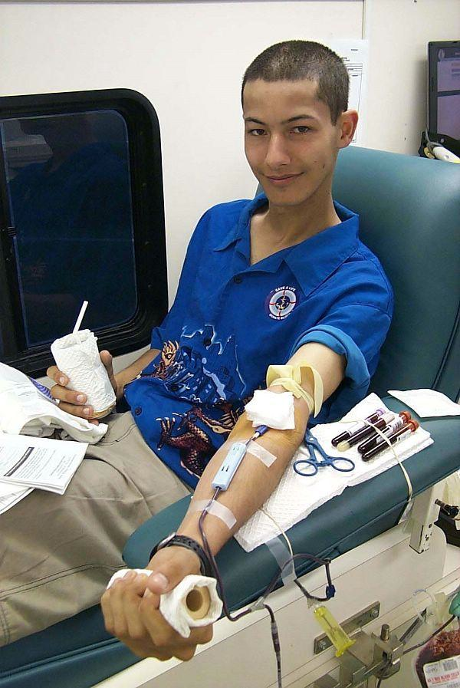
ethical DILEMMAS
Principles of Right or Wrong
Should parents be able to refuse a life-saving blood transfusion for their child due to religious beliefs?

Slide 18
ethical DILEMMAS
Principles of Right or Wrong
Can a healthcare facility refuse expensive treatment if the patient can’t afford it?

Slide 19
ethical DILEMMAS
Principles of Right or Wrong
Who should decide if a 75 year old or a 56 year old gets the kidney transplant?

Slide 20
ethical DILEMMAS
Principles of Right or Wrong
Should organs be sold for transplant?

Slide 21
ethical DILEMMAS
Principles of Right or Wrong
Should marijuana be used as a prescription medication?

Slide 22
ethical DILEMMAS
Principles of Right or Wrong
Should animals be used in research even if it results in the death of the animal?

Slide 23
ethical DILEMMAS
Principles of Right or Wrong
Should genes be transplanted to create the “perfect human”?

Slide 24
ethical DILEMMAS
Principles of Right or Wrong
Should cloning be allowed?

Slide 25
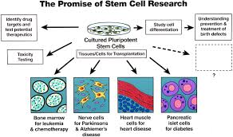
ethical DILEMMAS
Principles of Right or Wrong
Should aborted fetuses be used for stem cell research when scientists can use the stem cells to cure diabetes, osteoporosis, Parkinson’s?

Slide 26
Patient RIGHTS
Federal and state regulations require health care facilities to have written policies for insurance of patient rights.
Right to considerate and respectful care.
Right to obtain information about condition, diagnosis, and treatment.
Right to receive information to make informed consent.

Slide 27
Patient RIGHTS
4. Right to have advance directives or refuse care.
Right to privacy.
Right to confidentiality.

Slide 28
Patient RIGHTS
7. Right to a reasonable response to requests for service.
Ex: Pain medication administered within
reasonable time.
8. Right to refuse participate
in research.
9. Right to continuity of care.

Slide 29
Patient RIGHTS
Right to review medical records and bill.
11. Right to be informed of hospital rules.

Slide 30
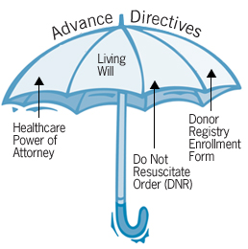
Advance directives
Advance directives: Legal documents that allow individuals to state medical treatment they Do or DO NOT want if they are incapacitated and unable to express their wishes regarding medical care.

Slide 31
Advance directives
*Living Will: Document that allows the individual to state what measures are desired (or not desired) to prolong life when the condition is terminal. This document frequently results in a DNR (do not resuscitate), let die with peace and dignity.

Slide 32
Advance directives
Durable Power of Attorney (POA): Document that permits the individual to appoint another person to make any decisions regarding health care if the principal becomes unable to make decisions for themselves; Ex: A daughter or son.
POA may hire or fire healthcare providers, spend or withhold healthcare funds, have access to medical records; the POA may be any qualified adult.

Slide 33
Advance directives
Patient Self Determination Act of 1990 (PSDA) requires, by federal law, all health care facilities that receive federal aide must:
1. Inform any adult of rights concerning medical care (including the right to refuse and the right-to-die).

Slide 34
Patient Self Determination Act of 1990 (PSDA)
2. Facility/hospital must provide information and assistance in preparing advance directives.

Slide 35
Patient Self Determination Act of 1990 (PSDA)
3. Document advanced directives on the medical record.

Slide 36
Patient Self Determination Act of 1990 (PSDA)
4. Have written statements to implement patient rights.

Slide 37
Patient Self Determination Act of 1990 (PSDA)
5. Affirm there is no discrimination due to advance directives.

Slide 38
Patient Self Determination Act of 1990 (PSDA)
6. Mandatory education and training the staff on medical and legal issues of advance directives.

Slide 39
The end!

