Slide 1
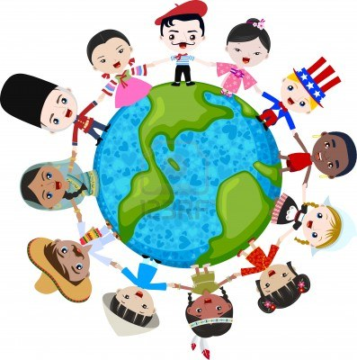
Cultural Diversity
Healthcare providers work with and provide care to many different people. Cultural/ethnic background is a major influence in an individual’s uniqueness.
Every healthcare worker must respect each person and what makes him or her unique.

Slide 2
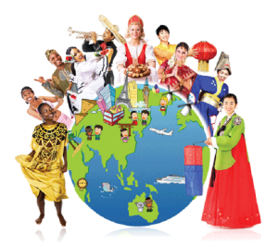
Cultural Diversity
*Cultural diversity is: the differences in values, beliefs, attitudes, customs among people.
Healthcare workers must show respect to a patient’s cultural beliefs and try to learn about cultural differences.

Slide 3
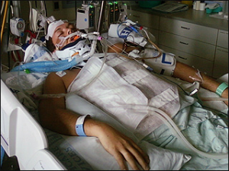
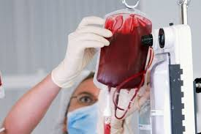
Cultural Diversity
Cultural beliefs/practices: Patients have the right to determine treatment and refuse treatment.

Slide 4
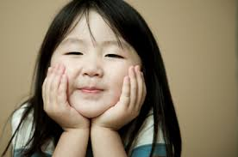
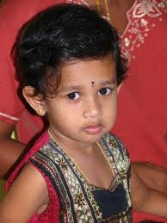
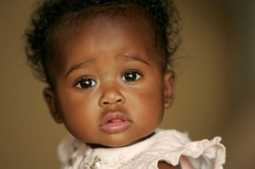
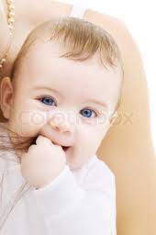
Cultural Diversity
What influences each person’s uniqueness?
Physical characteristics: Gender, body size, hair color, nail color, skin color.

Slide 5
Cultural Diversity
What influences each person’s uniqueness?
Family life

Slide 6
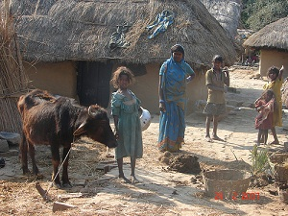
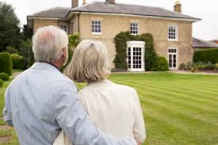
Cultural Diversity
What influences each person’s uniqueness?
Socio-economic status

Slide 7
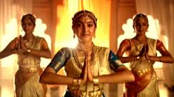
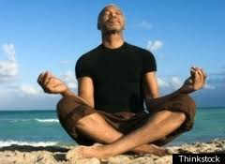
Cultural Diversity
What influences each person’s uniqueness?
Religious beliefs

Slide 8
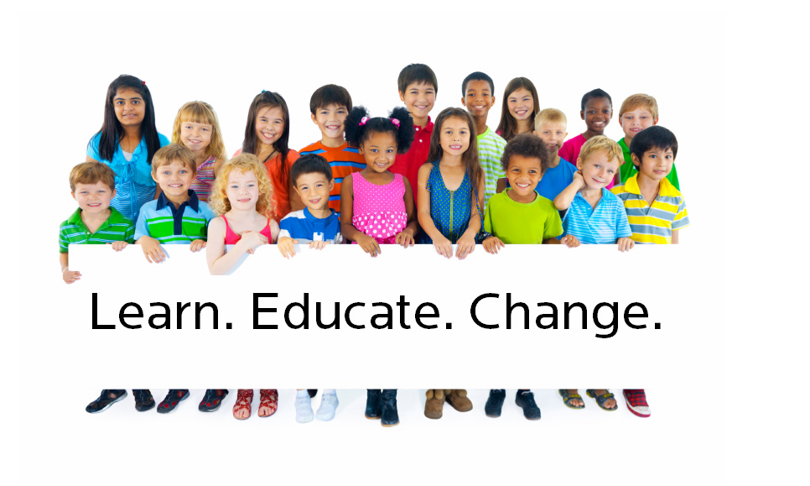
Cultural Diversity
What influences each person’s uniqueness?
Education

Slide 9
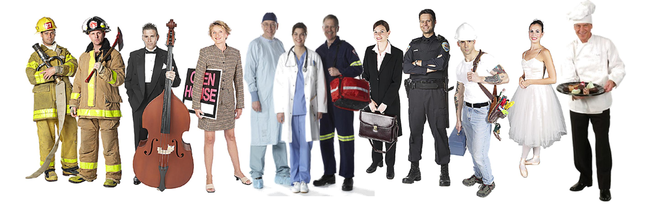
Cultural Diversity
What influences each person’s uniqueness?
Occupation

Slide 10
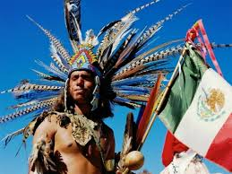
Culture
*Culture is: a set of values, beliefs, attitudes, language, symbols, rituals, behaviors and customs unique to a group of people and passed from one generation to the next.

Slide 11
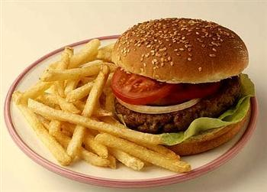
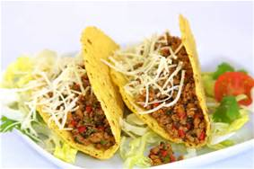
Culture
Four basic characteristics of culture
1. *Culture is: learned & taught.
*(Ex.: Behaviors, accepted attitudes, culture influences a person’s food preferences such as “American Food= Hamburger & french fries, Hispanic Food=Tacos & enchiladas, Asian Food Rice & fish”.)

Slide 12
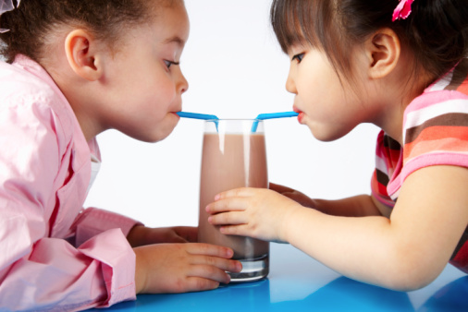
Culture
Four basic characteristics of culture
2. Culture is: shared.

Slide 13
Culture
Four basic characteristics of culture
3. Culture is: social.

Slide 14
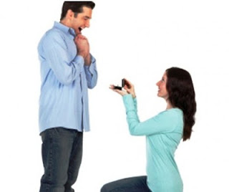
Culture
Four basic characteristics of culture
4. Culture is: dynamic and is constantly changing.

Slide 15
Ethnicity
*Ethnicity is: the classification of people based on their national origin.
Common ethnic groups: African American, Asian
American, European American, Hispanic American,
Middle Eastern/Arab American, Native American

Slide 16
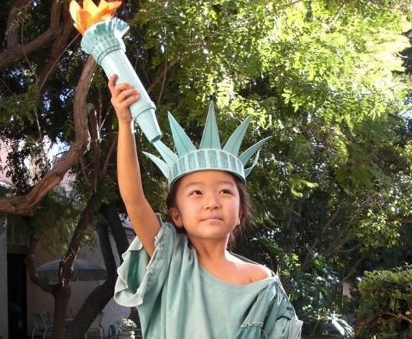
Ethnicity
Example of Ethnicity:
*An Asian/Korean couple has a baby in the U.S. and they raise the child in the U.S. What is the baby’s ethnic group? (Asian American)

Slide 17
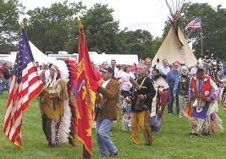
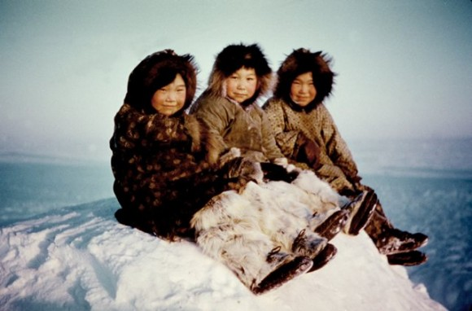
Ethnicity
Within each of the ethnic groups there are numerous subgroups.
For example, the Native American group includes: over 500 tribes of American Indians and Eskimos. They have different lifestyles and may even speak different languages.

Slide 18
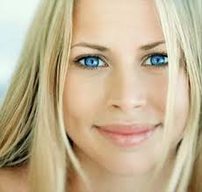
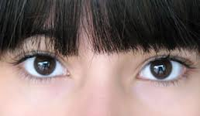
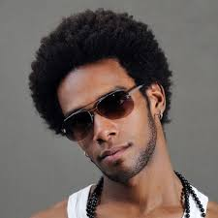
Race
*Race is: based on physical or biological characteristics: the color of their skin, hair, eyes, facial features, blood type, bone structure.

Slide 19
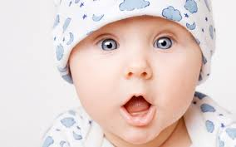
Examples of Race
*A white couple has a baby in Japan and raises the baby in the U.S. What is the baby’s race? (WHITE)
*A baby girl is born in South Africa to white parents and raised in the U.S. What is her race?(WHITE)

Slide 20
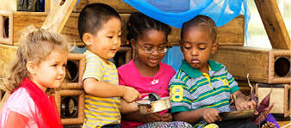
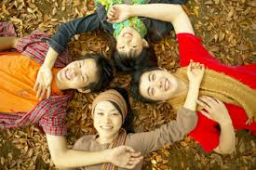
Cultural Diversity
Cultural Diversity-differences among individuals based on cultural, ethnic, and racial factors.

Slide 21
Cultural Assimilation
*Cultural assimilation requires: that newly arrived cultural groups alter beliefs and behaviors and adopt the ways of the dominant culture.
(Ex.: Mr. Hun feels that if people move to his country, they should know how to speak the language.)
Speak the language!

Slide 22
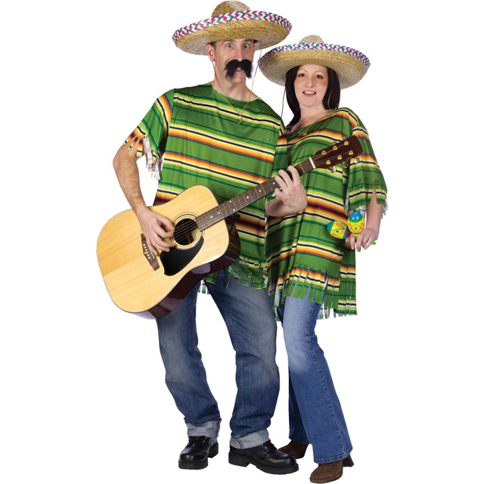
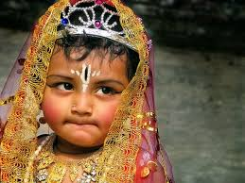
Acculturation
*Acculturation is: the process of learning the behaviors/beliefs of a dominant culture and assuming some of the characteristics.
(Ex.: Sally moves to Asia and begins to dress and talk like the “new” culture.)

Slide 23
Cultural Sensitivity
*Cultural sensitivity is: the ability to recognize and respect personal characteristics of others.

Slide 24
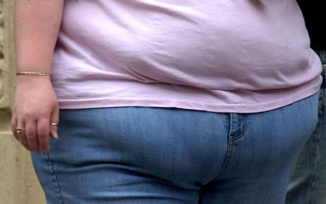
Cultural Behaviors
*Bias is: a preference that prevents impartial judgment.
(Ex.: The manager refused to hire Lindy because she was obese; believing that younger people are physically and/or mentally superior to older ones; women are inferior to men?)

Slide 25
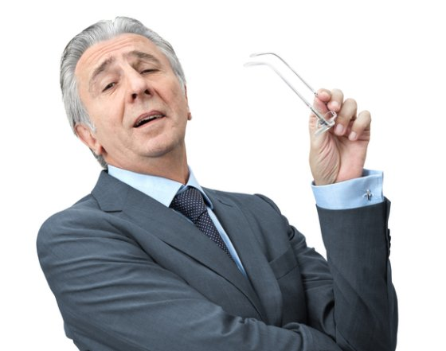
Cultural Behaviors
*Ethnocentric is when: individuals believe their cultural values are better.
(Ex.: Believing that being an American or Greek is better than any other nationality.)

Slide 26
Cultural Behaviors
*Prejudice is: to “prejudge”; a strong feeling about a person or subject that is formed without reviewing facts or information.
(Ex.: Refusing to take care of a patient because you learn that they are homosexual.)
NO!

Slide 27
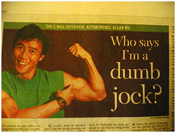
Cultural Behaviors
*Stereotyping is: assuming that everyone in a particular group is the same; to “label” an individual.
(Ex.: “All football players are dumb jocks”, “All blondes are dumb”, “All obese people are lazy”, etc.)

Slide 28
Cultural Behaviors
Bias, prejudice and stereotyping are barriers to effective relationships. Health care providers must make every effort to try to avoid these barriers by:
Be aware of personal and professional values and beliefs.
Obtain information about ethnic/cultural groups.
Be sensitive to behaviors different from your own.
Develop friendships with a wide variety of people.

Slide 29
Cultural Behaviors
Ask questions and encourage questions from other/share ideas and beliefs.
Evaluate all information before forming an opinion.
Be open to differences.
Avoid jokes that may offend.
Always show respect; apologize if you hurt others.

Slide 30
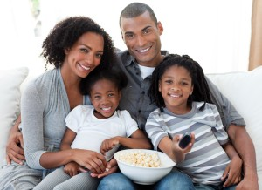
Family Organization
Family organization is the family structure and refers to the decision maker of the family.
*Two main types of family structure:
*Nuclear Family is: mother, father and children or parent and children.
(This is the basic unit in the: European and German American families.)

Slide 31
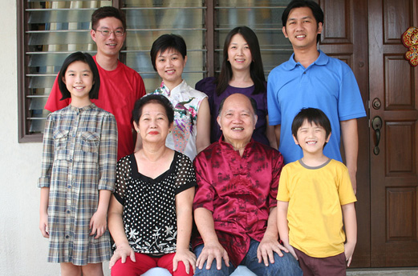
Family Organization
2. *Extended Family is: the nuclear family plus grandparents, aunts, uncles and cousins. (Asians, Hispanics, and some Native Americans live this way.)

Slide 32
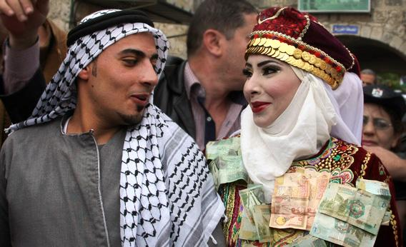
Family Organization
*Patriarchal is: the father or the oldest male is the authority figure in the family.
(Ex.: Some Asian/Middle Eastern husbands will make all the health care decisions for their wife.)

Slide 33
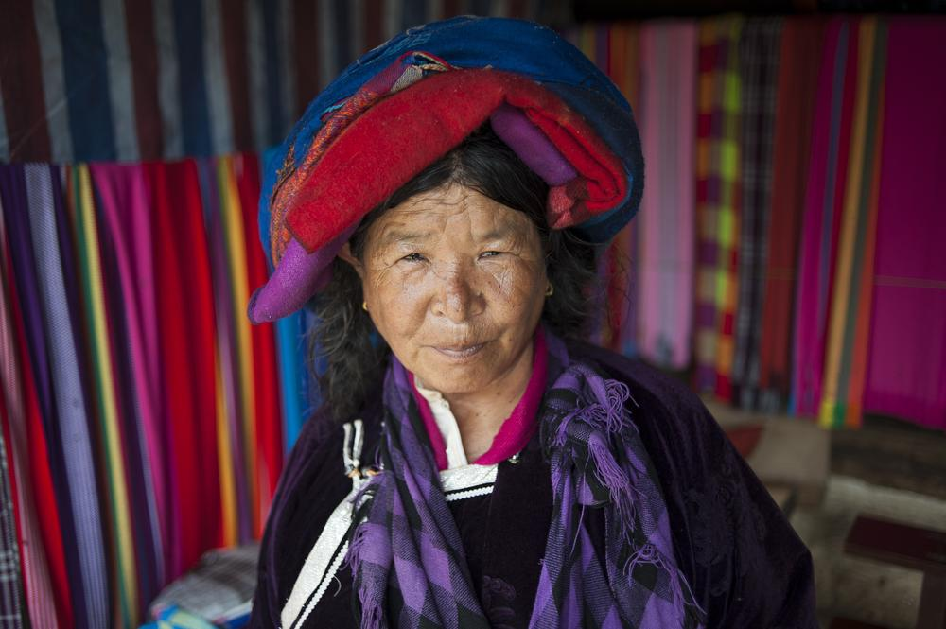
Family Organization
Matriarchal-the mother or the oldest daughter is the authority figure in the family.
The healthcare worker should ask the patient questions in order to determine family structure and preferences.

Slide 34
Language
Language-English is the dominant language in the U.S.; 20% of the population under the age of 65 speak another language when at home. The healthcare worker must determine the ability to communicate with the patient or relatives by asking questions. Whenever possible, the healthcare worker should try to find a translator.

Slide 35
Language
When providing care to people who have limited English-speaking abilities the following techniques should be used:
Speak slowly
Use gestures or pictures
Use non-verbal communication (smile, touch)
Don’t shout
Learn some phrases/words in the patients language to try to communicate.

Slide 36
Family Organization
Medical permits that require the patient’s signature needs to be in the patient’s language.

Slide 37
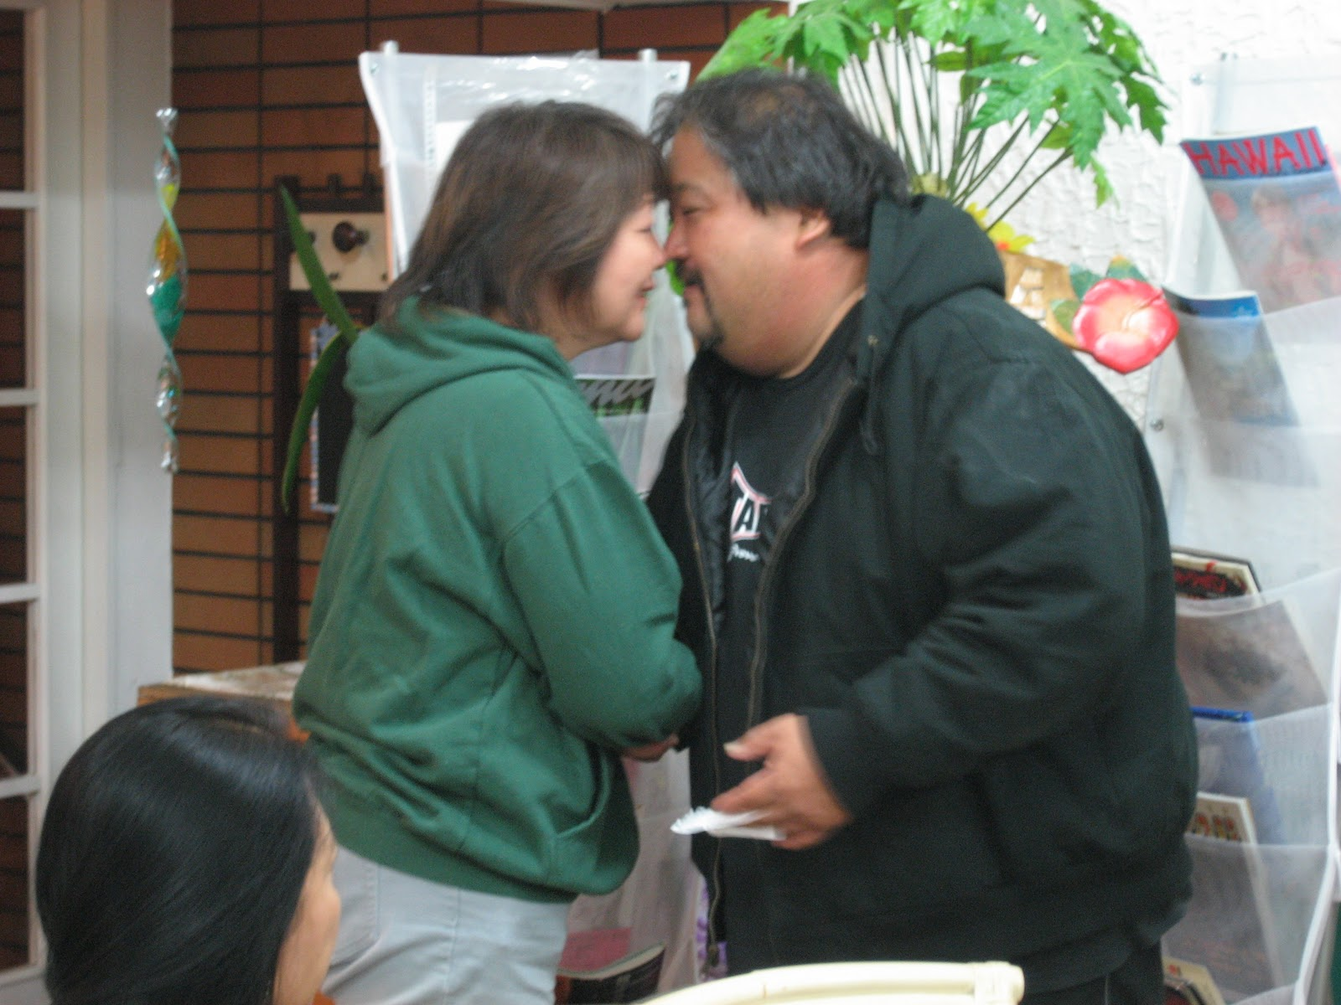
Personal Space and Touch
Territorial Space-the distance people need to feel comfortable.
*Close contact cultures: feel comfortable standing very close or even touching the person they are interacting with.
Hispanic Americans: are a close contact culture, they use hugs to greet & thank others.

Slide 38
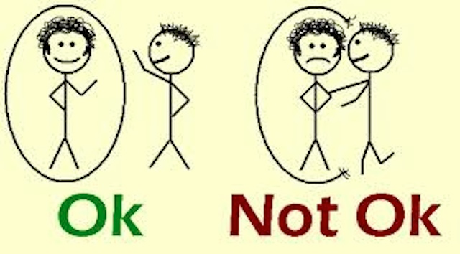
Personal Space and Touch
Distant contact cultures-less personal space is needed to feel comfortable.

Slide 39
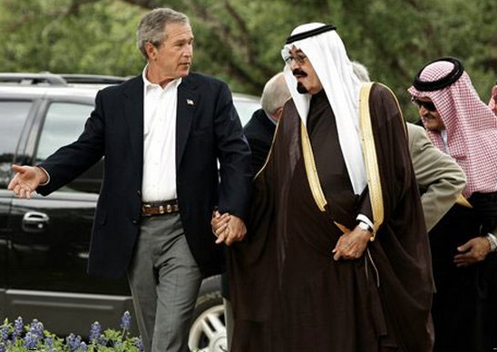
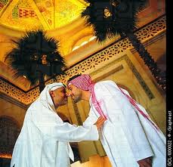
Personal Space and Touch
Examples of needs regarding personal space:
Arabs-touch, feel and smell people.

Slide 40
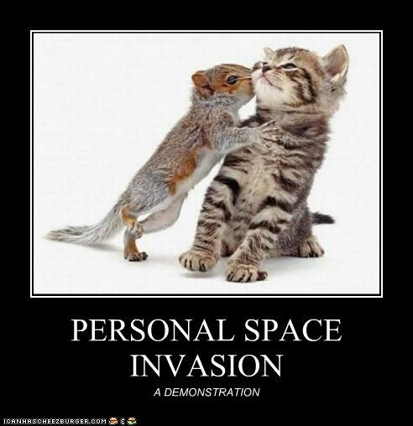
Personal Space and Touch
Examples of needs regarding personal space:
French and Latin Americans-Stand very close while talking.

Slide 41
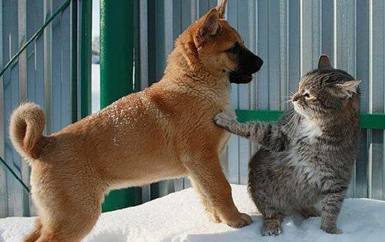
Personal Space and Touch
Examples of needs regarding personal space:
European and African Americans-prefer some space (2-6ft.); shake hands to greet.

Slide 42
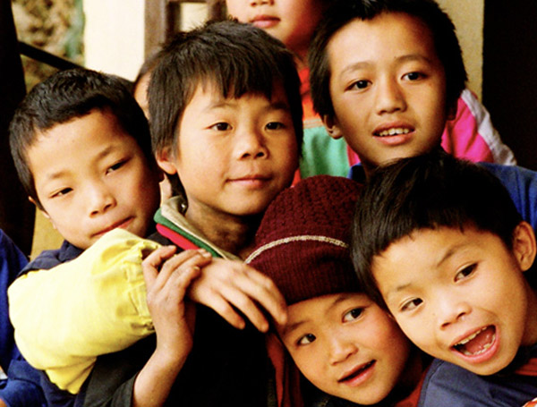
Personal Space and Touch
Examples of needs regarding personal space:
Asian Americans-Stand close but don’t touch, kissing/hugging is for intimate relationships and never in public view.

Slide 43
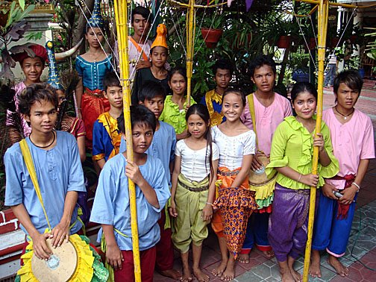
Personal Space and Touch
Examples of needs regarding personal space:
Cambodians- never touch the opposite sex in public—not even brothers and sisters; only a parent can touch the head of a child.

Slide 44
Personal Space and Touch
Examples of needs regarding personal space:
*Middle Eastern: men may not touch female’s who are not immediate family members. A Middle Eastern woman may refuse to have a male nurse; men only shake hands with men.
NO!

Slide 45
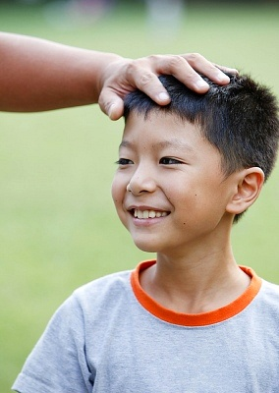
Personal Space and Touch
Examples of needs regarding personal space:
Vietnamese- only the elderly can touch a child’s head—the head is considered sacred.

Slide 46
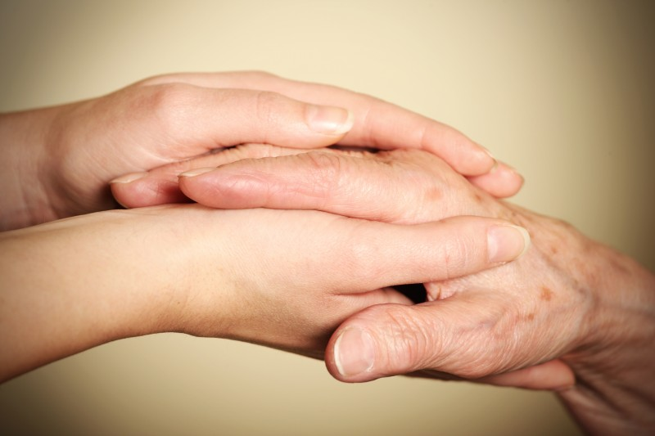
Personal Space and Touch
Examples of needs regarding personal space:
Native American-personal space is important; they lightly touch others hand during greeting.

Slide 47
Personal Space and Touch
Never make assumptions about an individual’s personal space and touch preferences—ask the individual questions about their preferences.

Slide 48
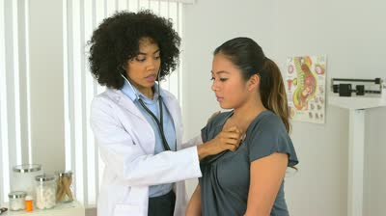
Personal Space and Touch
Healthcare providers have to use touch/invade personal space to give many types of care (measuring blood pressure, listening to respirations, etc.). A slow, relaxed approach, explanation of procedures, encouraging the patient to relax, will decrease fears and eliminate panic.

Slide 49
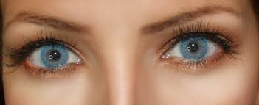
Personal Space and Touch
Eye contact-many different beliefs about eye contact can lead to misunderstandings; health care workers must be alert to the comfort levels of patients while using direct eye contact.

Slide 50
Personal Space and Touch
Gestures communicate many things; nodding the head “yes” or “no” in the U.S. means the complete opposite in India; pointing at someone is a strong threat to Asians and Native Americans; the hand gesture “O.K.” is an insult to Asians.

Slide 51
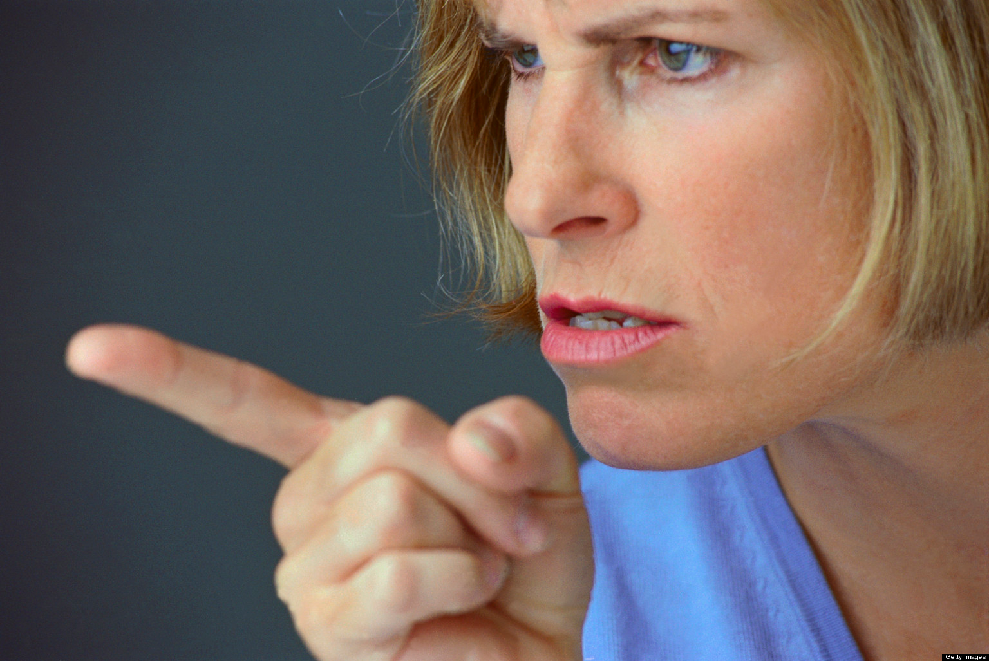
Personal Space and Touch
* Patients from Japan: The healthcare worker should not point with their finger or use direct eye contact. It is disrespectful.

Slide 52
Healthcare Beliefs
*Different cultures have different beliefs about health care, however: health care workers must remember that not all people within that culture follow all the customs of that culture.

Slide 53
Healthcare Beliefs
In the U.S. the biomedical healthcare system is the “Western” system which bases the cause of disease on microorganisms, diseased cells and the aging process.

Slide 54
Healthcare Beliefs
*“U.S./Western System Beliefs”:
Encourage patients to learn about their illness.
Inform patients about terminal diseases.
Teach patients self-care.
*Use medications and technology to cure or decrease the effects of disease.
Teach preventative care.

Slide 55
Healthcare Beliefs
Alternative healthcare therapies are: increasing in the U.S. More Americans are going to the chiropractor, homeopaths, naturopaths, hypnotists.

Slide 56
Healthcare Beliefs
*Hispanic, Asian, Middle Eastern cultures believe: that illness has a spiritual connection, They believe that health is a reward from God; health is a spiritual harmony.

Slide 57
Healthcare Beliefs
All individuals have the right to choose the method of treatment they feel is best. The health care worker should talk to the patient to determine their health care preferences.
(Ex.: A native American patient: may not accept pain medication based on his belief in the tolerance of pain. Healthcare workers must respect his wishes.)

Slide 58
Spirituality & Religion
Spirituality and religion are essential parts of every cultural group.
*Spirituality is: the beliefs that people have about the purpose of life, their belief in a higher power and their need to find meaning and purpose in life.

Slide 59
Healthcare Beliefs
*Spirituality is: often expressed through religious practices and provides a source of support and strength to deal with situations.
However, *spirituality does not: necessarily include the attendance of church.

Slide 60
Healthcare Beliefs
Spirituality and religion are not the same. Spirituality is an individualized, personal set of beliefs that changes throughout an individual’s life.

Slide 61
Healthcare Beliefs
Religion-an organized system of beliefs in a higher power and associated with a particular form or place of worship.

Slide 62
Healthcare Beliefs
Common religious beliefs: Baptist, Buddhism, Christian Scientist, Episcopal, Hindu, Islam, Jehovah’s Witness, Judaism, Lutheran, Methodist, Mormon, Catholic, Orthodox, 7th Day Adventist.
*In support of ANY spiritual beliefs: the health care worker should allow for privacy during clergy visits.

Slide 63
Healthcare Beliefs
*Atheist is: non-believer; does not believe in any deity/God or religion.

Slide 64
Healthcare Beliefs
*Agnostics: believe that the existence of God cannot be proved or disproved; doesn’t have any religious practices.

Slide 65
Healthcare Beliefs
*In order to fulfill spiritual and religious needs: the health care worker must ask the patient questions and determine their personal beliefs.
*Ex.: Joe’s new patient tells him that he is Hindu. Joe should ask him if there is anything he should know about his spiritual needs in order to provide him the best of care.

Slide 66
Healthcare Beliefs
The health care worker must allow patients to express their beliefs, practice rituals, or follow a special diet as long as it will not cause any harm.

Slide 67
Respect Cultural Diversity
*In the United States today: cultural differences are more appreciated and respected than in the past.

Slide 68
Respect Cultural Diversity
In the United States today, the healthcare worker appreciates & respects cultural differences by:
Being a willing listener.
Supporting spiritual and religious practices.
Respecting symbols and books.
Providing privacy during clergy visits.
Refraining from imposing their beliefs on the patient.

