Slide 1
History of Health Care
Health Team Relations

Slide 2
*Primitive times 4000 B.C.-3000 B.C.
Thought illness and disease was a punishment from the God’s.

Slide 3
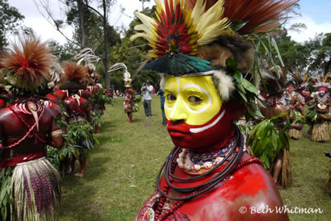
*Primitive times 4000 B.C.-3000 B.C.
The first doctor’s were witch doctors who performed ceremonies to rid the body of evil spirits.

Slide 4
*Primitive times 4000 B.C.-3000 B.C.
The first doctor’s were witch doctors who performed ceremonies to rid the body of evil spirits.

Slide 5
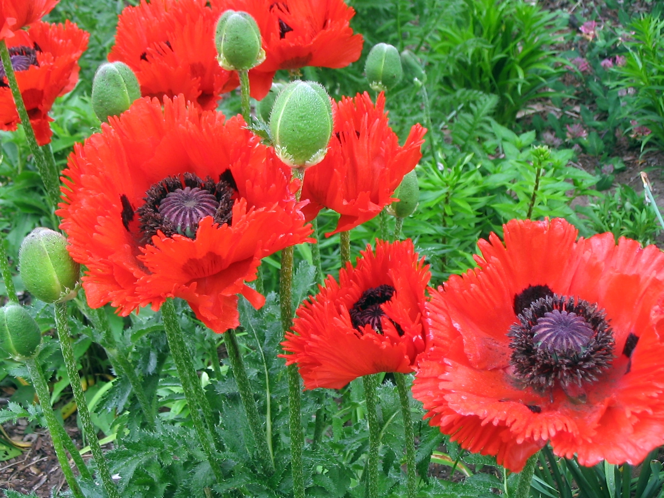
*Primitive times 4000 B.C.-3000 B.C.
Opium and morphine-came from the poppy plant; used to treat pain.

Slide 6
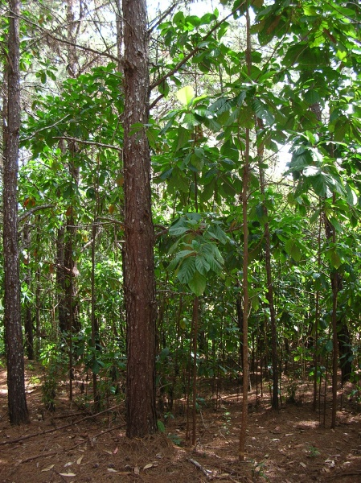
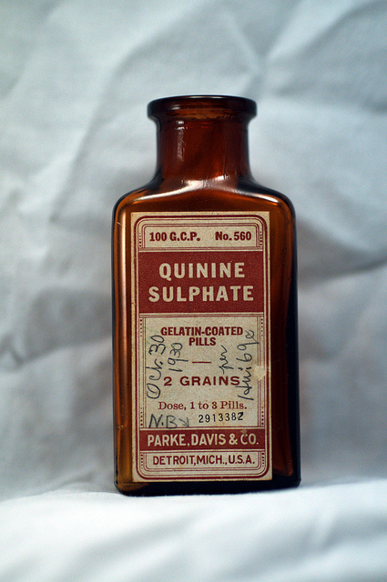
*Primitive times 4000 B.C.-3000 B.C.
Quinine-came from cinchona tree bark; used to treat stomach problems.

Slide 7
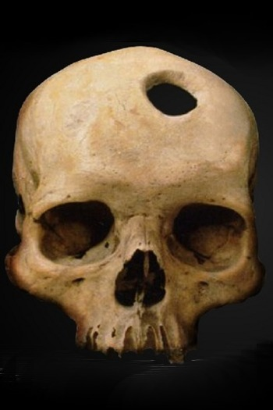
*Primitive times 4000 B.C.-3000 B.C.
Trepanation or trephining-drilling a hole in the skull to let out evil spirits, relieve pressure on the brain, relieve a headache or to heighten awareness.

Slide 8
*Primitive times 4000 B.C.-3000 B.C.
Lifespan during primitive times:
20 years!

Slide 9
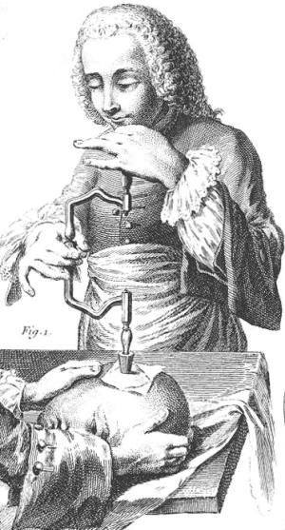
*Primitive times 4000 B.C.-3000 B.C.
Questions for discussion:
If you had a stomach ache and chills during primitive times, would you tell someone? Why or Why not?
What do you think were the complications of trepanation?

Slide 10
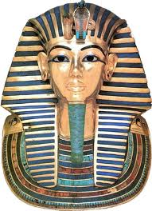
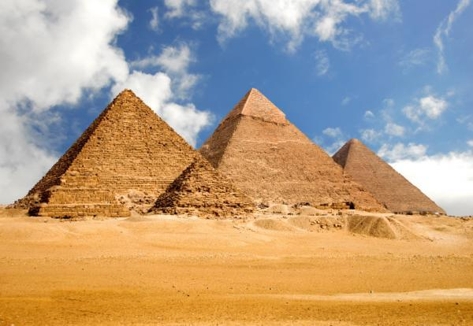
*Egyptians 3000 B.C. – 300 B.C
Question for Discussion:
What have you learned about Egyptians from your Mummy?

Slide 11
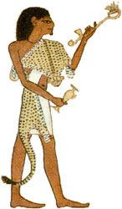
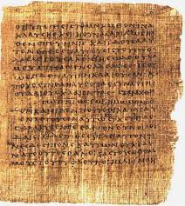
*Egyptians 3000 B.C. – 300 B.C.
First to keep accurate health records.
Wrote prescriptions on papyrus.
Physicians were priests.
Temples were used as places of worships, medical schools, and hospitals.

Slide 12
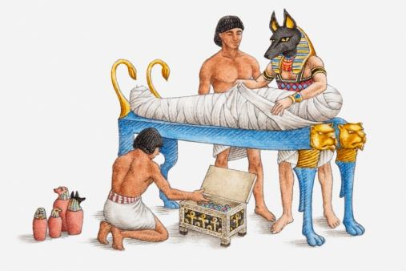
*Egyptians 3000 B.C. – 300 B.C
Embalming led to increased understanding of anatomy and diseases.
Gauze used to wrap bodies is much like the surgical gauze used today.
Strong antiseptics kept bodies from decaying.

Slide 13
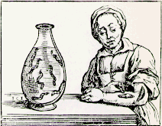
*Egyptians 3000 B.C. – 300 B.C
Leeches were used for bloodletting (draining human blood).
Doesn’t hurt because leech’s saliva had a natural anesthetic.
Their saliva also has a blood thinner, a vasodilator, and an agent that prevents bacteria from infecting the wound.

Slide 14
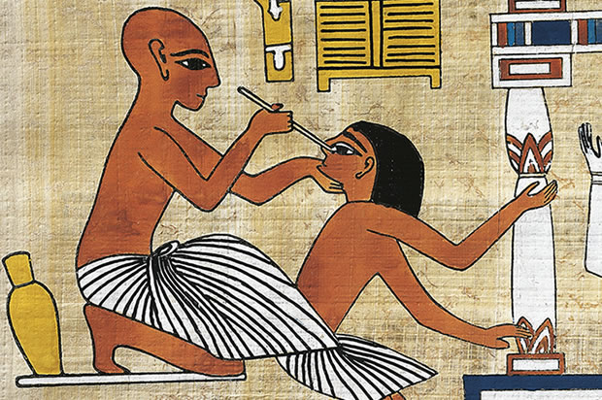
*Egyptians 3000 B.C. – 300 B.C
Question for Discussion:
Why do you think the Egyptians used leeches, and what do you suspect was the result?

Slide 15
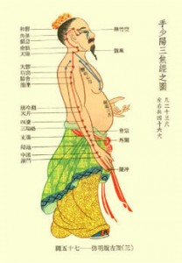
*Ancient Chinese 1700 B.C.- 220 A.D.
Religion prohibited dissection
Believed you had to treat both the body and spirit.
Recorded first know pharmacopoeia of medications derived from herbs
Therapies included acupuncture.

Slide 16
*Ancient Chinese 1700 B.C.- 220 A.D.
Question for Discussion:
Do you think acupuncture works? Why or why not?

Slide 17
*Ancient greeks 1200 B.C.-200 B.C.
The first to study disease; observed the human body and the effects of disease; led to the development of modern medicine.
Discovered that disease was caused by lack of sanitation.
Greeks began to believe that disease was not caused by supernatural forces.

Slide 18
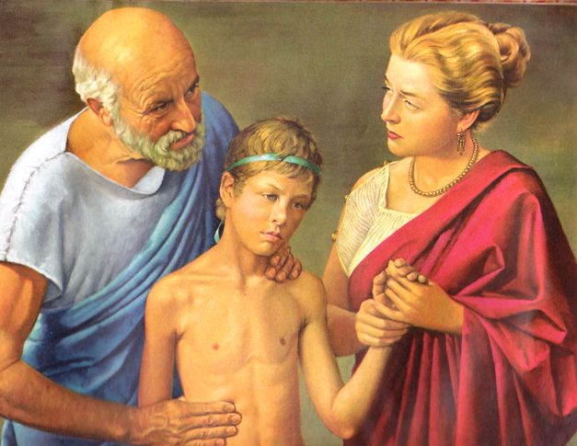
*Ancient greeks 1200 B.C.-200 B.C.
Hippocrates “The father of medicine”-studied the human body; recorded signs and symptoms of disease; created standards for treating diseases.
Hippocrates knew that stomach ache was not caused by the God’s…it was caused by eating something bad.

Slide 19
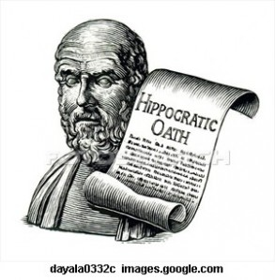
*Ancient greeks 1200 B.C.-200 B.C.
Hippocrates wrote the Hippocratic Oath. The Hippocratic Oath laid the foundation for professional behavior of ALL physicians. It is still used today.

Slide 20
*Ancient greeks 1200 B.C.-200 B.C.
Hippocratic Oath (Modern version)
I swear to fulfill, to the best of my ability and judgment, this covenant: I will respect the hard-won scientific gains of those physicians in whose steps I walk, and gladly share such knowledge as is mine with those who are to follow. I will apply, for the benefit of the sick, all measures which are required, avoiding those twin traps of overtreatment and therapeutic nihilism. I will remember that there is art to medicine as well as science, and that warmth, sympathy, and understanding may outweigh the surgeon's knife or the chemist's drug. I will not be ashamed to say "I know not," nor will I fail to call in my colleagues when the skills of another are needed for a patient's recovery. I will respect the privacy of my patients, for their problems are not disclosed to me that the world may know. Most especially must I tread with care in matters of life and death. If it is given me to save a life, all thanks. But it may also be within my power to take a life; this awesome responsibility must be faced with great humbleness and awareness of my own frailty. Above all, I must not play at God. I will remember that I do not treat a fever chart, a cancerous growth, but a sick human being, whose illness may affect the person's family and economic stability. My responsibility includes these related problems, if I am to care adequately for the sick. I will prevent disease whenever I can, for prevention is preferable to cure. I will remember that I remain a member of society, with special obligations to all my fellow human beings, those sound of mind and body as well as the infirm. If I do not violate this oath, may I enjoy life and art, respected while I live and remembered with affection thereafter. May I always act so as to preserve the finest traditions of my calling and may I long experience the joy of healing those who seek my help.

Slide 21
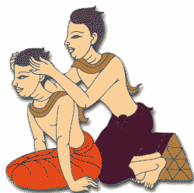
*Ancient greeks 1200 B.C.-200 B.C.
Greeks used therapies to treat people who didn’t feel well.
Massage

Slide 22
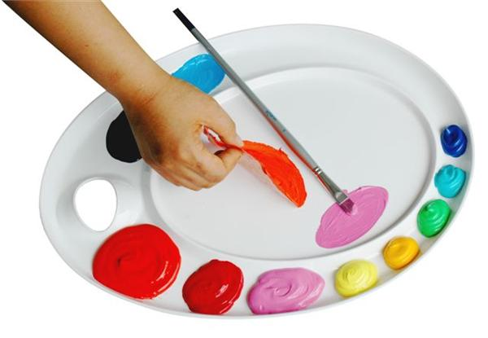
*Ancient greeks 1200 B.C.-200 B.C.
Greeks used therapies to treat people who didn’t feel well.
Art

Slide 23
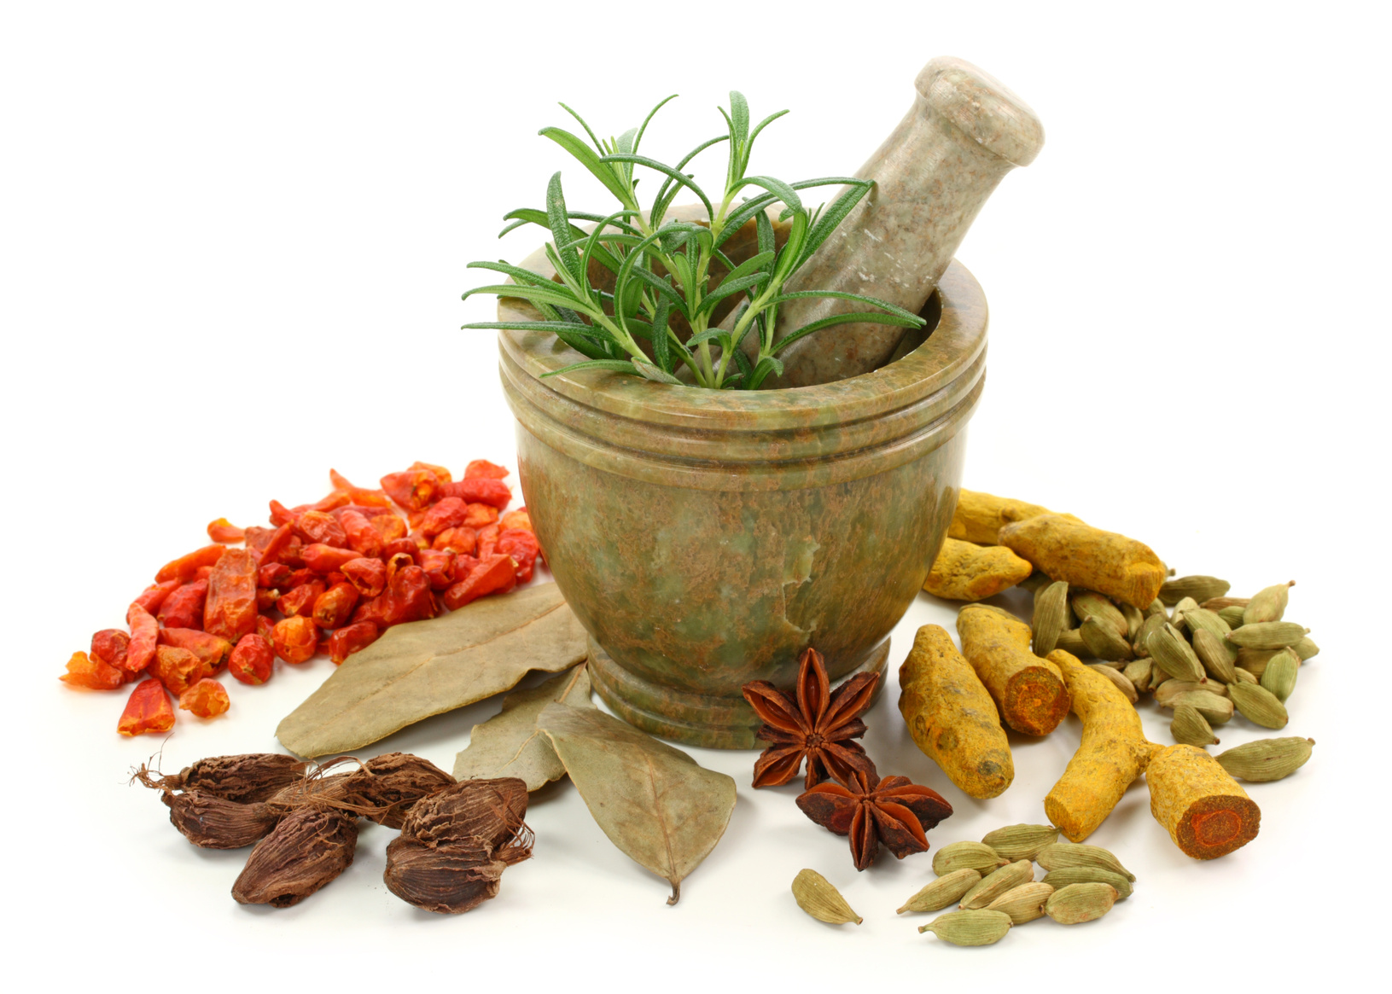
*Ancient greeks 1200 B.C.-200 B.C.
Greeks used therapies to treat people who didn’t feel well.
Herbal remedies

Slide 24
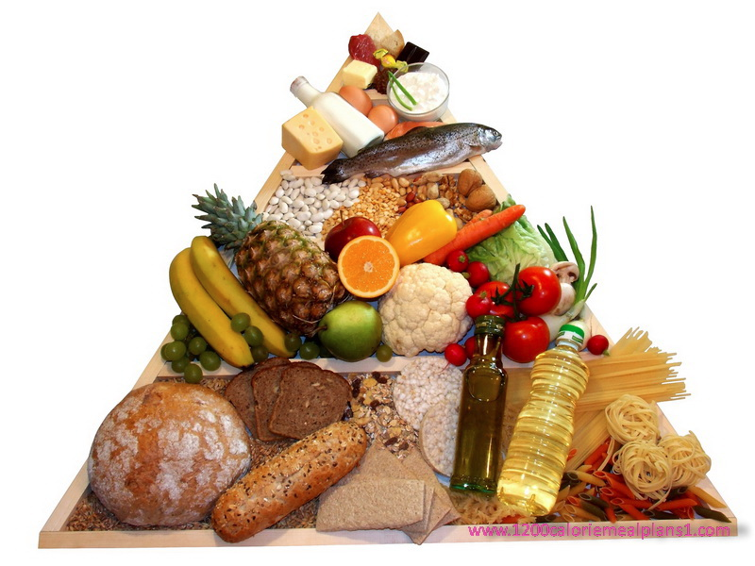
*Ancient greeks 1200 B.C.-200 B.C.
Greeks used therapies to treat people who didn’t feel well.
Stressed diet and cleanliness

Slide 25
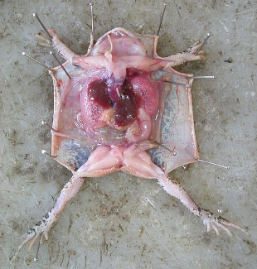
*Ancient greeks 1200 B.C.-200 B.C.
Greeks used therapies to treat people who didn’t feel well.
Aristotle dissected animals

Slide 26
*Ancient greeks 1200 B.C.-200 B.C.
Average life span
is 25-30 years!

Slide 27
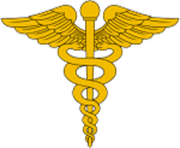
*Ancient greeks 1200 B.C.-200 B.C.
Question for Discussion?
Why do some people say that the Greeks are the founders of modern medicine?

Slide 28
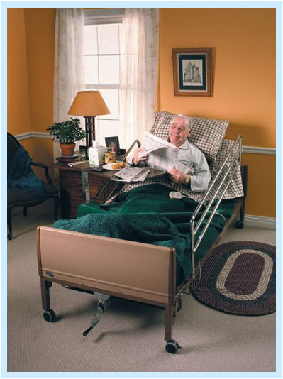
*Ancient romans 753 B.C.-410 A.D.
First to organize medical care.
Established the 1st hospitals in homes; later the hospitals were in monasteries.

Slide 29
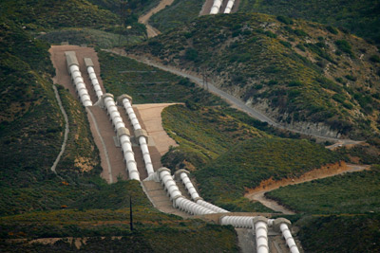
*Ancient romans 753 B.C.-410 A.D.
Created aqueducts to carry clean water
Built sewers and sanitation systems after the Greeks discovered that disease was caused by lack of sanitation.

Slide 30
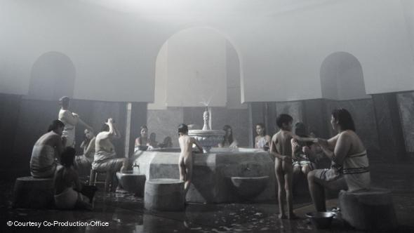
*Ancient romans 753 B.C.-410 A.D.
Took public baths

Slide 31
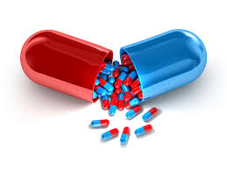
*Ancient romans 753 B.C.-410 A.D.
Treated illness with:
Diet, exercise, medicine

Slide 32
*Ancient romans 753 B.C.-410 A.D.
Average life span
25-35 years!

Slide 33
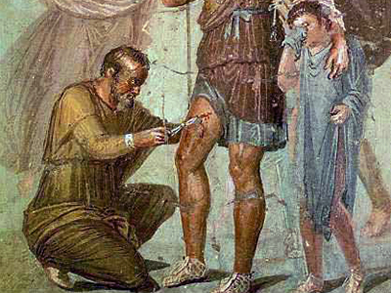
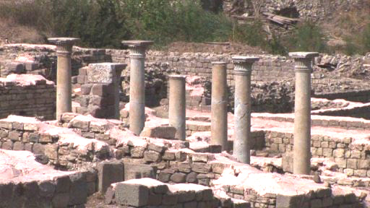
*Ancient romans 753 B.C.-410 A.D.
Question for Discussion:
In history class you learned that the Romans were known for building roads and impressive buildings, and for fighting wars. How do those facts relate to the Roman’s contributions to medicine?

Slide 34
*The dark ages 400 A.D.-800 A.D.
Fall of Roman Empire
The study of medicine stopped for 100 years.

Slide 35
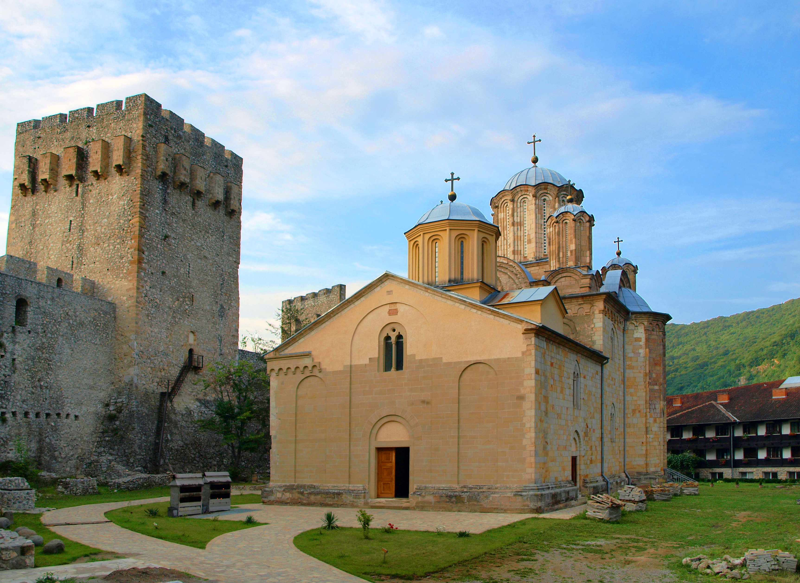
*The dark ages 400 A.D.-800 A.D.
Medicine was only practiced in monasteries where they stressed prayer. Prayer is not a superstitious belief.

Slide 36
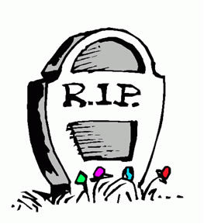
*The dark ages 400 A.D.-800 A.D.
Millions died from disease.
The only medications were herbs.

Slide 37
*The dark ages 400 A.D.-800 A.D.
The average life span
is only 20 years!

Slide 38
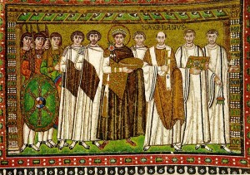
*The dark ages 400 A.D.-800 A.D.
Question for Discussion:
Why did they call it the Dark Ages?

Slide 39
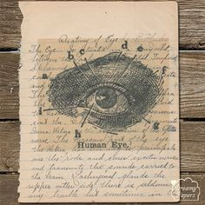
*middle ages 800 A.D.-1400 A.D.
Rebirth of learning occurred
Made handwritten books

Slide 40
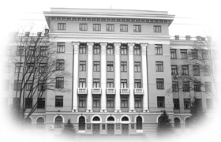
*middle ages 800 A.D.-1400 A.D.
Medical universities were built

Slide 41
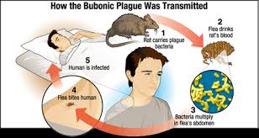
*middle ages 800 A.D.-1400 A.D.
The Bubonic Plague (Black Death) killed 75% of the population in Europe and Asia.
Other major diseases were smallpox, diptheria and TB.
Discovered that blood may cause diseases.

Slide 42
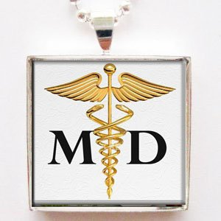
*middle ages 800 A.D.-1400 A.D.
Animal guts were used for suture material.
Physicians must pass an exam to become an M.D.
Diagnosis was based on observation.

Slide 43
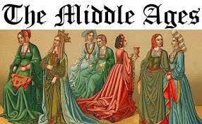
*middle ages 800 A.D.-1400 A.D.
Average life span
of 20-35 years!

Slide 44
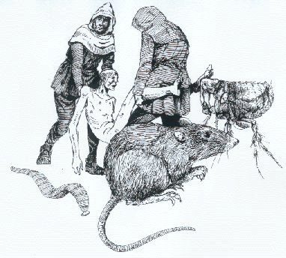
*middle ages 800 A.D.-1400 A.D.
Questions for Discussion:
What killed 75% of the population in Europe and Asia?
Do you recall learning another name for that disease?
What caused it?
How was it transmitted?

Slide 45
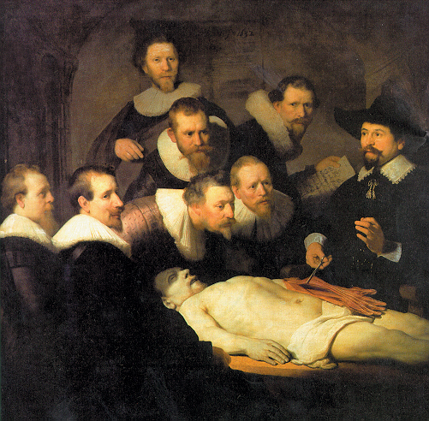
*renaissance period 1350 A.D.-1650 A.D.
Rebirth of science of medicine.
Dissection was accepted so that the inside of the body could be studied.

Slide 46
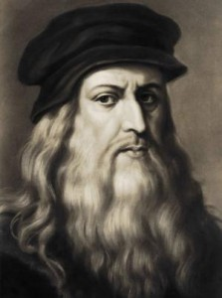
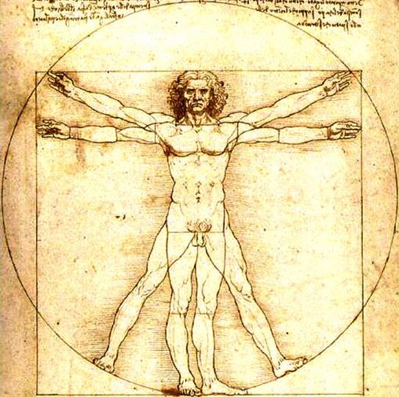
*renaissance period 1350 A.D.-1650 A.D.
Michelangelo and Leonardo da Vinci studied the anatomy of the human body and drew pictures of the inside and outside of the human body.

Slide 47
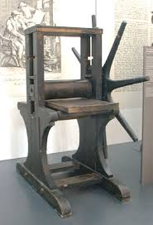
*renaissance period 1350 A.D.-1650 A.D.
The printing press was invented and now medical information could be shared.

Slide 48
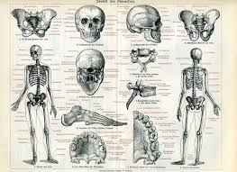
*renaissance period 1350 A.D.-1650 A.D.
The first anatomy books were published.

Slide 49
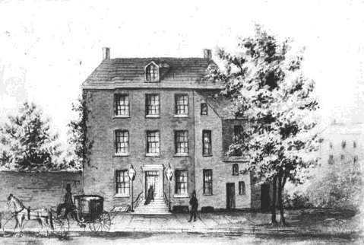
*renaissance period 1350 A.D.-1650 A.D.
Universities and medical schools were built.

Slide 50
*renaissance period 1350 A.D.-1650 A.D.
The average life span
of 30-40 years!

Slide 51
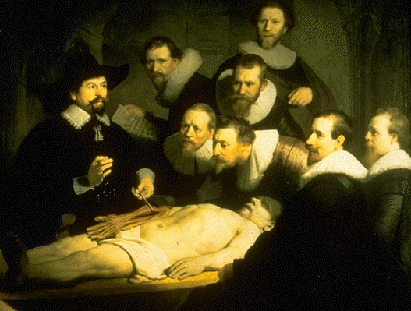
*renaissance period 1350 A.D.-1650 A.D.
Question for Discussion:
What led to a better understanding of anatomy and physiology during this historical period?
Why was that important?

