Slide 1
History of Health Care
Health Team Relations

Slide 2
Part 2:
“Medical Advances Made in the 16th-20th Century Health Care and the Men and Women Who Made Historical Contributions”

Slide 3
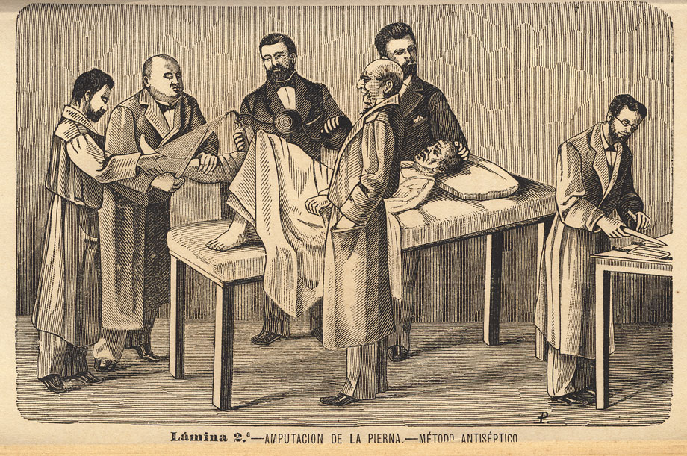
*The 16th and 17th century
16th Century 1500-1600 17th Century 1600-1700
Disease still not fully understood, many died from infection.
Many died from childbed/puerpal fever because they didn’t practice handwashing!

Slide 4
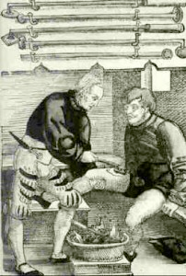
*The 16th and 17th century
Learned to bind arteries to stop bleeding.
Used boiling oil to cauterize wounds.

Slide 5
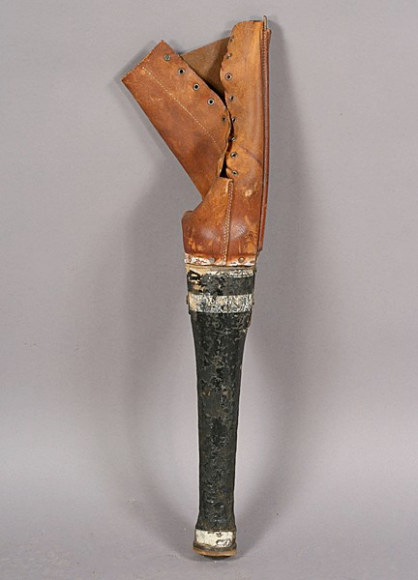
*The 16th and 17th century
Improved splinting of fractures.
Artificial limbs were developed.

Slide 6
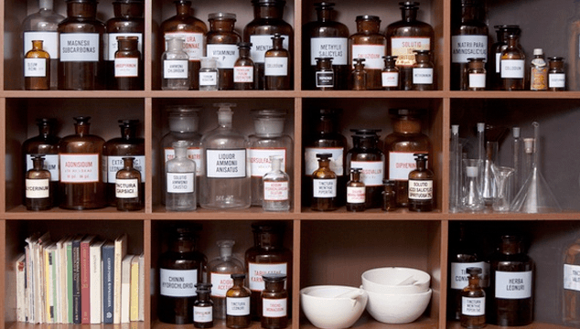
*The 16th and 17th century
Pharmacies were called “Apothecaries”, this is where they began to make, prescribe and sale medications.
They still used plants and herbs for medicine.

Slide 7
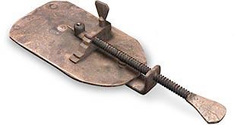
*The 16th and 17th century
Anton van Leeuwenhoek invented the microscope.
He learned he had an invention when he scraped his teeth and studied the contents under the microscope. He was able to see germs and confirm that disease is caused by microorganisms and not by the God’s.

Slide 8
*The 16th and 17th century
Average lifespan
of 35-45 years!

Slide 9
*The 18th century 1700AD-1800AD
The thermometer was developed by Gabriel Fahrenheit.
The oxygen element was discovered.
The first scientific surgical procedure was performed.

Slide 10
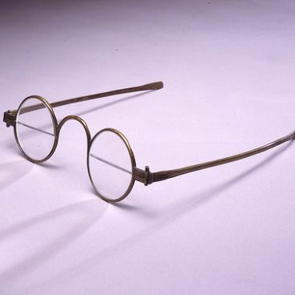
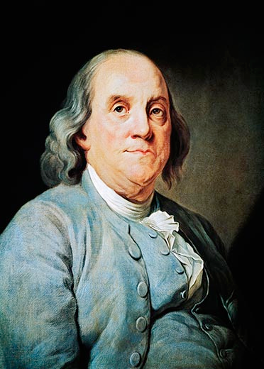
*The 18th century
Benjamin Franklin invented bifocals, discovered that colds can be passed from person to person and invented the catheter.

Slide 11
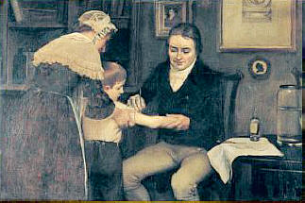
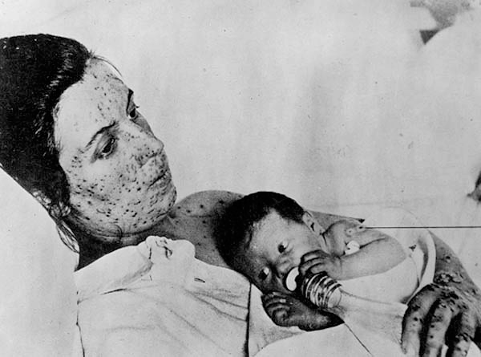
*The 18th century
Edward Jenner developed the smallpox vaccine.

Slide 12
*The 18th century
Average life span
of 40-50 years!

Slide 13
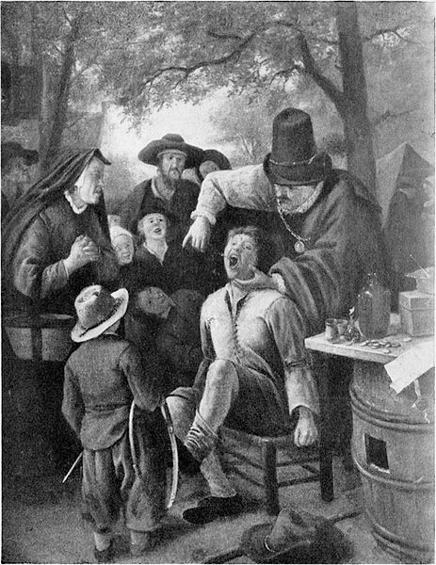
*The 19th century 1800AD-1900AD
French barbers extracted teeth.

Slide 14
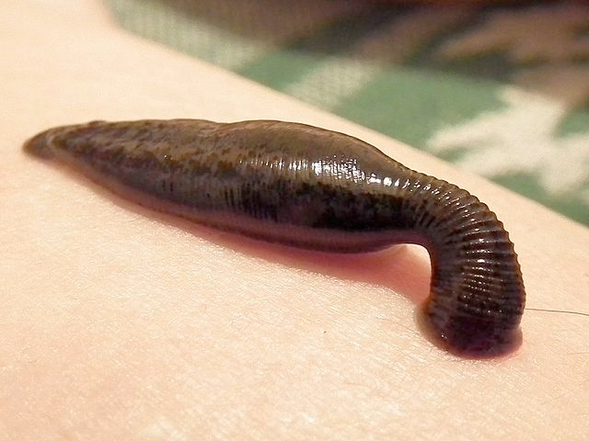
*The 19th century
Leaches were used.

Slide 15
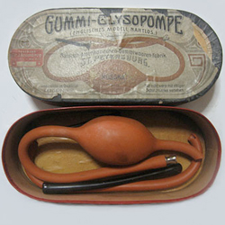
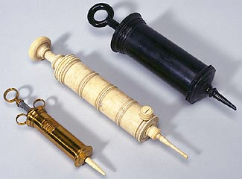
*The 19th century
Enemas were used.

Slide 16
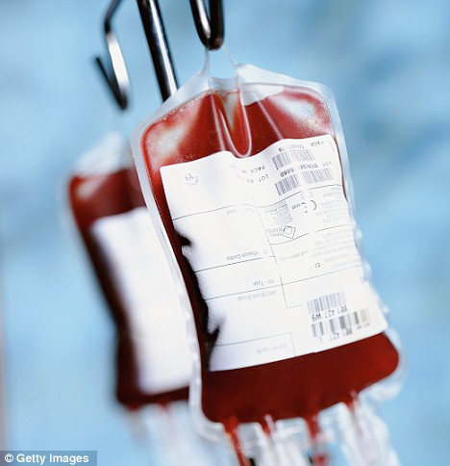
*The 19th century
1st blood transfusion.

Slide 17
*The 19th century
Provided treatment for mental illness.

Slide 18
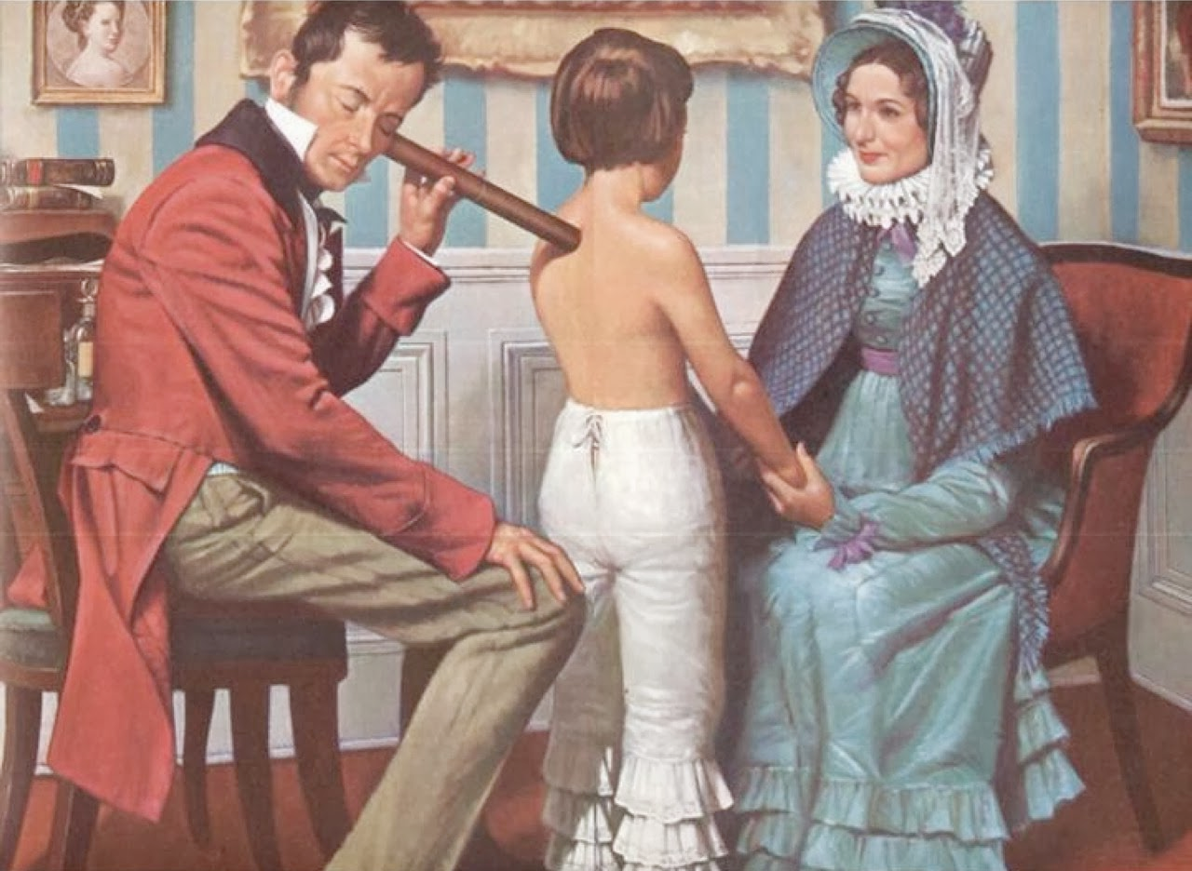
*The 19th century
Rene’ Laennec invented a stethoscope made of wood so now we could hear sounds inside the body.

Slide 19
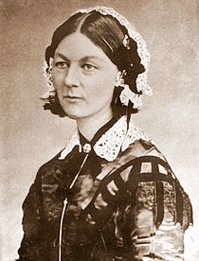
*The 19th century
Florence Nightingale started the first nursing school and respectable women could now be nurses.; Nightingale was the founder of modern nursing. She also invented the call bell.

Slide 20
*The 19th century
Discovered that handwashing decreases the spread of germs.

Slide 21
*The 19th century
Infection control standards were established since doctors understood that microorganisms cause disease.

Slide 22
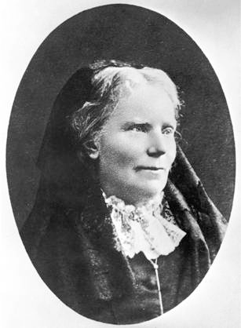
*The 19th century
Elizabeth Blackwell became the 1st female physician in the U.S. in 1849.

Slide 23
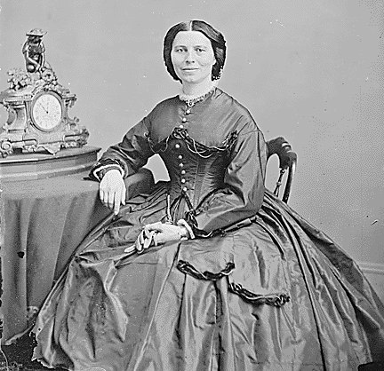
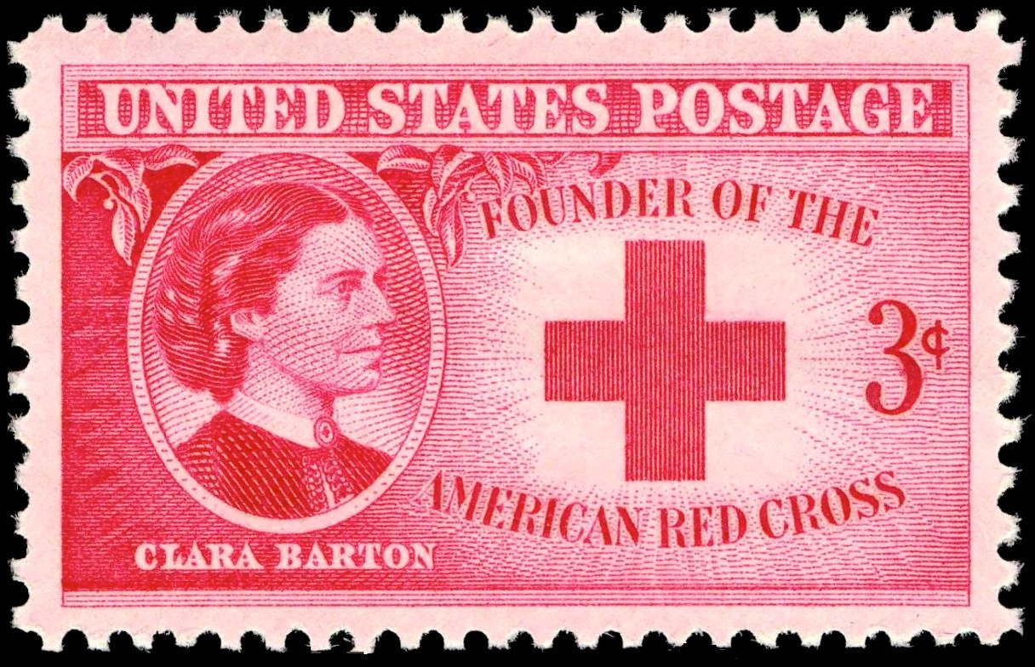
*The 19th century
Clara Barton founded the American Red Cross in 1881.

Slide 24
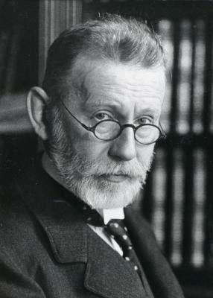
*The 19th century
Paul Ehrlich discovered the “magic bullet”, chemicals to fight disease (syphilis).

Slide 25
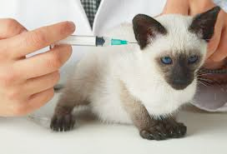
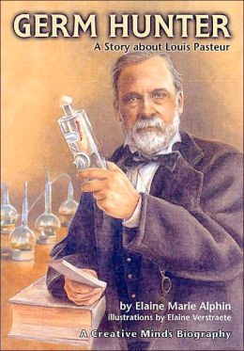
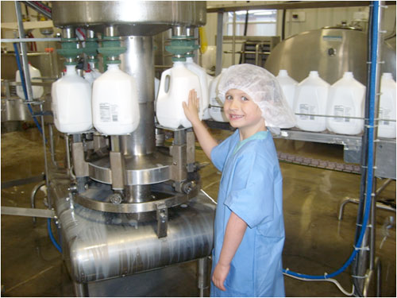
*The 19th century
Louis Pasteur invented the pasteurization of milk since microorganisms cause disease/infection.
Developed the rabies vaccine.

Slide 26
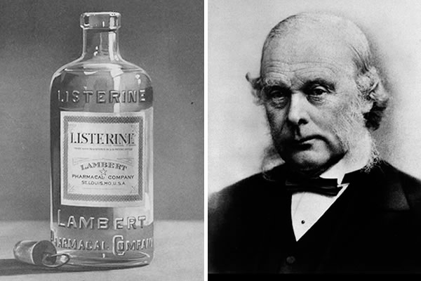
*The 19th century
Joseph Lister invented disinfectants and antiseptics after discovering that carbonic acid kills germs. Now antiseptics are used during surgery to help prevent infection.

Slide 27
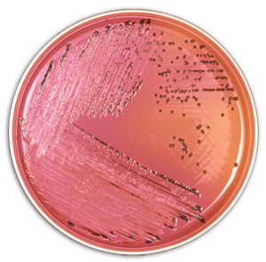
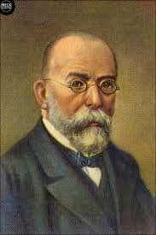
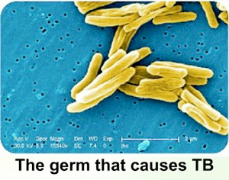
*The 19th century
Robert Koch developed the culture plate to identify pathogens; also discovered the germ that causes Tuberculosis.

Slide 28
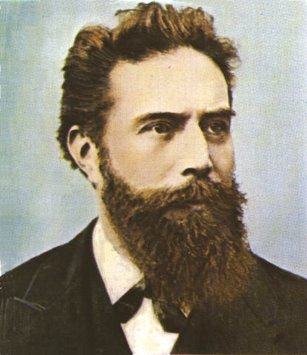
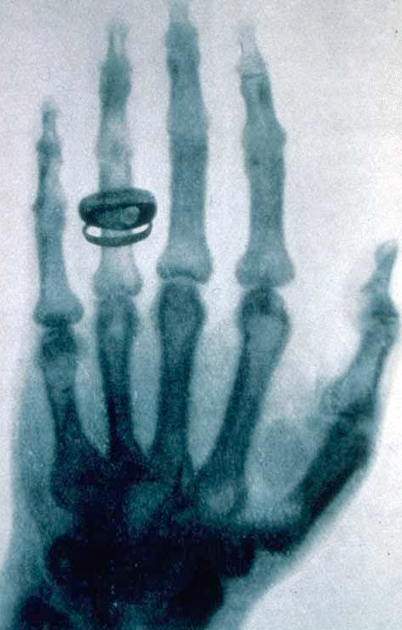
*The 19th century
Wilhelm Roentgen invented x-rays in 1895 so that we could view the inside of the body.

Slide 29
*The 19th century
Average life span
of 40-60 years!

Slide 30
*The 20th century
Classified the blood groups.

Slide 31
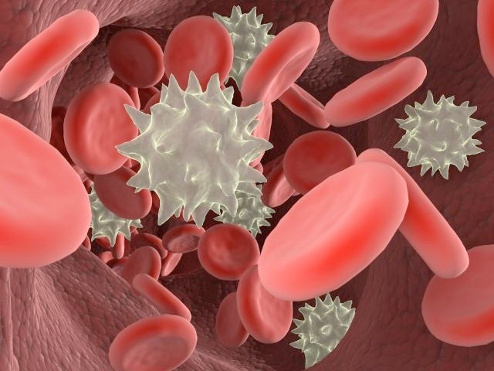
*The 20th century
Discovered that white blood cells fight disease.

Slide 32
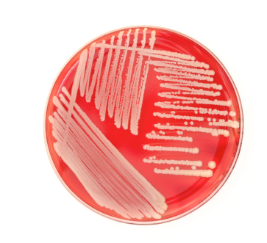
*The 20th century
Began to grow viruses in cultures.

Slide 33
*The 20th century
Health insurance was formed.

Slide 34
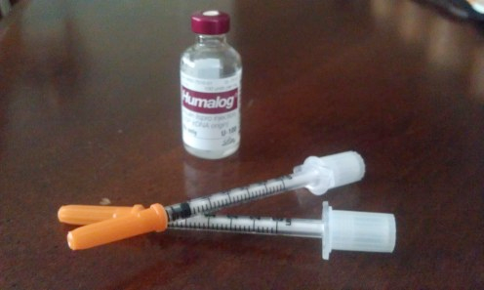
*The 20th century
Insulin was discovered to treat diabetes. (Diabetes cannot be prevented through an immunization.)
Insulin for Diabetes

Slide 35
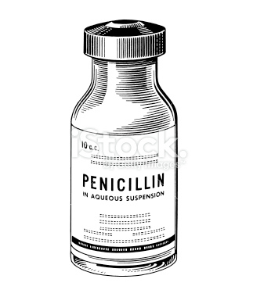
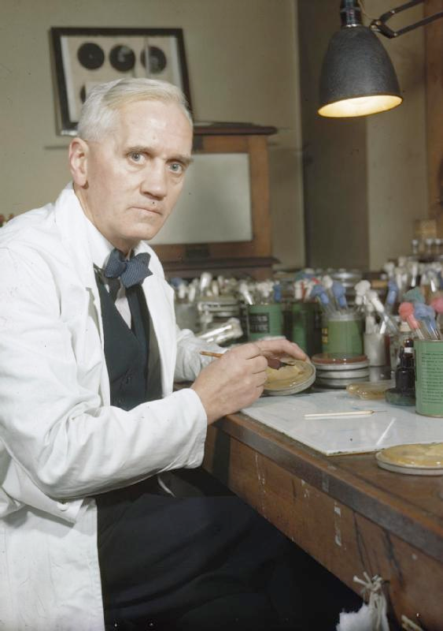
*The 20th century
Alexander Fleming discovered penicillin to cure life-threatening illnesses such as gonorrhea. This was one of the most important discoveries of the 20th century.

Slide 36
*The 20th century
Antibiotics and sulfa drugs were invented to fight infections.
Antibiotics
and
Sulfa drugs

Slide 37
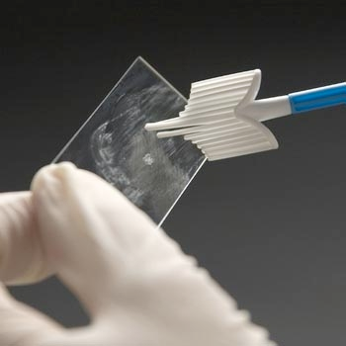
*The 20th century
The pap smear test that helps to diagnose cervical cancer was invented.

Slide 38
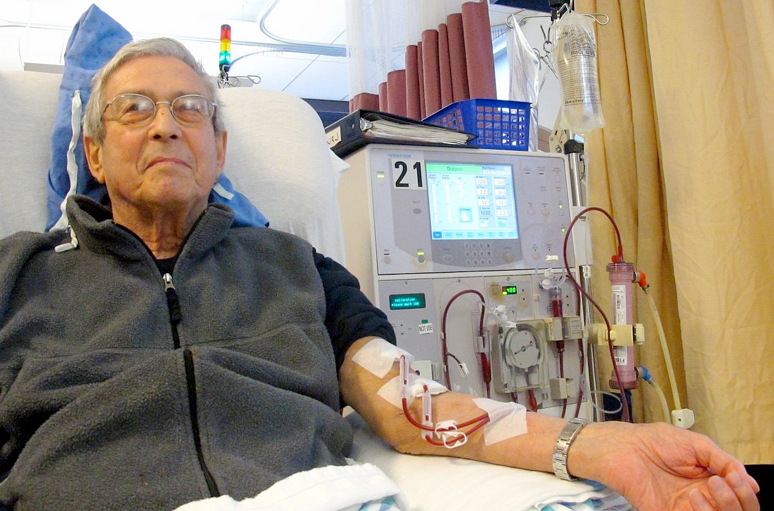
*The 20th century
The kidney dialysis machine was invented.

Slide 39
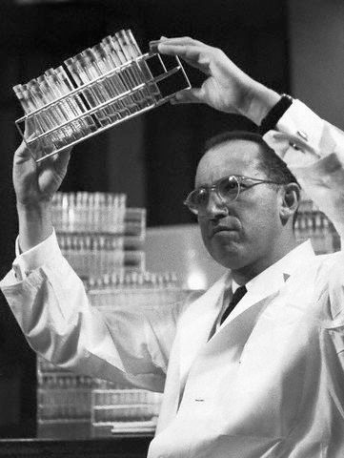
*The 20th century
Jonas Salk discovered the polio vaccine using a dead virus.
Polio
with
Dead
virus

Slide 40
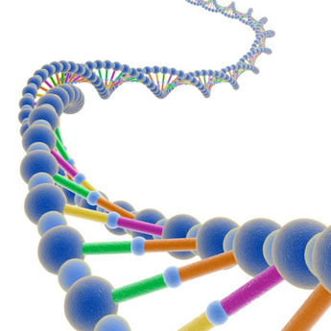
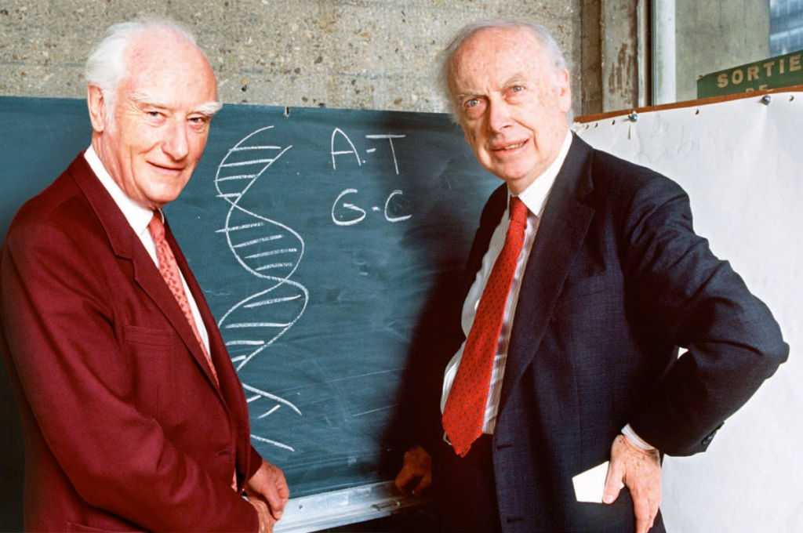
*The 20th century
Francis Crick and James Watson described the structure of DNA; they built a DNA model and won a Nobel Peace Prize.

Slide 41
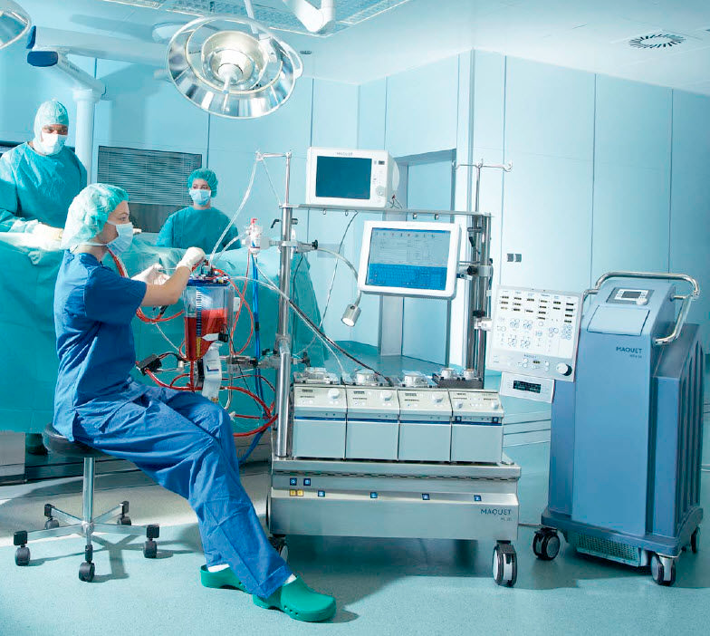
*The 20th century
The heart-lung machine was invented and used for open heart surgery.
The 1st kidney transplant was performed

Slide 42
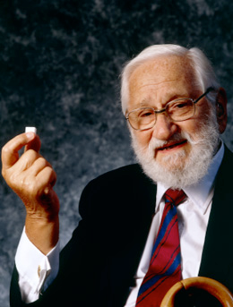
*The 20th century
Albert Sabin invented the live polio vaccine which saved many lives.
Polio
with
Live
virus

Slide 43
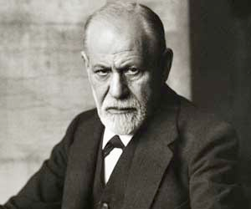
*The 20th century
Sigmund Freud studied psychology as he observed the conscious and unconscious human mind.

Slide 44
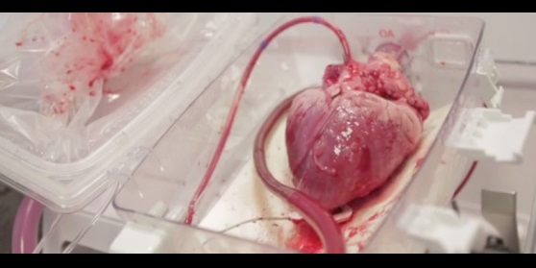
*The 20th century
Christiaan Barnard performed the 1st successful heart transplant in 1968.

Slide 45
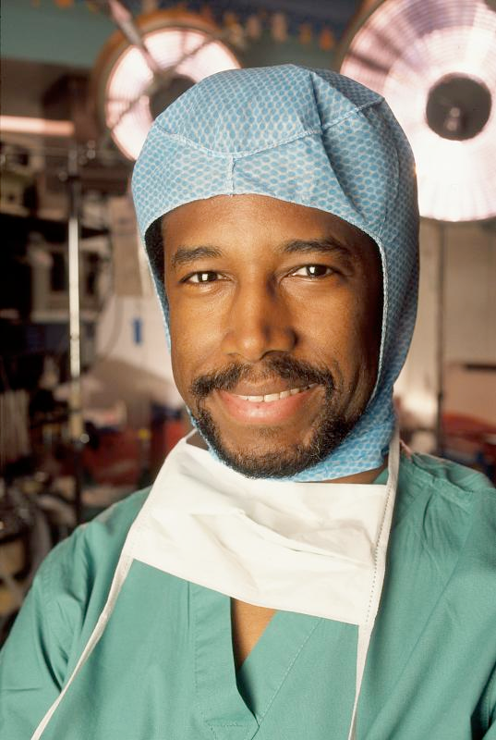
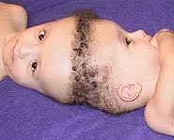
*The 20th century
Ben Carson was the 1st successful surgeon to separate siamese twins that were conjoined at the head. He refined the hemispherectomy (removal of part or half of the brain to stop seizures.) He recently retired as a neurosurgeon from Johns Hopkins Hospital.

Slide 46
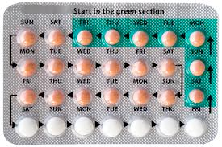
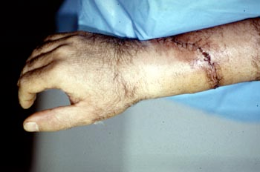
*The 20th century
The birth control pill was invented.
Severed limbs were
reattached.

Slide 47
*The 20th century
Medicare and Medicaid insurance plans allowed for everyone to have healthcare.
HMO’s were established

Slide 48
*The 20th century
Hospice was founded

Slide 49
*The 20th century
Omnibus Budget Reconciliation Act (OBRA) was established. OBRA is a federal law that states ALL persons working with the elderly are certified. Ex: C.N.A.
OBRA =

Slide 50
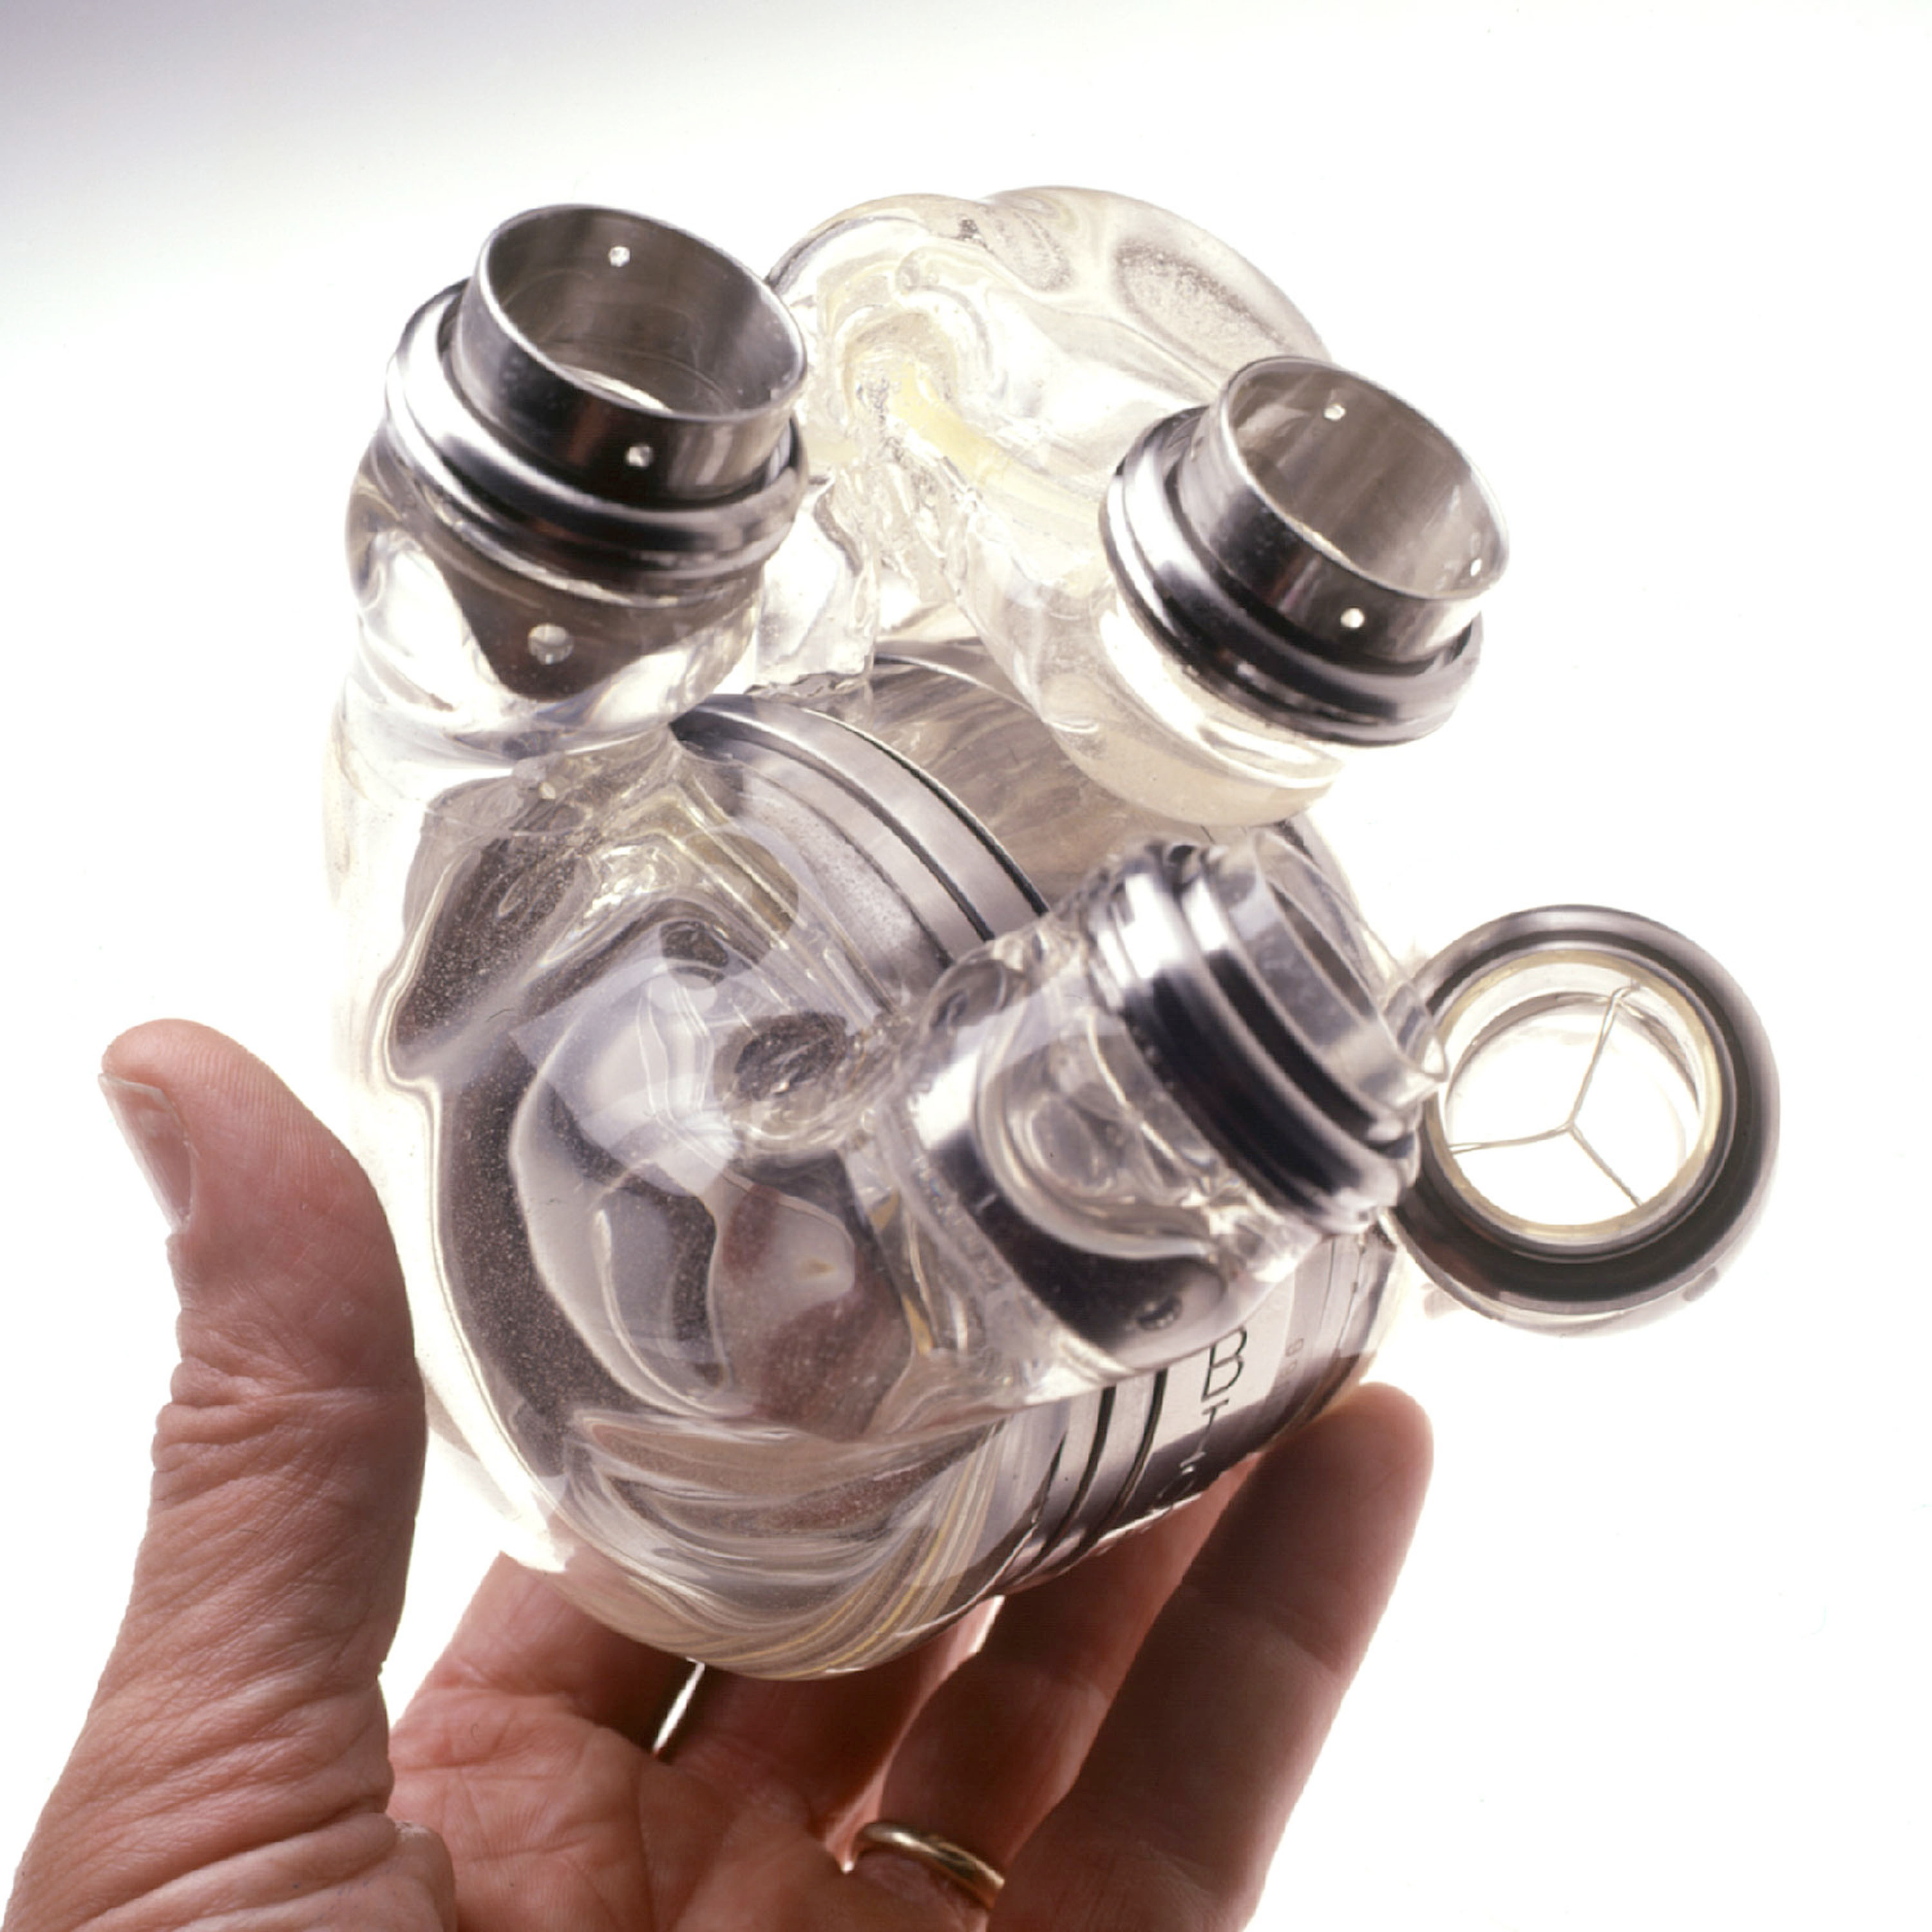
*The 20th century
The 1st artificial heart was made.

Slide 51
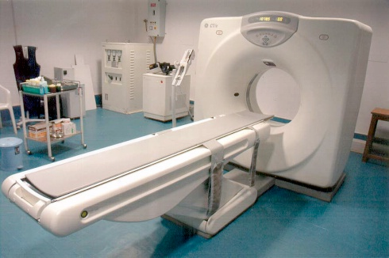
*The 20th century
CT scan was invented.

Slide 52
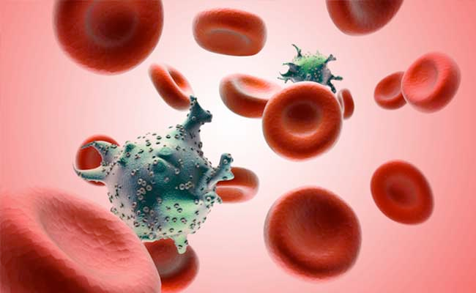
*The 20th century
The AIDS virus was discovered.

Slide 53
*The 20th century
Sheep were cloned.

Slide 54
*The 20th century
Sheep were cloned.

Slide 55
*The 20th century
Gene therapy began.
Genetic screening was performed.

Slide 56
*The 20th century
The first test tube baby was created. (This is considered the most recent medical discovery.)

Slide 57
*The 20th century
Average life span
of 60-70 years.

