Slide 1
History of Health Care
Health Team Relations

Slide 2
Part 3:
“Exploring Current Trends in Health Care”

Slide 3
*Exploring current trends in health care
Cost containment-trying to control the high cost of healthcare.

Slide 4
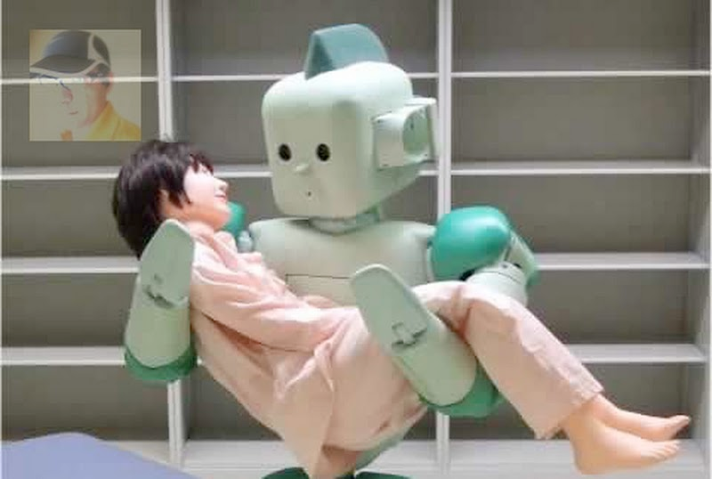
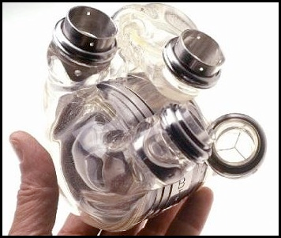
*Exploring current trends in health care
Reasons for high health care costs
Technological advances: heart-lung machine, artificial hearts, computers, robots, etc.

Slide 5
*Exploring current trends in health care
Reasons for high health care costs
Aging population: Medical science needs to have a better understanding of Geriatric medicine because people are living longer.

Slide 6
*Exploring current trends in health care
Reasons for high health care costs
Health related lawsuits: People sue for anything! Cost containment would put a cap on malpractice lawsuits.

Slide 7
*Methods of cost containment
Diagnostic Related Groups (DRG’s)-People are placed in groups based on their diagnosis. The agency can only charge one set amount for treatment. If the agency charges more, the agency has to accept the loss. DRG’s are regulated by the federal government.
Asthma
C-sections
Strep throat
Diabetics
Kidney stones

Slide 8
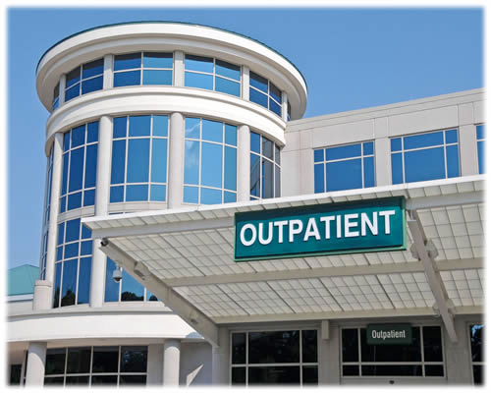
*Methods of cost containment
Outpatient services-patients aren’t admitted to the hospital. (Ex.: emergency room, doctor’s office, outpatient surgery, etc.)

Slide 9
*Methods of cost containment
Mass or bulk purchasing-buying equipment and supplies in large quantities.

Slide 10
*Methods of cost containment
Early intervention and preventative services-preventing illness before it happens, diagnosing the disease right away. This can occur through patient education, physicals, immunizations, etc.

Slide 11
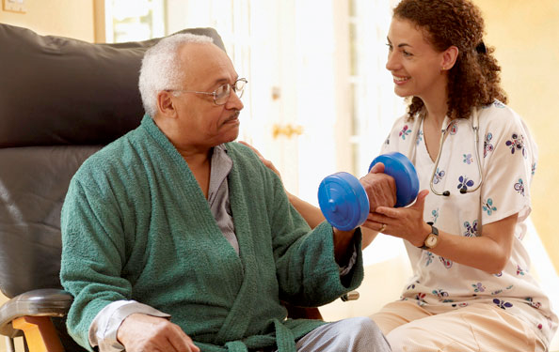
*Methods of cost containment
Home Health Care-Nurses, certified nursing assistants, dieticians, physical therapists take care of patients at home.

Slide 12
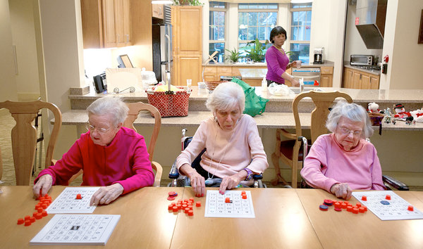
*Methods of cost containment
Geriatric Care-taking care of the elderly in adult daycare centers, nursing homes, retirement communities, etc.

Slide 13
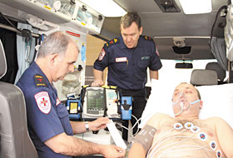
*Methods of cost containment
Telemedicine-the use of videos, audio, computers, phone lines to care for patients. Ex.: from miles away emergency medical technicians can transmit information to the emergency room doctor about a heart attack victim. Patients can send doctor test blood sugar, monitor pregnancies, pacemakers, etc. through phone lines.

Slide 14
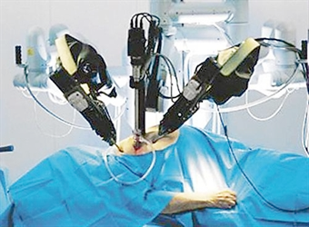
*Methods of cost containment
Doctors can perform surgeries through robots 1000 miles away from the patient.

Slide 15
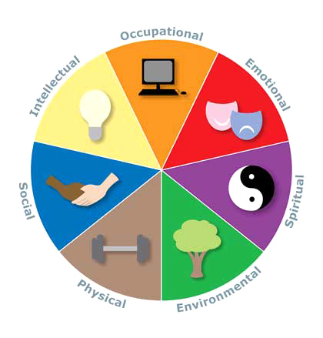
Wellness
Physical wellness – taking care of your body.
Mental wellness- taking care of your mind & emotions
Spiritual wellness- Taking care of your spirit & values

Slide 16
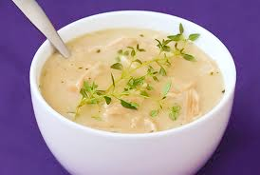
*Holistic health care
Holistic health care-belief that the body will heal itself; avoids the doctor and medications; eats chicken soup and rests.
Focuses on:
Body
Mind
Spirit

Slide 17
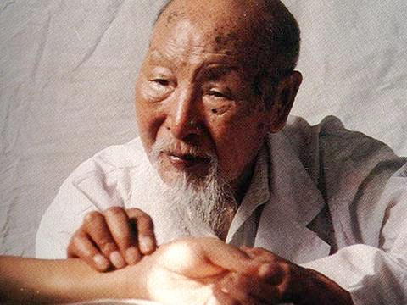
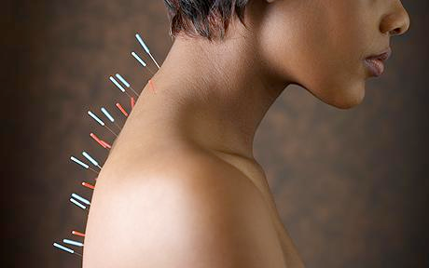
*Alternative and complementary methods of health care
Chinese Practitioners-believe that life energy (Chi) flows through every person; use acupuncture, acupressure, tai chi and herbs to increase energy flow.

Slide 18
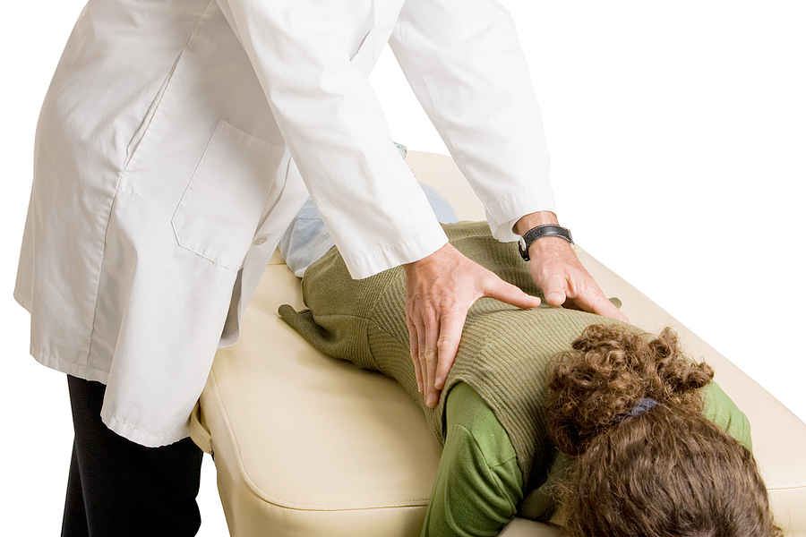
*Alternative and complementary methods of health care
Chiropractors-believe energy is sent to all parts of the body through the spinal cord; use hands to manipulate the spine and use massage to increase flow of energy.

Slide 19
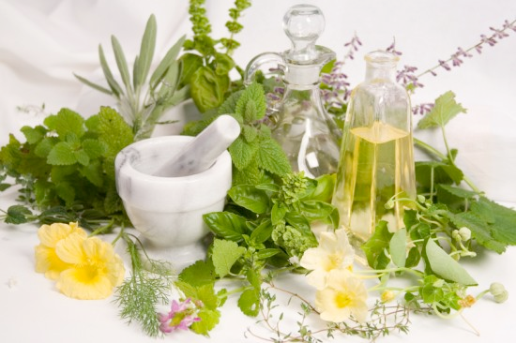
*Alternative and complementary methods of health care
Naturopaths-use only natural therapies; fasting, special diets, lifestyle changes to promote healing.

Slide 20
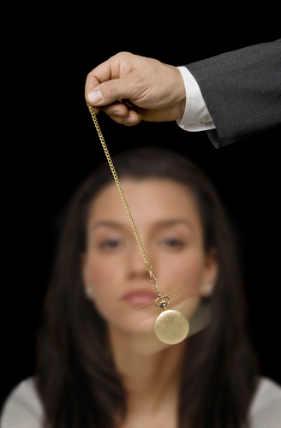
*Alternative and complementary methods of health care
Hypnotist-help people go into a trance-like state to become more receptive to suggestion and change behavior.

Slide 21
*Alternative and complementary methods of health care
Traditional health care- believe in preventing diseases, getting a diagnosis and treatment.
PREVENT
DIAGNOSE
TREAT

Slide 22
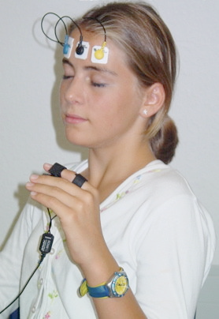
*Alternative and complementary methods of health care
Other forms of alternative medicine:
Aroma therapy
Biofeedback-provides info
on reactions to stress

Slide 23
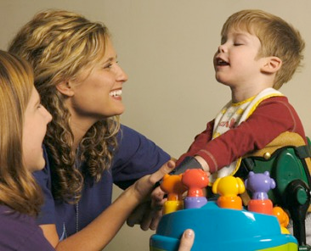
*Alternative and complementary methods of health care
Other forms of alternative medicine:
Healing touch
Pet therapy
Play therapy

Slide 24
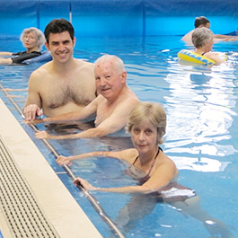
*Alternative and complementary methods of health care
Other forms of alternative medicine:
Positive thought
Imagery
Hydrotherapy

Slide 25
*Alternative and complementary methods of health care
Other forms of alternative medicine:
Meditation
Yoga
Spiritual therapies

Slide 26
THE END!

