Slide 1
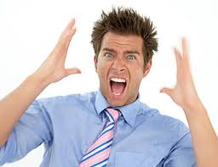
Stress Management

Slide 2
*Analyze Stressors and Stress Management Skills
Stress is the body’s reaction to any stimulus that requires a person to adjust to a changing environment. Not all stress is harmful; a small amount of stress is good; it makes us more alert and increases our energy.

Slide 3
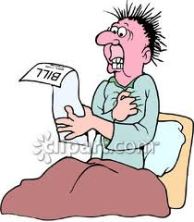
*Analyze Stressors and Stress Management Skills
Stressors can be internal (heart attack) or external forces (new job).
***EX:Failing a test is an example of a typical stressor.

Slide 4
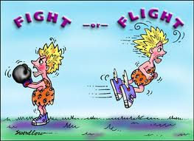
*Analyze Stressors and Stress Management Skills
Stressors can cause the body to go into an alarm or warning mode: “fight or flight”.
Signs and symptoms: Rapid heart beat, increased blood pressure, increased breathing, slower digestion, dry mouth. These symptoms provide a burst of energy and strength; afterwards fatigue or exhaustion sets in.

Slide 5
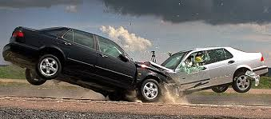
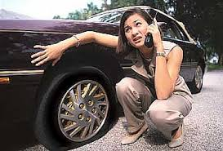
*Steps Involved in Controlling Stressors
***Identify stressor (always the first step)
What was the event?
Why do you feel stress?

Slide 6
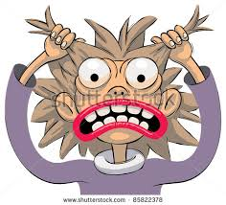
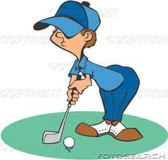
*Steps Involved in Controlling Stressors
How much stress was experienced?
Do you have negative
or positive feelings?
How did you deal with the stress?

Slide 7
*Steps Involved in Controlling Stressors
Problem solving method:
A. Gather information
Identify the problem
List possible solutions
Make a plan
Act on your solution
Evaluate the results
Change the solution

Slide 8
*Management of stress when it causes a physical reaction
STOP and break out of the stress response.

Slide 9
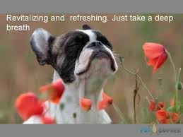
*Management of stress when it causes a physical reaction
2. ***BREATHE-take a slow deep breath to relieve tension.

Slide 10
*Management of stress when it causes a physical reaction
3. REFLECT and think about the cause of the stress.

Slide 11
*Management of stress when it causes a physical reaction
4. CHOOSE how you want to deal with the stress

Slide 12
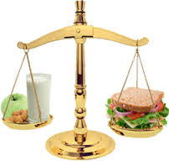
*Stress Reducing Techniques
1. Live a healthy life. ***(A balanced diet and exercise provide the best long-term relief.)

Slide 13
*Stress Reducing Techniques
2. Take a break from stressors.
(Sit in a comfortable chair with your feet up.)

Slide 14
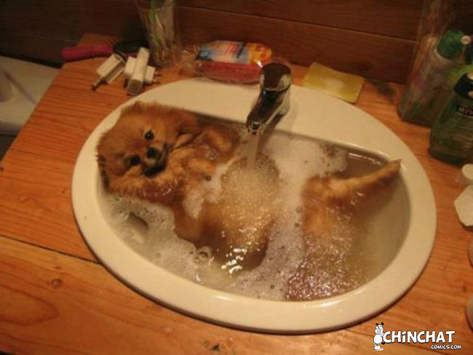
*Stress Reducing Techniques
3. Relax. (Take a warm bath.)

Slide 15
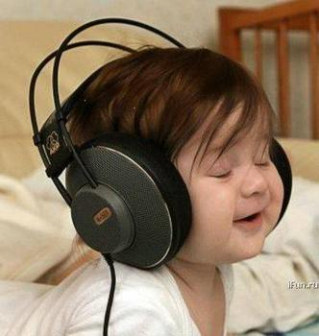
*Stress Reducing Techniques
4. Escape. (Listen to soothing music.)

Slide 16
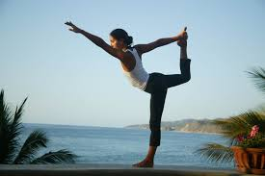
*Stress Reducing Techniques
5. Relieve tension. (Concentrate on relaxing each muscle.)

Slide 17
*Stress Reducing Techniques
6. Rely on others. (Talk to a friend.)

Slide 18
*Stress Reducing Techniques
7. Meditate. (Think about your values and beliefs in a higher power.)

Slide 19
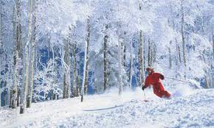
*Stress Reducing Techniques
8. ***Use imagery. (Close your eyes and use all your senses to place yourself in a place that you feel comfortable and relaxed.) EX: SITTING IN THE SUN AT THE BEACH

Slide 20
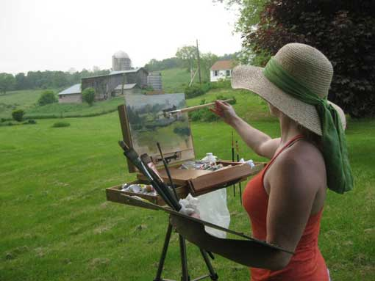
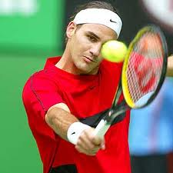
*Stress Reducing Techniques
9. Enjoy yourself. (Find a hobby, sport, etc. to provide “time-out”.)

Slide 21
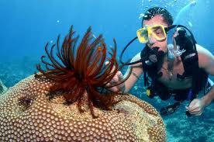
*Stress Reducing Techniques
10. ***Renew yourself. (Learn a new skill or a hobby, participate in community activities.)

Slide 22
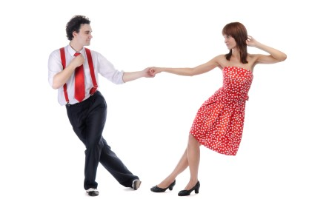
*Stress Reducing Techniques
11. Develop outside interests. (Provide time for yourself.)

Slide 23
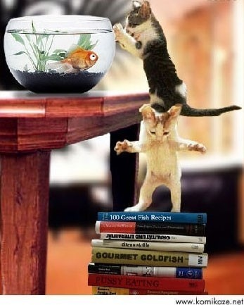
*Stress Reducing Techniques
12. Seek assistance or
delegate tasks.
(No one can do
Everything
all the time.)

Slide 24
*Stress Reducing Techniques
13. Avoid too many commitments. (Say “no”)

Slide 25
*Stress Reducing Techniques
***FOCUS ON YOUR SUCCESSES!!

