Slide 1
5.03 Careers in Healthcare Facility Services, Medical Services, Mental Health and Social Services.

Slide 2
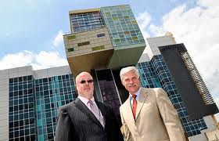
Hospital/Health Care Facility Services
1. Health Care Administrator (CEO): Plans, directs, coordinates and supervises delivery of health care; manages, hires and fires.

Slide 3
2. Central/Sterile Supply Technician:
Orders supplies and equipment, maintains equipment, sterilizes instruments, fills orders from departments.

Slide 4
Medical Careers
*Physician/Doctor of Medicine (M.D.): Diagnose disease and illness, treat disease and illness; order tests, perform simple surgeries; income: $300,000/year
"HOW TO BECOME A PHYSICIAN" VIDEO

Slide 5
Medical Careers
*Doctor of Osteopathy (D.O.): Same as medical doctor but focuses on mind, body and emotions;
If you have a sore throat or a fever you can go to a D.O.
"WHAT IS A DOCTOR OF OSTEOPATHY?”
VIDEO

Slide 6
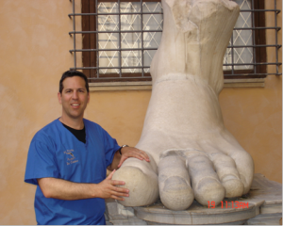
Medical Careers
*Doctor of Podiatry (D.P.M.):
Foot doctor

Slide 7
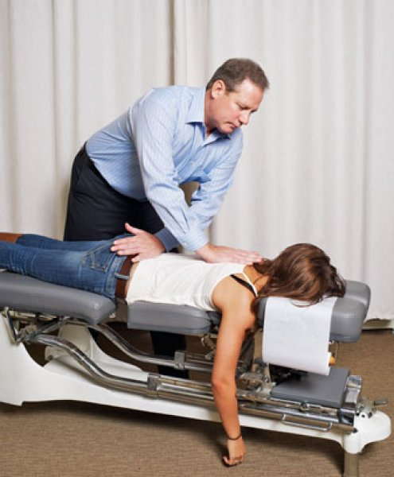
Medical Careers
Doctor of Chiropractics:
focus on spine, nervous system.

Slide 8
Physician Specialties
* Anesthesiologist: Put people to sleep for surgery.

Slide 9
Physician Specialities
* Cardiologist: Heart doctor; treats people with chest pain.

Slide 10
Physician Specialities
Dermatologist: Doctor that treats disorders of the skin.

Slide 11
Physician Specialities
Gastroenterologist: Doctor that treats stomach and intestinal problems.

Slide 12
Physician Specialities
Gerontologist: Doctor that treats the elderly.

Slide 13
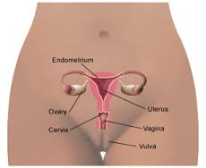
Physician Specialities
Gynecologist: Doctor that treats female problems.

Slide 14
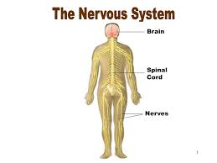
Physician Specialities
Neurologist: Doctor that treats disorders of the brain and nervous system.

Slide 15
Physician Specialities
Obstetrician: Doctor that delivers babies.

Slide 16
Physician Specialities
*Oncologist: Doctor that treats cancer.

Slide 17
Physician Specialities
*Ophthalmologist: Doctor that treats problems with the eyes; go to this doctor is glasses break, may work at Wal-Mart Vision Center.
An index card is the best occluder to use when doing an eye exam.

Slide 18
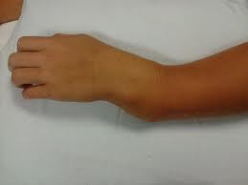
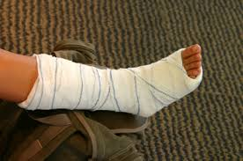
Physician Specialities
Orthopedist: Doctor that treats the bones.

Slide 19
Physician Specialities
Otolaryngologist: Doctor that treats the ears, nose and throat.

Slide 20
Physician Specialities
Pathologist: Doctor that studies disease.

Slide 21
Physician Specialities
*Pediatrician: Doctor that treats children; treats ear infections, asthma, chicken pox, sore throat.

Slide 22
Physician Specialities
*Psychiatrist: Doctor that treats mental disorders; earns the highest salary of all the mental health professionals.

Slide 23
Physician Specialities
*Radiologist: Doctor that reads x-rays.

Slide 24
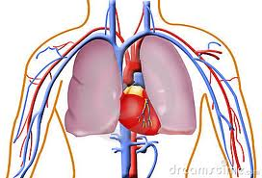
Physician Specialities
Thoracic Surgeon: Doctor that does surgery on chest, lungs, heart.

Slide 25
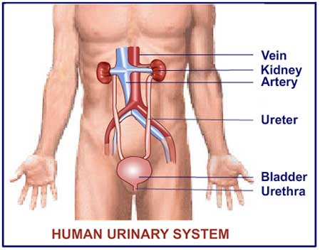
Physician Specialities
Urologist: Doctor that treats disorders of the urinary system (kidneys, bladder, etc.)

Slide 26
Physician’s Assistant (PA, PAC)
Work under the supervision of a doctor, can do anything physician trains them to do; can perform physical exams, order tests, treat minor injuries.
PHYSICIAN ASSISTANT VIDEO

Slide 27
Physician Specialities
Medical Assistant: Attend college less than 2 years; work under physician; prepare patient for exams, takes vital signs, records histories, assists with procedures, performs lab tests. Works in medical office.

Slide 28
Mental/Social Services
Psychiatrist: Doctor of mental illness; may specialize; may prescribe medications.
"HOW TO BECOME A PSYCHOLOGIST"
VIDEO

Slide 29
Mental/Social Services
Psychologist: Provides counseling for mental illness; may specialize; cannot prescribe medications.

Slide 30
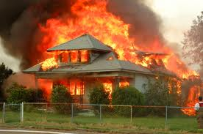
Mental/Social Services
Social Worker: Help families cope with problems; help people to make life adjustments; refer for assistance; provide emotional support, evaluate abuse charges. (Ex.: If house burns down, family in the hospital, etc. the social worker may be called in to help out.)
"HOW TO BECOME A SOCIAL WORKER" VIDEO

Slide 31
REMEMBER
A stethoscope is used to measure an apical pulse.
"HOW TO MEASURE RADIAL & APICAL PULSE" VIDEO

