Slide 1
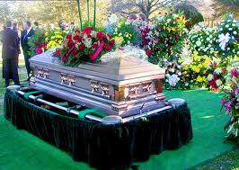
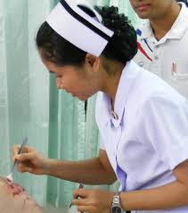
5.04 Careers in Mortuary, Nursing, Nutrition and Dietary Careers.

Slide 2
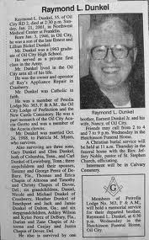
Mortuary Careers
Mortician: *Funeral director; assists to make arrangements for burial, secure legal documents, file death certificates, perform embalmment of body, help families to write obituary (*never include home address in obituary), help families to cope.
"Mortuary Careers" Video

Slide 3
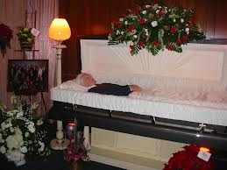
Mortuary Careers
*Embalmer: Prepares body, embalms, restructures disfigured bodies, takes classes in hair and makeup, dresses body and places in casket.

Slide 4
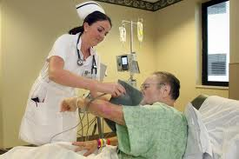
Nursing Careers
*Registered Nurse (RN):
Provides total patient care; works under the
doctor; observes, assesses, reports, medicates, teaches, supervises, manages, may specialize in a particular field.
"Registered Nurse" Video

Slide 5
NURSING
The Power To Make A Difference!

Slide 6
Nurses in
North Carolina
1 of every 70
people in NC is a Nurse!

Slide 7
A Lifetime of Variety!
Specialties
Work Settings
Age Groups

Slide 8
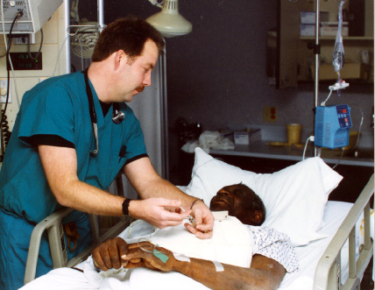
Work Setting Variety!
Hospitals
Nursing Homes
Clinics/Private Offices
Private Homes
Public health Departments
Schools
Colleges

Slide 9
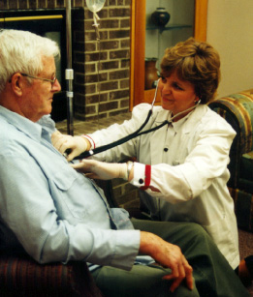
Work Setting Variety
Home Care Agencies
Hospice Agencies
Urgent Care Centers
Rehabilitation Centers
Mental Health Centers
Industries
Military

Slide 10
Area of Practice Variety!
Medical
Surgical
Emergency
Operating Room
Obstetrics and Gynecology
Orthopedics
Critical Care
Pediatrics
Psychiatry
Rehabilitation
Dialysis
Geriatrics
Coronary Care
Neonatal Intensive Care
Women’s Health
Flight and Transport

Slide 11
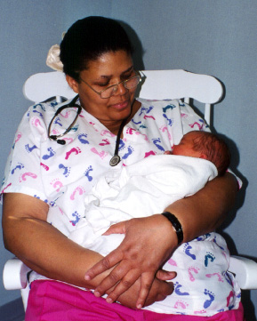
Client Population Variety!
Newborns
Babies
Toddlers
Children
Adolescents
Young Adults
Middle-Aged Adults
Older Adults

Slide 12
Variety of Career Entry Points
Nurse Aide
Licensed Practical Nurse
Registered Nurse
Advanced Practice Registered Nurse

Slide 13
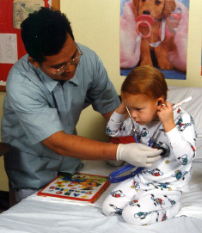
Variety of RN Educational Pathways
Associate Degree in Nursing
Community College
(2 years)
Diploma Degree
Hospital Based
(2 years)
Baccalaureate
University
(4 years)

Slide 14
Opportunities for Career Progression
Nurse Aide: $13,100 - 17,500
LPN: $21,770 - 29,900
RN: $32,500 - 44,200
Nurse Practitioner $44,000 - 56,000
CNM $55,000 - 66,700
CNS $42,400 - 76,000
CRNA $68,000 - 92,000
VP Nursing $85,244 - 175,000
Salaries compiled by NC Center for Nursing using an Economic Research Institute Database for the year 2000

Slide 15
Nurses are the “Eyes and Ears” of Health Care!
Nurses are the heart and soul of healthcare.
Patients and families depend on nurses.
Nurses function as the ‘eyes & ears’ of doctors.
They are constantly in and out of the patients’ rooms.
They are constantly assessing patients for changes and reporting to the doctors.
They pick up patient behavior that doctors may not notice.
Their vigilance often saves lives.
They are the patient’s voice.

Slide 16
Nursing Careers:
Advanced Practice Registered Nurses=6-8 years education
Masters or Doctorate degree
Nurse Practitioner (NP):
Diagnoses and treats patients.

Slide 17
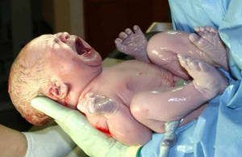
Nursing Careers:
Advanced Practice Registered Nurses
Nurse Midwife (NM): Delivers babies

Slide 18
Nursing Careers:
Advanced Practice Registered Nurses
Nurse Educator (MSN): Teaches about how to care for oneself based on the diagnosis, treatment, etc.

Slide 19
Nursing Careers:
Advanced Practice Registered Nurses
Nurse Anesthetist (CRNA): Assists the anesthesiologist to put patients to sleep for surgery/procedures; monitors the patient that is under anesthesia.

Slide 20
Nursing Careers:
Advanced Practice Registered Nurses
Clinical Nurse Specialist: (CNS) A nurse that works in a specialty area (ICU, PICU, ER, L & D, etc.)

Slide 21
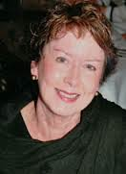
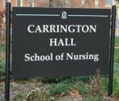
Nursing Careers:
Advanced Practice Registered Nurses (APRN)
*Dean of Nursing at a major university:
academic and administrative leader of the School of Nursing; salary $100,00 year;
Holds a Doctoral degree

Slide 22
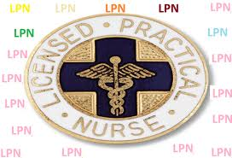
Nursing Careers
*Licensed Practical Nurse (LPN)/ Licensed Vocational Nurse (LVN):
Work under physician and R.N.
Provides technical patient care & gives medication
One year of nursing education

Slide 23
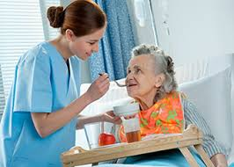
Nursing Careers
*Nursing Assistant (CNA/NA): Work under R.N., L.P.N., L.V.N.; assist the patient and the nurses, provide basic treatment, take vital signs, observe patients; education through a state approved certification program in high school or community college
May also be called a patient care technician, orderly, geriatric aide, home health assistant.

Slide 24
Nursing Careers
*Surgical Technician: attends college 1-2 years; works under the R.N.; prepares the patient for surgery, sets up instruments and equipment; works in the operating room and assists with surgeries.

Slide 25
Nutrition/Dietary Services
*Registered Dietician: Analyzes nutritional content of food, balances meals, manages food service, assesses patient nutritional needs, plans meals, teaches nutrition; *4 year degree.
"Dietician Career" Video

Slide 26
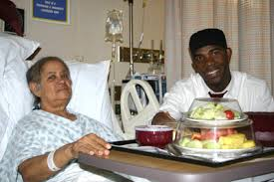
Nutrition/Dietary Services
*Dietetic Assistant: Works under dietician, assists dietician; prepares food, cleans work area, delivers trays to patients.

Slide 27
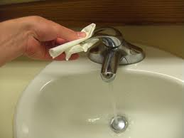
REMEMBER
*ALWAYS wash hands for 20 seconds before rinsing.
“Handwashing" Video
*When washing hands, use a dry, clean paper towel
to turn the faucet off.

Slide 28
REMEMBER
*When feeding a patient, Let the patient do as much as possible
"Feeding a Patient" Video

