Slide 1
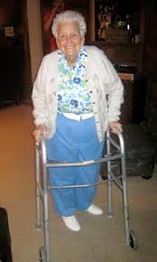
Careers in Therapeutic Services, Veterinary Medicine,
And Vision Services.

Slide 2
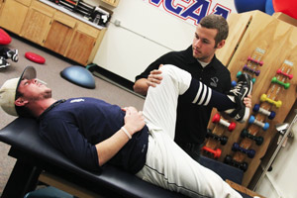
THERAPEUTIC SERVICES:
Health care services that help to restore or
maintain a patient’s health.

Slide 3
Therapeutic Services (treat patients)
Pharmacist: Dispenses medications that are ordered by the doctor, provide drug information, ensures drug compatibility, maintains medication records, mixes medications; *attends college for 5-6 years

Slide 4
Therapeutic Services (treat patients)
Pharmacy Technician:
Works under the supervision of a Pharmacist; helps prepare medications, maintain records for the Pharmacist; 1-2 year certification or Associate’s degree; *need to have good math skills

Slide 5
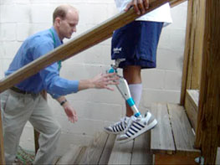
Therapeutic Services (treat patients)
Occupational Therapist (O.T.): Helps injured/sick to relearn activities of daily living. *(Ex.: Soldier who loses leg in war, the therapist will help him/her adapt to life with a prosthetic leg.); Master’s degree

Slide 6
Therapeutic Services (treat patients)
Occupational Therapy Assistant (O.T.A.):
Works under an O.T.; helps carry out prescribed treatment, directs patients in rehabilitation activities & activities of daily living; 2 year Associate degree

Slide 7
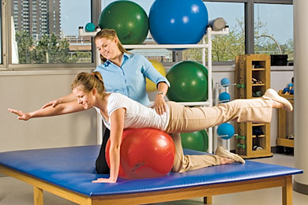
Therapeutic Services (treat patients)
Physical Therapist (P.T.): Provides treatment such as exercise, massage, application of heat/cold, etc. to improve movement, works on bones, joints, muscles; plans treatment under the doctor; Master’s or Doctorate degree
Physical Therapy Assistant (P.T.A.): Works under physical therapist; *trained in therapeutic massage; 2 year Associate degree

Slide 8
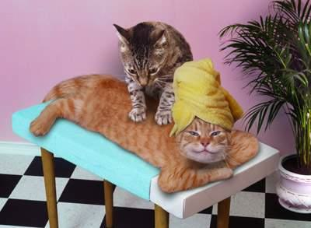
Therapeutic Services (treat patients)
Massage Therapist:
May work under a Physician or P.T. or be an Entrepreneur; Uses massage, manipulation, & therapeutic touch to decrease pain, relieve stress & tension; 3 month-1year Massage Therapy Program

Slide 9
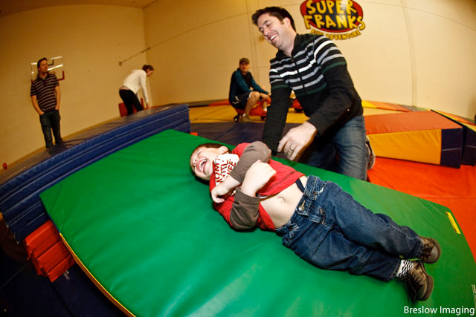
Therapeutic Services (treat patients)
Recreational Therapist: Use recreation to treat patients; organize games, activities, dances, movies, etc. *The recreational therapist may create a padded obstacle course for handicapped children.

Slide 10
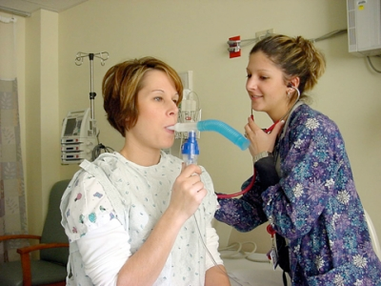
Therapeutic Services (treat patients)
Respiratory Therapist: *Provide care for patients with lung disease; give breathing treatments, administer oxygen, monitor ventilators, measure breathing capacity; 2 year Associate’s degree

Slide 11
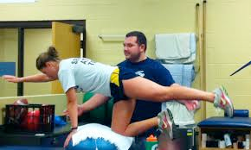
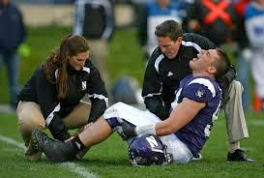
Therapeutic Services (treat patients)
Athletic Trainer: Work under the sports medicine physician; help to prevent athletic injuries, provide rehabilitative services, teach nutrition, assess the athlete’s condition, apply braces, tape, padding, treat minor injuries, provide first aide; Bachelor’s or Master’s degree

Slide 12
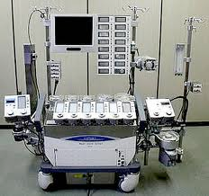
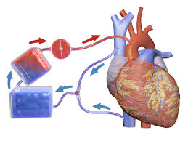
Therapeutic Services (treat patients)
Perfusionist: Specialized in Extracorporeal Circulation; *Operates the heart-lung machine during open heart surgery; assist with heart research, monitor artificial heart.

Slide 13
Therapeutic Services (treat patients)
Art Therapist: Use art to treat patients; *must be artistic and athletic; they draw, paint, color, dance, etc.

Slide 14
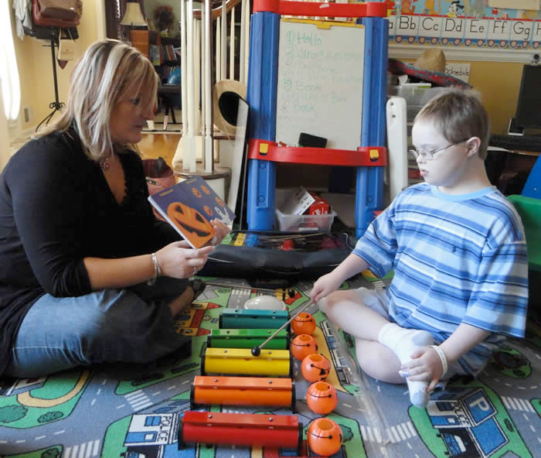
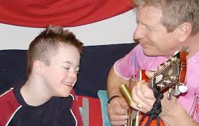
Therapeutic Services (treat patients)
Music Therapist: Use music to treat patients; *often work with mentally retarded children.

Slide 15
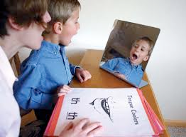
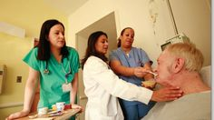
Therapeutic Services (treat patients)
Speech/Language Therapist: Identify, evaluate and treat speech/language/swallowing disorders; help patients with communication & eating.

Slide 16
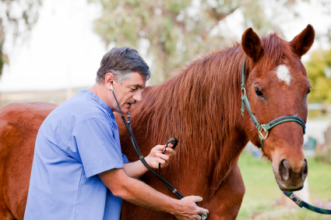
VETERINARY CAREERS:
Provide care to all animals from house pets to livestock to wildlife.

Slide 17
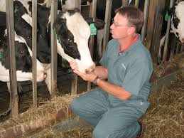
Veterinary Careers
Veterinarian (D.V.M.): Provide care for all types of animals; diagnose, treat, perform surgeries; *can spay or neuter a dog so that they cannot have puppies.

Slide 18
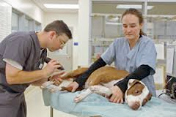
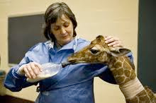
Veterinary Careers
Veterinarian Technician: Work under the vet; assist the vet with surgeries, perform lab tests.
Veterinary Assistant: Bathe animals, exercise animals, prepare animals for examination; work with animals but they do not have to attend college.

Slide 19
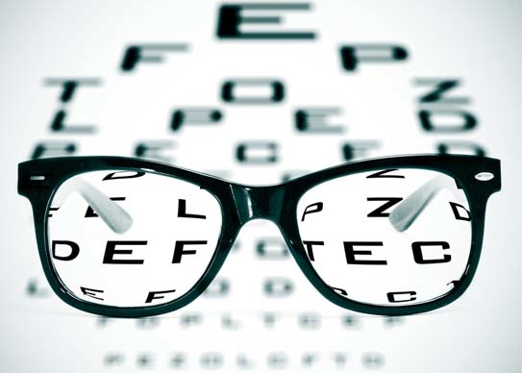
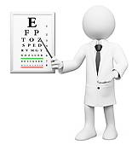
VISIONARY SERVICES:
Prevent & treat vision disorders

Slide 20
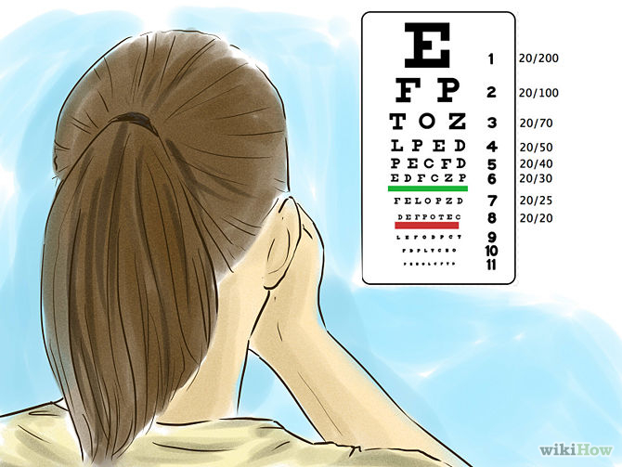
Visionary Services
Ophthalmologist (M.D.): diagnose and treat diseases and disorders of the eye; may perform surgery, correct vision.
Optometrist (O.D.): Examine eyes, diagnose, treat, prescribe glasses; refer to ophthalmologist if needed.

Slide 21
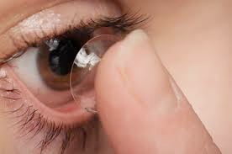
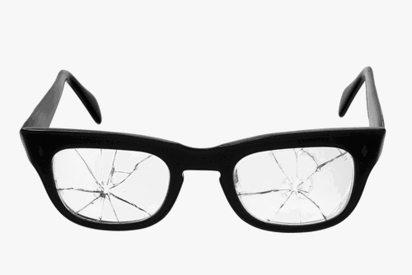
Visionary Services
Optician: Make, fit eyeglasses; specialize in contacts; *fixes broken glasses.

Slide 22
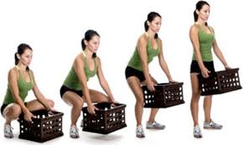
F.Y.I.
GOOD BODY MECHANICS
*When lifting a heavy object, tighten your stomach
muscles to protect your spine.

Slide 23
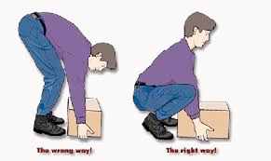
F.Y.I. GOOD BODY MECHANICS
*The best reason to use proper body mechanics is to prevent injury to yourself.
*When moving a heavy box, push, pull or slide the box.

Slide 24
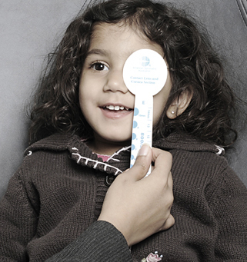
F.Y.I. VISION SCREENING
*An index card is the best occluder to use when doing an eye exam.

