Slide 1
Government, Non-profit agencies, & Insurance Plans

Slide 2
Government Agencies
World Health Organization (WHO)
International agency sponsored by United Nations
Compiles statistics and information on disease
Publishes health information
Investigates and deals with serious health problems throughout the world

Slide 3
United States Department of Health and Human Services (USDHHS)
5 Divisions:
National Institutes of Health (NIH): research on disease
Centers for Disease Control and Prevention (CDC): Researches causes, spread and control of diseases in populations

Slide 4
United States Department of Health and Human Services (USDHHS)
Food and Drug Administration (FDA): regulates food and drug products sold to the public

Slide 5
United States Department of Health and Human Services
Agency for Health Care Policy and Research (AHCPR): established in 1990 to research the quality of health care delivery and identify the standards of treatment that should by provided by health care facilities

Slide 6
United States Department of Health and Human Services
5. Occupational Safety and Health Administration (OSHA): establishes and enforces standards that protect workers from job-related injuries and illnesses-KEEPS US SAFE ON THE JOB

Slide 7
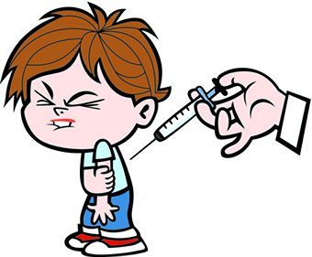
County Health Departments
Provide specific services needed by state or local community
Immunizations
Inspections

Slide 8
Health Departments
Health education
Collection of statistics and health records-birth and death records, communicable diseases, STD’s

Slide 9
Nonprofit / Volunteer Agencies
Supported by donations, membership fees, fundraisers, and federal or state grants
Provide health services at national, state, and local levels
Research diseases
Refers to doctors
Provides disease information

Slide 10
Nonprofit / Volunteer Agencies
Examples:
American Cancer Society
American Heart Association
American Respiratory Disease Association
American Diabetes Association
National Association of Mental Health
National Foundation of March of Dimes
American Red Cross
HOSA

Slide 11
Health Insurance Plans-helps us pay for healthcare
Deductibles-what the patient must pay before the insurance will pay
Co-insurance-shared cost; patient pays 20%, insurance pays 80%
Co-payment-set amount the patient pays-example: patient pays $25.00 no matter what service is provided.

Slide 12
Health Insurance Plans
Health Maintenance Organizations (HMO)-Care directed at prevention of disease. Patient must only see HMO approved providers!!
Preferred Provider Organization (PPO)-Group of doctors & hospitals that provide care to a specific group

Slide 13
Health Insurance Plans
Medicare-
Elderly
Social security disability benefits for 2 years
With end-stage renal disease
Type A-Hospital
Type B-Outpatient
Medicaid-
Low income
Disabled or Blind
Children who qualify for assistance

Slide 14
Health Insurance Plans
Workers’ Compensation-Pays for healthcare for workers injured on the job
TRICARE-Government funded for military & their families
Managed Care-Networks of doctors & agencies to provide quality care at the lowest possible cost

Slide 15
Summary
Many different types of health care facilities
Employ many types of health care workers
Important to be aware of facilities and type of services
Important to be aware of different insurance plans

