Slide 1
Unit D 4.01 Personal Qualities of the Healthcare Worker

Slide 2
With over 200 different health careers, in a variety of healthcare facilities, certain professional standards should be followed.
When we meet someone for the first time, we develop an opinion of them within the first 20 seconds to 4 minutes. Therefore, we must: *Create a positive first impression by being well-groomed and having a natural appearance.

Slide 3
*Ways to promote good health
Diet: *Follow the Food Guide Pyramid for a well balanced diet, to promote weight loss to improve overall health and to improve mental alertness.

Slide 4
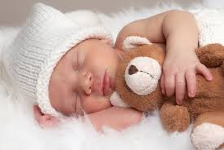
*Ways to promote good health
Rest: Provides energy and the ability to deal with stress.
*Example: After studying for 4 hours, you stick to your plan to go to bed at 10pm = to improve your mental alertness and ability to deal with stress.

Slide 5
*Ways to promote good health
Exercise: Maintains circulation, improves muscle tone, helps attitude and promotes restful sleep.
*Example: Regular dance or exercise 3-4 times a week will maintain circualtion & improve muscle tone.

Slide 6
*Ways to promote good health
Avoid alcohol, tobacco and drugs. Most health care facilities have a “smoke-free” policy.
*Remember it is TRUE that most health care facilities are “smoke-free.”

Slide 7
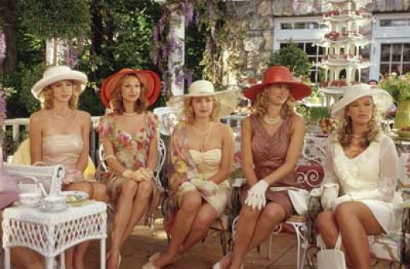
*Ways to promote good health
Good posture: Prevents fatigue and muscle stress. Stand with shoulders straight, stomach muscles in, shoulders relaxed and weight balanced on each foot; females should sit with their ankles crossed. (Especially when wearing a dress or skirt.)

Slide 8
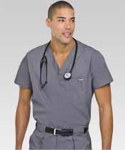
*Appearance
Uniform: Clean, neat, fits well; neutral colored undergarments must be worn. Uniform must be appropriate for the job—
*Remember: Before beginning a new job = check the facilities policy for dress code before purchasing uniforms.

Slide 9
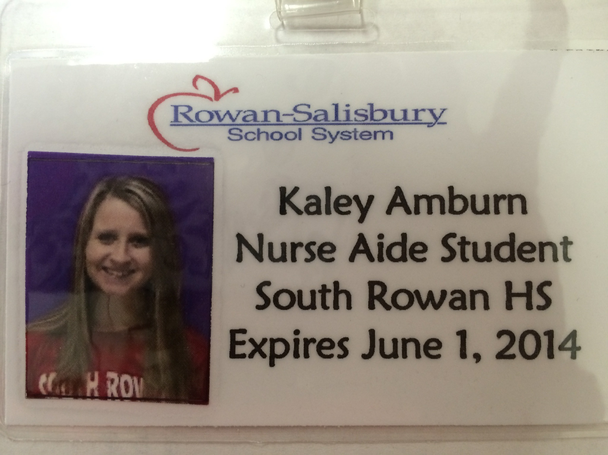
*Appearance
Name Badge: REQUIRED! Includes name, title and department.
*Remember: All clinical uniforms should include a name badge.

Slide 10
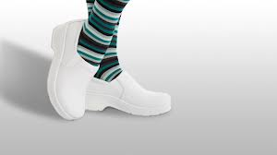
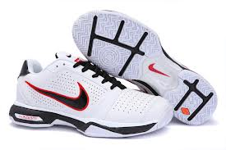
*Appearance
Shoes: Fit well, good support, low heels.
*Example: You stand all day on the job & your feet hurt. What can you do to improve this problem? Get well fitting shoes with low heels & good support.

Slide 11
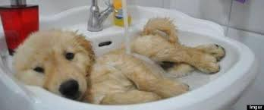
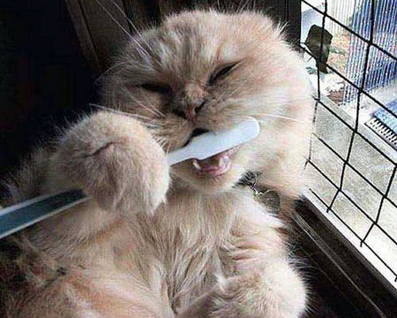
*Appearance
Personal Hygiene:
Daily baths, use deodorant,
brush teeth, avoid strong odors.

Slide 12
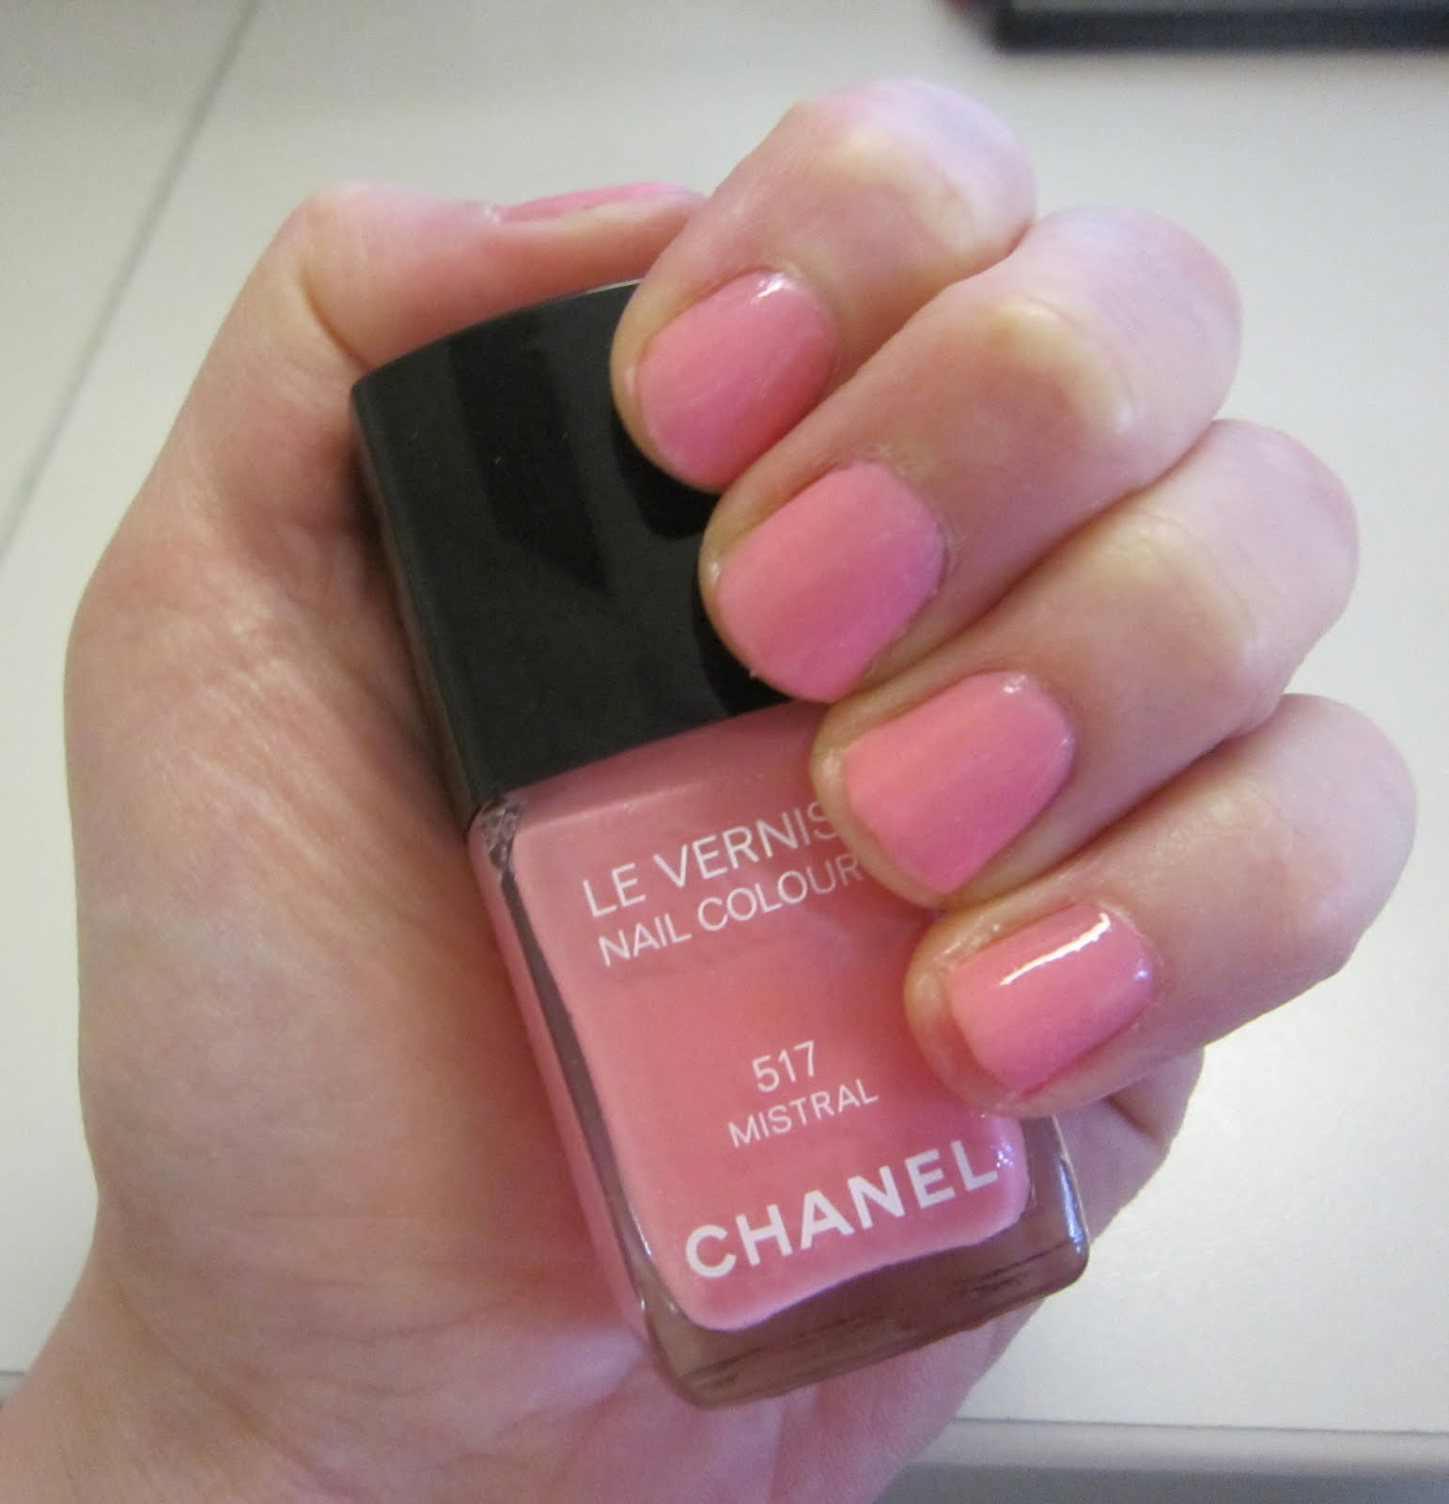
*Appearance
Nails: Short, clean; if polish is permitted, avoid bright or dark colors.
*Example: Red nail polish would be a professional apperance violation.

Slide 13
*Appearance
Hair: Clean, neat, pinned back and off of the collar.
*Example: You have long hair & you are job shadowing= You should pull your hair back to avoid patient contact.

Slide 14
Jewelry & Make-up
7. Jewelry & Make-up- Make-up should be natural looking & not loud & excessive; Avoid excess jewelry.
*Example: You wear a new ring to work,
pin the ring inside your pocket with a safety pin to avoid injury to patient & transmission of germs.

Slide 15
*Personal Characteristics (must be practiced and learned and we must constantly strive to improve.)
Empathy: Understanding others feelings.
*Example: A dental patient tells the assistant, “I hate coming to the dentist.” An empathetic response would be = “Many people find dental work uncomfortable.”

Slide 16
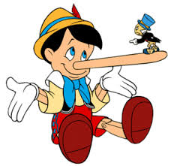
*Personal Characteristics
2. Honesty: Willing to admit mistakes in order to correct them.

Slide 17
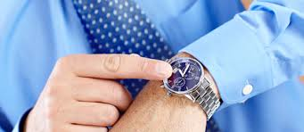
*Personal Characteristics
Dependability: Prompt, on time, good attendance, plans absences ahead of time.
*An Example of Dependability for a Job Interview response: “I am never absent from school and I always turn my assignments in on time.”

Slide 18
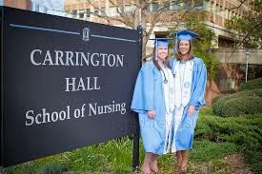
*Personal Characteristics
4. Willingness to Learn: Able to adapt to changes; prepared for lifelong learning.

Slide 19
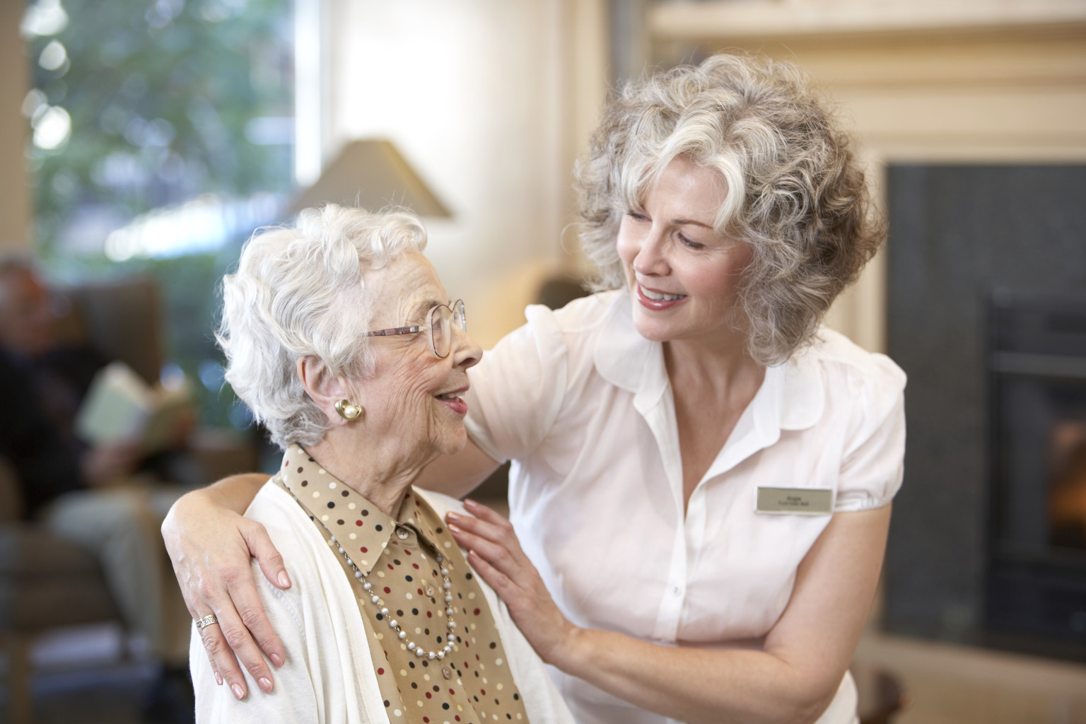
*Personal Characteristics
5. Patience: Tolerance and understanding is a must! Must be able to deal with frustration and temper.

Slide 20
*Personal Characteristics
6. Accept Criticism: Have a positive attitude and learn from mistakes; listen to suggestions from co-workers.

Slide 21
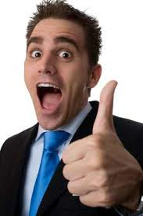
*Personal Characteristics
7. Enthusiasm: Display a positive attitude; enjoy your work.

Slide 22
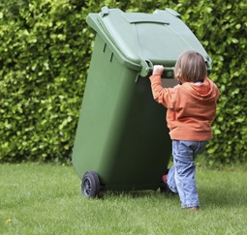
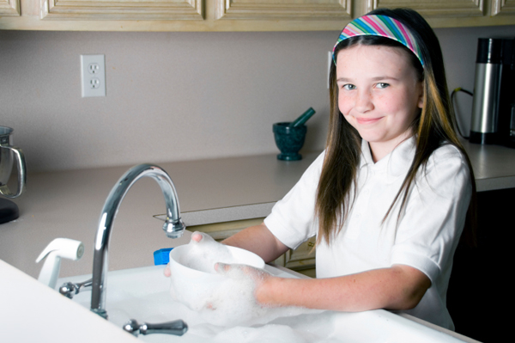
*Personal Characteristics
Self-Motivation: Set goals; determine what needs to be done and do it.
*Example: A Self-motivated health care worker would = Figure out what needs to be done & go ahead & do it.

Slide 23
*Personal Characteristics
Tact: Consider others feelings, say kind things.
*Example: An elderly patient is loud, demanding, impatient & critical & a family member asks if their mom is causing trouble, say, “Your mom speaks her mind & knows what she wants.” is TACT.

Slide 24
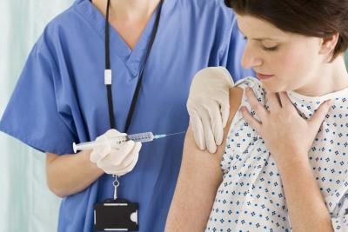
*Personal Characteristics
10. Competence: Qualified and capable to perform a task.

Slide 25
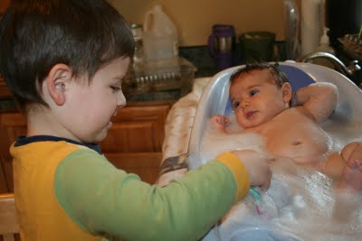
*Personal Characteristics
11. Responsibility: Willing to be held accountable for your actions. Doing what you are suppose to do. Ex.: Don’t delay a patient’s bath until the next shift arrives if it is your responsibility.

Slide 26
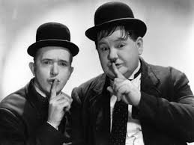
*Personal Characteristics
12. Discretion: Use good judgment in what is said or done. Keep patient information confidential.

Slide 27
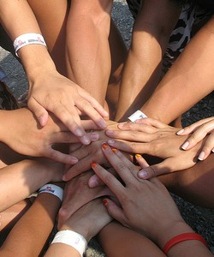
*Personal Characteristics
13. Team Player: Work well with others to provide patient with quality care.

Slide 28
Unit D 4.02 Elements of Effective Communication

Slide 29
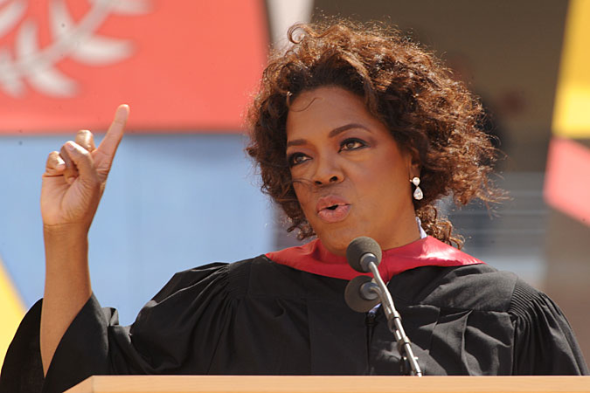
*Elements of Effective Communication
Verbal Communication: Spoken or written words.

Slide 30
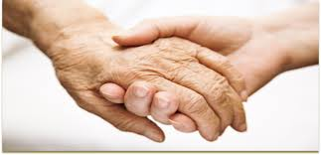
*Elements of Effective Communication
Non-verbal communication: The use of body language, gestures, eye contact and touch to convey messages or ideas. (Healthcare workers must be aware of their non-verbal behaviors and the patient’s non-verbal behavior.)

Slide 31
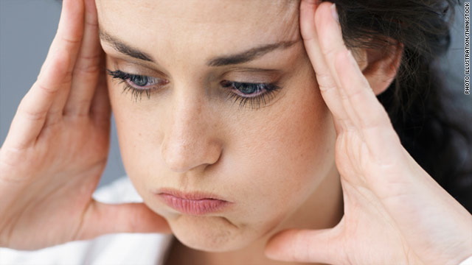
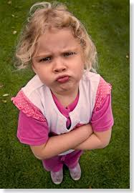
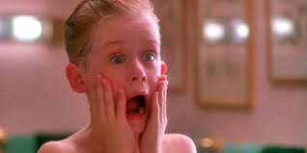
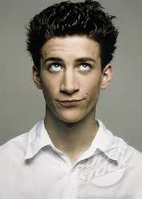

Slide 32
*Communication Process
*Sender: Starts the message.

Slide 33
*Communication Process
Message: Information, ideas or thoughts.

Slide 34
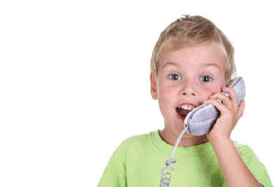
*Communication Process
*Receiver: The person who receives the message from the sender.

Slide 35
*Communication Process
Communication cannot occur without a sender, message and a receiver.
Feedback: The receiver’s response to the message, can be verbal or nonverbal; determines if communication was successful.
*Example: You say “Hello” to a co-worker as you walk past them. They smile back.
Using the communication model, what is the feedback? = Their smile!

Slide 36
Communication Model
Sender
Message
Receiver
Feedback
*Example: Janice sends an email to Jack, asking him if he can come to work early. Jack replies that he will. Using the communication model, Jack is the? = Receiver.

Slide 37
*Factors that interfere with communication
1. The message must be clear. It must be in terms the sender and receiver can understand.

Slide 38
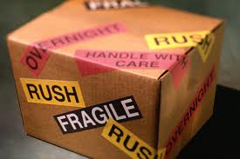
*Factors that interfere with communication
2. The sender must deliver the message in a clear and concise manner.

Slide 39
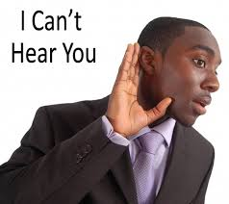
*Factors that interfere with communication
3. The receiver must be able to hear and receive the message.

Slide 40
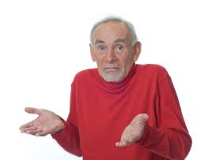
*Factors that interfere with communication
4. The receiver must be able to understand the message. Use terms that the patient can understand. (Avoid medical terms such as p.o., PRN, NPO, etc.)

Slide 41
*Factors that interfere with communication
*Example: What is wrong with a nurse asking a 13 year-old girl if she has been NPO since midnight?
= The receiver may not understand the message. (Use terms the patient understands. Avoid using medical terms.)

Slide 42
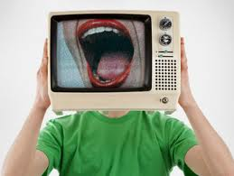
*Factors that interfere with communication
Interruptions or distractions must be avoided. (Ex.: T.V., loud music, crying baby, screaming children, etc.) Find a quiet area.

Slide 43
*Factors that interfere with communication
*Example: When a nurse is giving instructions to a mother who is holding her screaming baby, the nurse must understand what?
= The baby’s behavior could distract the mother & interfere with communication.

Slide 44
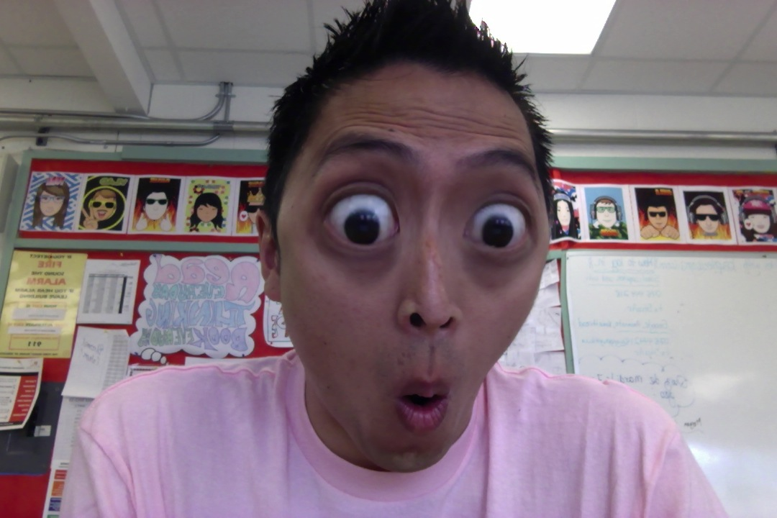
*Good Listening Techniques (Listening allows the patient to express their fears.)
1. Show interest and concern for what the speaker is saying.

Slide 45
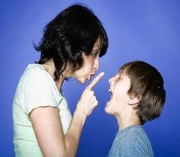
*Good Listening Techniques
2. Avoid interrupting the speaker.

Slide 46
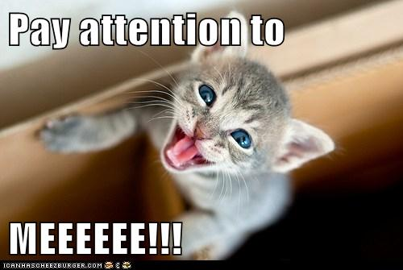
*Good Listening Techniques
3. Pay attention to what the speaker is saying.

Slide 47
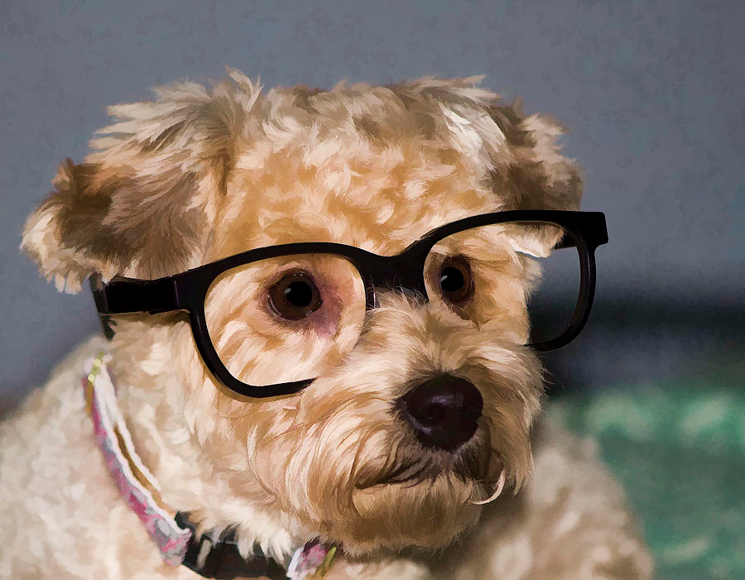
*Good Listening Techniques
Be alert and maintain eye contact with the speaker.
*Example: A patient tells her doctor she is frightened. The doctor asks her to explain. What behavior would further demonstrate the doctor’s listening skills?
= Maintaining eye contact & trying to understand the patient’s fears.

Slide 48
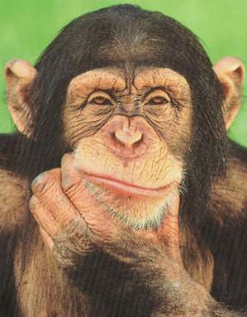
*Good Listening Techniques
5. Avoid thinking about how you are going to respond.

Slide 49
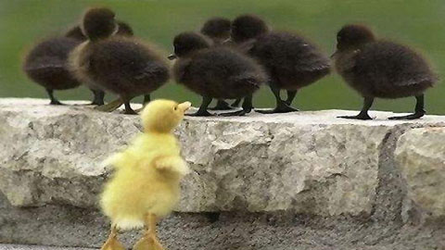
*Good Listening Techniques
6. Try to eliminate your own prejudices and see the other person’s point of view.

Slide 50
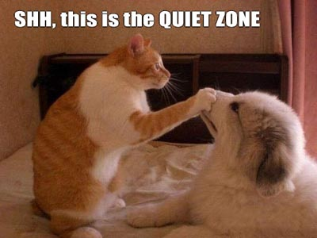
*Good Listening Techniques
7. Eliminate distractions by moving to a quiet area for the conversation.

Slide 51
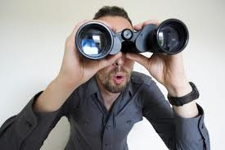
*Good Listening Techniques
8. Watch the speaker closely to observe actions that may contradict what the person is saying.

Slide 52
*Good Listening Techniques
9. Reflect statements back to the speaker to let them know you hear them. (Ex.: A patient states he doesn’t want his bath now because he wants to sleep, respond by saying, “I’ll come back in an hour to see if you’re ready.”

Slide 53
*Good Listening Techniques
Ask questions if you do not understand part of the message. (Ex.: If the patient says they are frightened, ask them to explain. Listen and maintain eye contact.)
*Also: If a patient tells you he just cannot stay in the hospital & you are not sure what he means.
You should? =Ask him to explain.

Slide 54
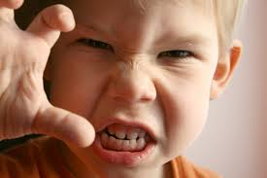
*Good Listening Techniques
11. Keep your temper under control and keep a positive attitude.

Slide 55
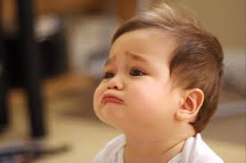
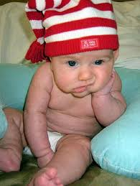
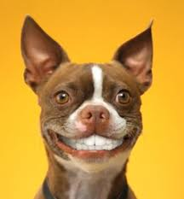
*Non-verbal Communications
Facial Expressions: Boredom, smile, frown.

Slide 56
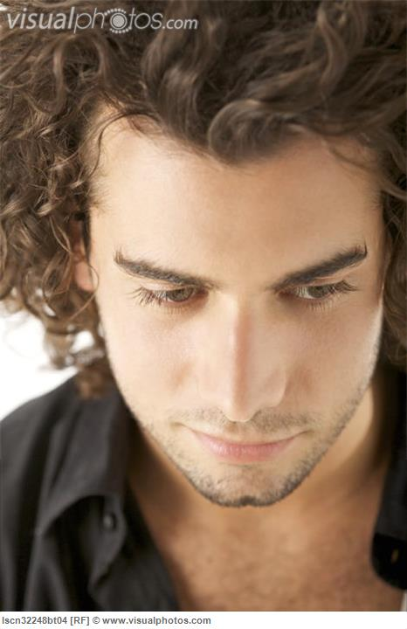
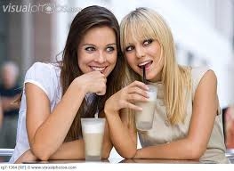
*Non-verbal Communications
Eye Contact: Looking down, looking around.

Slide 57
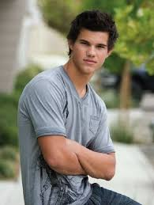
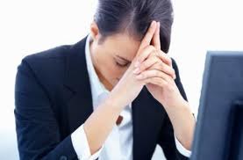
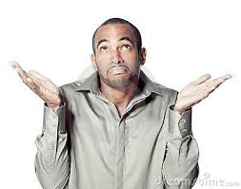
*Non-verbal Communications
Body Language: Shrugging shoulders, slumping, crossing arms.

Slide 58
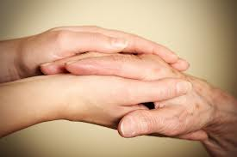
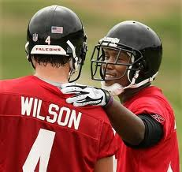
*Non-verbal Communications
Touch: A pat on the back, a firm handshake, a hug, a touch on the hand.

Slide 59
*Non-verbal Communications
Gestures: Winking, eye-rolling, frequently looking at watch.

Slide 60
*Non-verbal Communications
*Example #1: What form of non-verbal communication would convey caring to a patient?
= Gently touching the patient’s arm.
*Example #2: A patient is frowning & tapping his fingers. What message is he sending?
= “I have lost my patience.”

Slide 61
*Barriers to Communication (Physical Disabilities)
Deafness/Hearing loss: Use body language (gestures and signs), speak clear and in short sentences, face the individual to allow for lip-reading, write messages, make sure hearing aids are inserted correctly and batteries are working.

Slide 62
*Barriers to Communication (Physical Disabilities)
*Example approach for a hearing impaired patient:
Face him and speak clearly in short
sentences when talking to him.

Slide 63
*Barriers to Communication
Blindness/Impaired Vision: Use soft tone of voice, be descriptive, announce your presence as you enter a room, explain sounds/noises, use touch when appropriate.

Slide 64
*Barriers to Communication
*Example approach for a patient who is blind:
(In a soft voice)
“Knock. Knock. Hi Mrs. Jones.
It’s Jordan, your nursing assistant. I have your lunch tray. Looks like you are having a turkey sandwich.”

Slide 65
*Barriers to Communication
Aphasia/Speech Impairments: Be patient and let them try to speak, encourage them to take their time, ask questions that only require short answers, speak slow and clear, repeat the message to see if it correct, encourage use of gestures or point to objects, allow to write messages, use pictures.

Slide 66
*Barriers to Communication
Psychological Barriers: Often caused by prejudice, attitudes, and/or stereotyping. Healthcare workers must respect each person as an individual and remember that each person has the right to good care and considerate treatment. Fear is usually the cause of anger or negative attitudes. Let patients express their fears.

Slide 67
*Barriers to Communication
Cultural Diversity: (Differences in values, beliefs, attitudes, customs.) Healthcare workers must show respect to a patient’s cultural beliefs and try to learn about cultural differences.

Slide 68
*Barriers to Communication
Cultural Beliefs/Practices: They have a right to determine treatment and refuse treatment.

Slide 69
*Barriers to Communication
Eye Contact: In some cultures direct eye contact may not be acceptable, they may believe that looking down shows respect.
*Example: Mr. Ono is a new patient. When the doctor talks to him, Mr. Ono looks down at the floor. What communication barrier MOST LIKELY would explain Mr. Ono’s lack of eye contact? = CULTURE

Slide 70
*Barriers to Communication
Touch: In some cultures it is inappropriate to touch the head, shake hands and only family members provide personal care.

Slide 71
*Recording and Reporting
This is an important part of effective communication and includes observation and listening to the patient. All senses are used to make the observations.

Slide 72
*Recording and Reporting
Sight: color of skin, swelling, rashes/sores, color of urine or stool, amount of food eaten.

Slide 73
*Recording and Reporting
Smell: Body odor, unusual odors of the breath, wounds, urine/stool.

Slide 74
*Recording and Reporting
Touch: Feel the pulse, dryness or perspiration, temperature of the skin and swelling.
*Example: Your patient has the flu. What observation would a health care worker make with her sense of touch? = Hot, dry skin (temperature)

Slide 75
*Recording and Reporting
Hearing: Listen to respirations, abnormal body sounds, cough, speech.

Slide 76
*Recording and Reporting
Two Types of Observations
1. Subjective: Statements or complaints made by the patient; they cannot be seen or felt, these are symptoms. (Ex.: Headache, dizziness)
*An example of a subjective observation a physician would record in a patient’s progress note is:
Patient complains of feeling dizzy.

Slide 77
*Recording and Reporting
2. Objective: can be seen or measured, these are signs. (Ex.: bruises, rashes, cuts, swelling, vital signs.)

Slide 78
*The basic rule of effective written communication:
*Remember: When a patient’s statement is recorded, it must be in the patient’s own words and in quotation marks.
(Ex.: Pt. states, “I have a headache.”)

Slide 79
*Health Insurance Portability and Accountability Act (HIPAA)
HIPAA established strict standards to maintain confidentiality of health care records. Patients have total control of how their medical information is used.
*Remember HIPAA standards relate to respect for the private information in medical records.

