Slide 1
Leadership

Slide 2
Teamwork is:
ALL MEMBERS OF THE HEALTHCARE TEAM WORKING TOGETHER TO SERVE THE PATIENT’S NEEDS.
Teams:
Identify patient needs
Offer opinions on the best type of care
Suggest other professionals that may be able to assist.

Slide 3
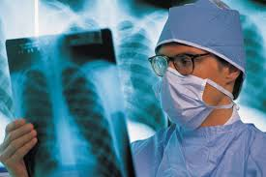
Teamwork:
Example of a medical office health care team: Doctor, nurse, office manager and receptionist.

Slide 4
Leadership is:
The skill or ability to encourage people to work together and do their best to achieve common goals.

Slide 5
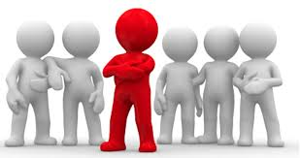
A Leader is:
A person who leads or guides others, or who is in charge or in command of others.

Slide 6
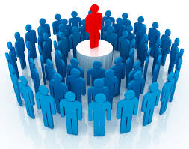
Leader’s Responsibility
Organizes and coordinates activities.

Slide 7
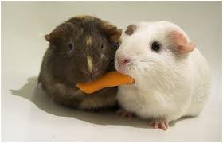
Leader’s Responsibility
Encourages everyone to share ideas and give opinions.

Slide 8
Leader’s Responsibility
Motivates team members to work together toward goals.

Slide 9
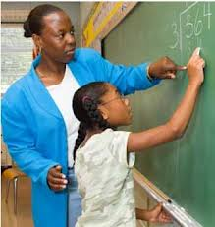
Leader’s Responsibility
Assist with problems
Ex: You are head nurse in hospital. 2 staff members constantly complain about another worker. What should the head nurse do?
=Help the staff members
solve their differences.

Slide 10
Leader’s Responsibility
Monitor’s team progress

Slide 11
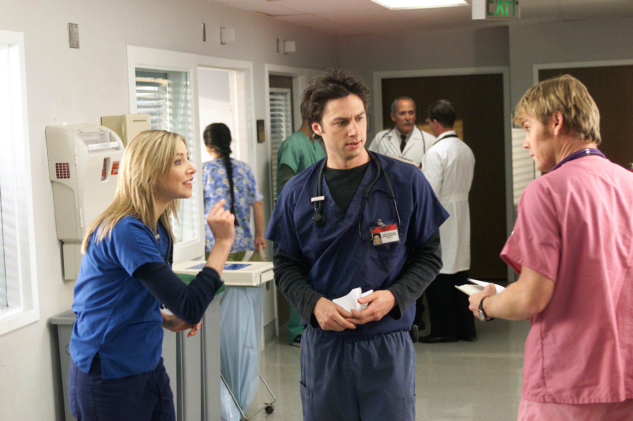
Leader’s Responsibility
Provides reports and feedback on effectiveness of the team.
Ex: If an R.N. is constantly fussing about another R.N., the head nurse should help them solve the problem.

Slide 12
Methods to Develop Good Interpersonal Relationships include:
Maintain a Positive Attitude

Slide 13
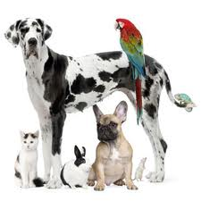
Methods to Develop Good Interpersonal Relationships include:
Be friendly and cooperative with others

Slide 14
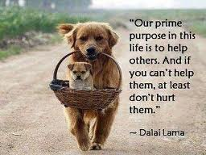
Methods to Develop Good Interpersonal Relationships include:
Provide assistance
Ex: Assist others when you see that they need help.

Slide 15
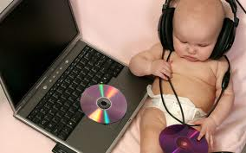
Methods to Develop Good Interpersonal Relationships include:
Be a good Listener
Ex: Listen carefully when another person is sharing ideas or beliefs.

Slide 16
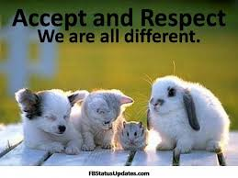
Methods to Develop Good Interpersonal Relationships include:
Respect others opinion
Ex: even though you may not agree with them.

Slide 17
Methods to Develop Good Interpersonal Relationships include:
Ex: Megan is a new nurse aide. She made 3 mistakes on her first day at work. What should she do the next day?
=Have a positive attitude & listen carefully to suggestions from co- workers.

Slide 18
Methods to Develop Good Interpersonal Relationships include:
Be open-minded/willing to compromise

Slide 19
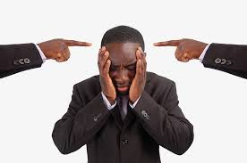
Methods to Develop Good Interpersonal Relationships include:
Avoid criticizing other team members

Slide 20
Methods to Develop Good Interpersonal Relationships include:
Show optimism
Ex: A good leader believes that the group
= will succeed!

Slide 21
Methods to Develop Good Interpersonal Relationships include:
Praises others and gives credit to others

Slide 22
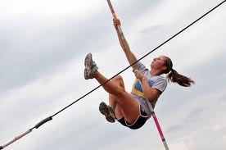
Methods to Develop Good Interpersonal Relationships include:
Dedicated to meeting high standards

Slide 23
Methods to Develop Good Interpersonal Relationships include:
Good communication skills

Slide 24
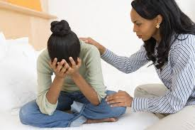
Methods to Develop Good Interpersonal Relationships include:
Support and encourage others

Slide 25
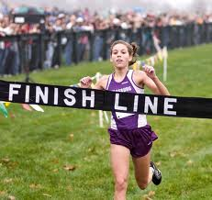
Methods to Develop Good Interpersonal Relationships include:
Perform to the best of your ability!
Ex: Mary notices the other co-workers get all the praise & attention. What should she do to develop good interpersonal relationships on the job?
=Do the best she can in her job & maintain a positive attitude.

Slide 26
Professional leadership is the ability to encourage others to work together and do their best to achieve goals.
Ex: A new leader might say what to indicate he understands professional leadership?
=“We will work together to provide the best quality care for the people of this town.”

Slide 27
Professional Leadership Characteristics:
Respects the rights,
dignity, opinions
and abilities of others.

Slide 28
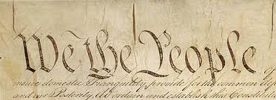
Professional Leadership Characteristics:
Understands the principles of democracy

Slide 29
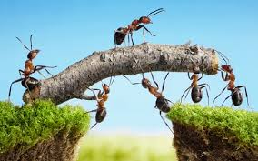
Professional Leadership Characteristics:
Works with a group and guides the group toward
a goal.

Slide 30
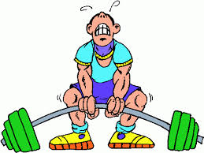
Professional Leadership Characteristics:
Understands own strengths and weaknesses

Slide 31
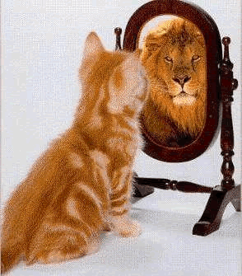
Professional Leadership Characteristics:
Displays self confidence and willingness to take a stand

Slide 32
Professional Leadership Characteristics:
Communicates effectively and states ideas clearly

Slide 33
Professional Leadership Characteristics:
Shows self initiative and a willingness to work

Slide 34
Professional Leadership Characteristics:
Completes tasks

Slide 35
Types of Leadership
Democratic Leader
Is a good listener; encourages participation of all; bases decisions on what is best for the group as a whole; group takes responsibility for decisions.

Slide 36
Types of Leadership
Laissez-faire Leader
Informal leader; minimal rules; individuals in the group function independently with little or no direction; “hands-off” leader; avoids decisions until forced to make one.

Slide 37
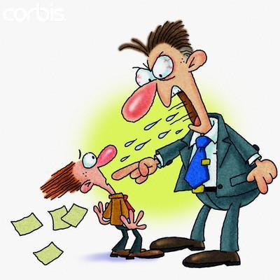
Types of Leadership
Autocratic Leader
“Dictator”; maintains total rule; makes all decisions; tells the group what to do and when to do it; ignores groups suggestions

